Slide 1
The Law of Victory
January 27, 2022
Reflections from “The 21 Irrefutable Laws of Leadership” by John C Maxwell

Slide 2
What does
Law of Victory
Leadership
look like?
Leadership is responsible.
Losing is unacceptable.
Passion is unquenchable.
Creativity is essential.
Quitting is unthinkable.
Commitment is unquestionable.
Victory is inevitable.
pg183

Slide 3
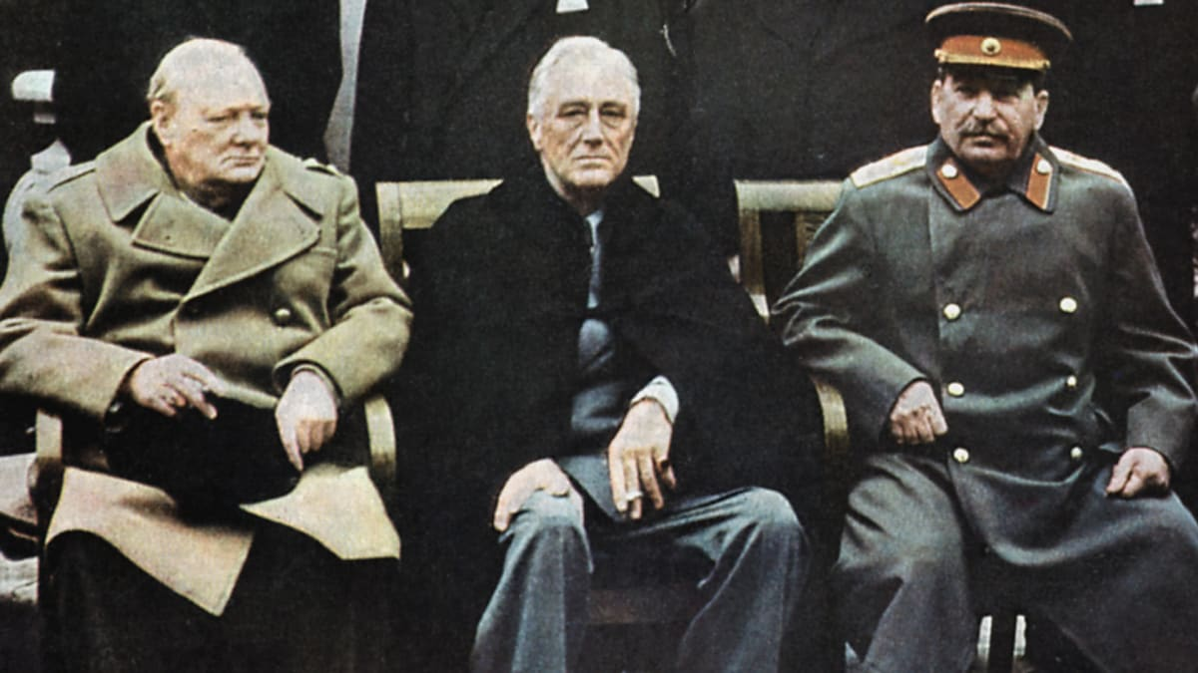
Leadership is responsible.
Losing is unacceptable.
Passion is unquenchable.
Creativity is essential.
Quitting is unthinkable.
Commitment is unquestionable.
Victory is inevitable.
pg183
FDR, Churchill, and Stalin

Slide 4
When the pressure is on, great leaders are at their best. Whatever is inside them comes to the surface. pg183
The Law of Victory
Leaders always find a way for the TEAM to win.

Slide 5
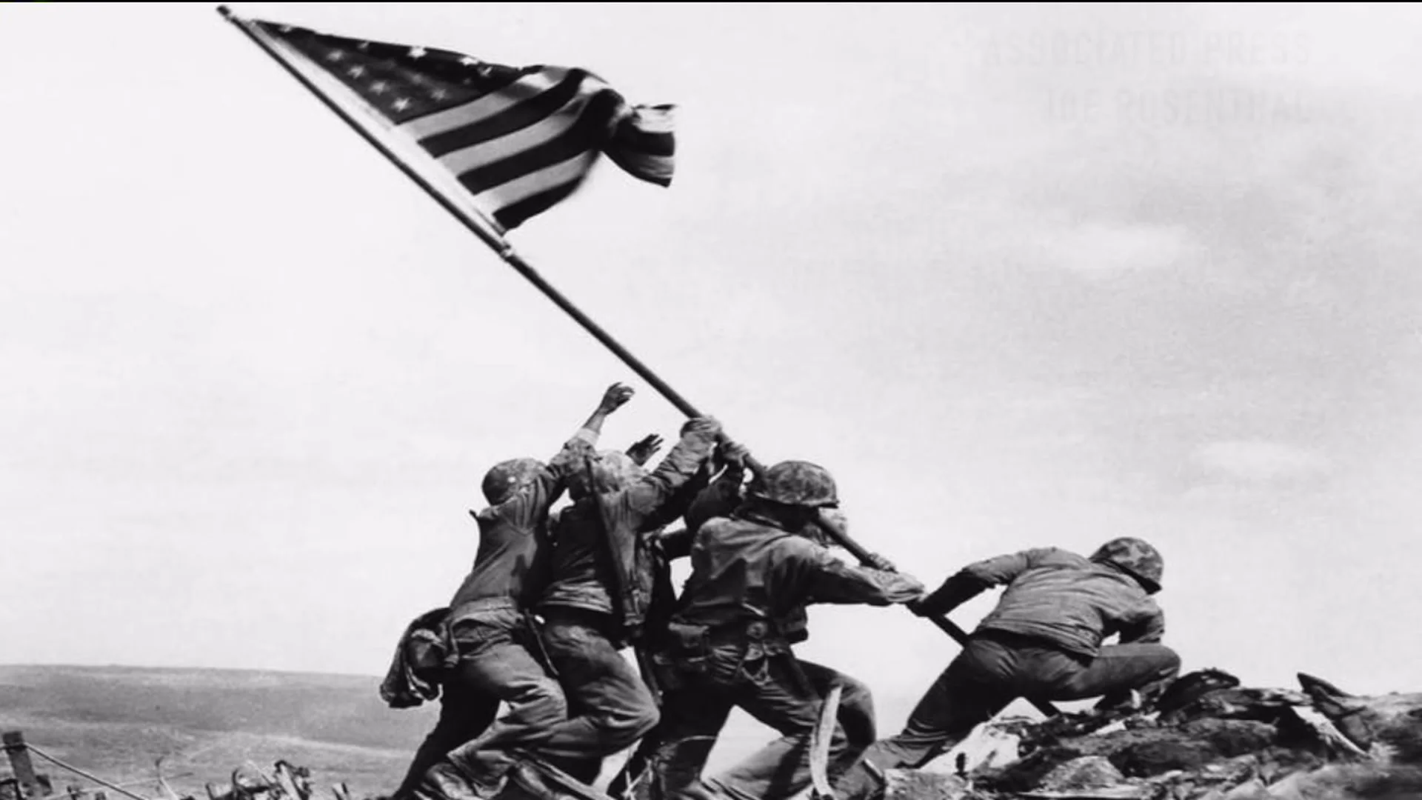
Who are your people?
What is victory?
Leaders “...embrace the vision and approach the challenges with the resolve to take their people to victory.”

Slide 6
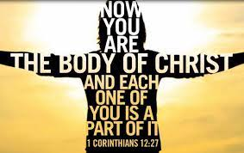
Three components that contribute to a team’s dedication to victory…
I Unity of Vision
II Diversity of Skills
III Pull It Together
Motivation
Empowerment
Direction

Slide 7
Victorious leaders:
*Take responsibility for the team
*Are unwilling to accept defeat
*Take it personally
*Are Proactive

Slide 8
How high are your expectations for success? (Extremely Passionate)
How dedicated are you?
(Unquestioned)
Why are you the leader?
(Higher commitment than the team members)
Are you surviving or thriving?
(Right role)

