Slide 1
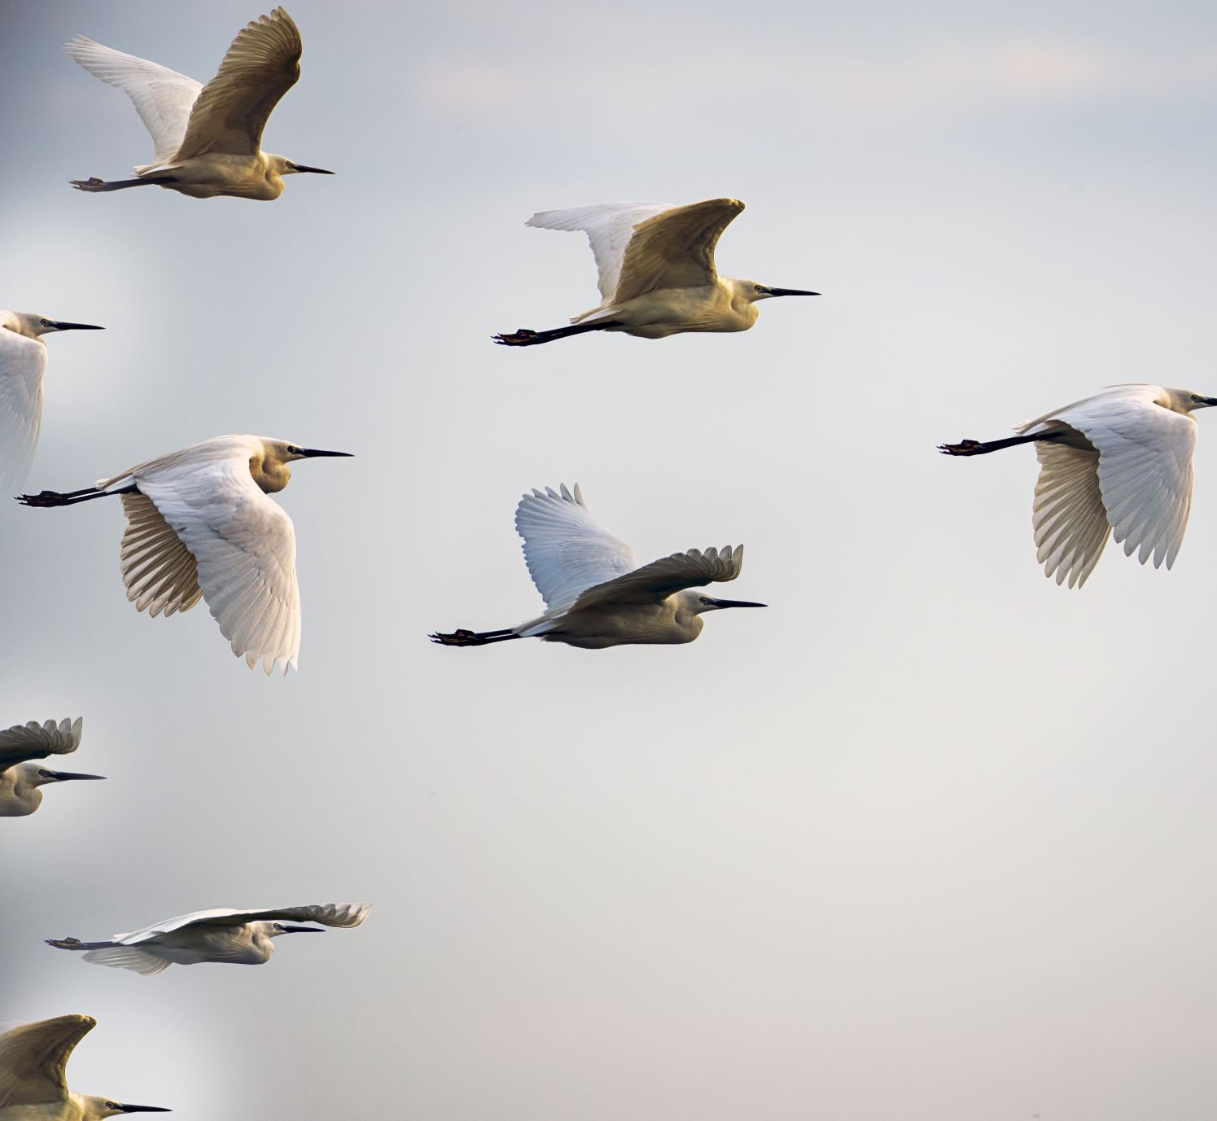
The Principles and Practices of a Facilitative Leader
Module #1: Introduction
Notes:
1. Print and place in binder on quality paper
2. Take notes
3.

Slide 2
Lessons of the Geese
As each bird flaps its wings, it creates uplift for the bird following. By flying in a "V" formation, the whole flock adds 71 percent greater flying range than if one bird flew alone.
Whenever a goose falls out of formation, it suddenly feels the drag and resistance of trying to fly alone and quickly gets back into formation to take advantage of the lifting power of the bird immediately in front.
When the lead goose gets tired, it rotates back into the formation and another goose flies at the point position.
When a goose gets sick or wounded or shot down, two geese drop out of formation and follow it down to help and protect it until it is able to fly again or dies. Then they launch out on their own, with another formation, or they catch up with their flock.
The geese in formation honk from behind to encourage those up front to keep up their speed.
Notes:
Have different Principals read each paragraph

Slide 3
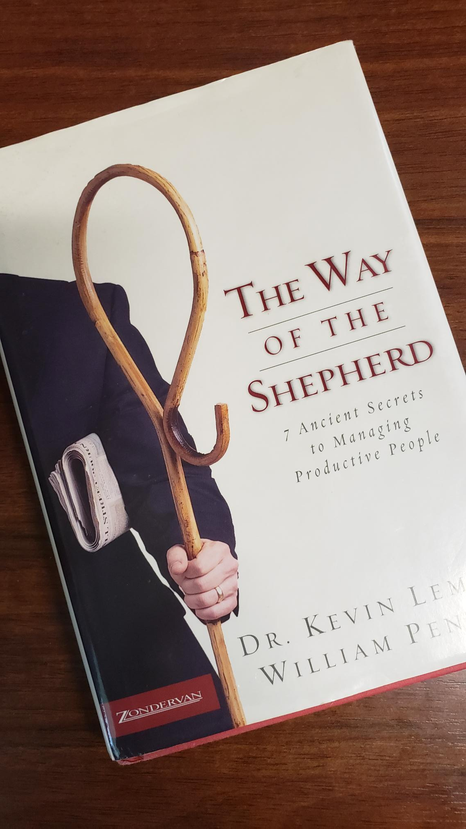
Quote:
"The ultimate test of leadership isn't setting the direction for your flock. The ultimate test is this: can you get your flock where you want it to go?" - The Way of the Shepherd

Slide 4
The Principles and Practices of a FACILITATIVE LEADER
WORKSHOP PURPOSE:
To develop practical skills and tools for tapping-the creativity, experience, and commitment of the people with whom your work.
To provide a forum for you to explore your challenges and aspirations as a leader.

Slide 5
Life-long Learner

Slide 6
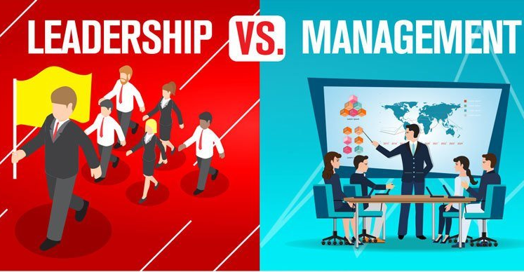

Slide 7
Old Definition: “control and centralization of power with a common theme of domination.”
LEADERS
Organization

Slide 8
Definition: Facilitative Leaders empower people to work together to achieve a common goal.
Organization
LEADERS
Fac-cil-I-ta-tive adj: causing or capable of making easier
Lea-der n: a person who has commanding authority or influence

Slide 9
Ellen White on Leadership
For the leader, humility is a prerequisite to the Spirit’s blessing. “When the laborers have an abiding Christ in their own souls, when all selfishness is dead, when there is no rivalry, no strife for the supremacy, when oneness exists, when they sanctify themselves, so that love for one another is seen and felt, then the showers of the grace of the Holy Spirit will just as surely come upon them as that God’s promise will never fail in one jot or tittle. But when the work of others is discounted, that the workers may show their own superiority, they prove that their own work does not bear the signature it should. God cannot bless them.” Last Day Events - 190

Slide 10
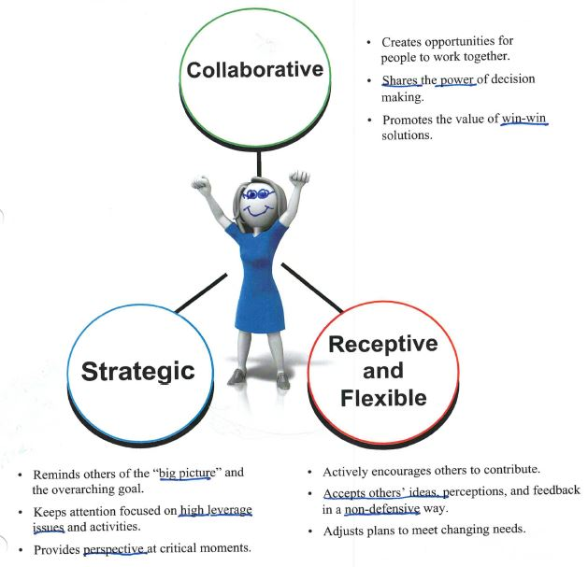
Profile of a Facilitative Leader

Slide 11
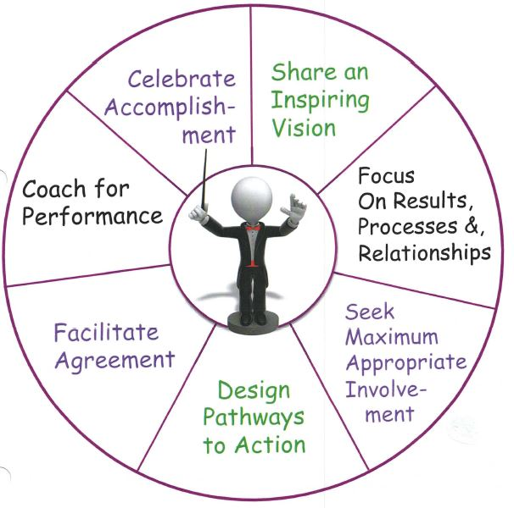
Seven Practices of a Facilitative Leader

Slide 12
Seven Practices of a Facilitative Leader
Read pages 1-6 and 1-7
Complete Personal Learning Plan on page 1-8
Return ready to share

Slide 13
Proposal
"Because we learn in different ways, the workshop leaders will be using a variety of online learning strategies in this workshop. If you are not getting your needs met, despite the variety of learning formats, please take the responsibility for your own learning by asking for what you need."

Slide 14
Ground Rules for this Workshop
Take responsibility for your own learning and engagement.
Honor time limits and commitments.
Listen and consider the opinions of others.
Participate by sharing your own opinions and experiences.
Be willing to experiment with ideas and techniques presented.
Be zoom responsible and respectful
Other ____________________________

Slide 15
Connect, Reflect and Summarize
Turn to page 1-11
Review and reflect about your thoughts on each image on the left side
Write your thoughts in the empty box to the right
Return ready to share

