Slide 1


Images © Alamy www.alamy.com
®
Images used in PowerPoint presentation are part of the presentation and not to be used out of context of the presentation, may not be used as stand-alone images unless to promote the presentation/event, and may not be resold in singular form or as part of an image library. Images are © Alamy and presentation templates and content therein are © MISDA, any other usage requires written permission from both parties.

Slide 2
®
Scripture quotations used in Balanced Living PowerPoints are taken from Bibles in the Public Domain which have no USA copyright restrictions. We have indicated which version each quotation is taken from as follows:
KJV - King James Version
BBE - Bible in Basic English
WEB - World English Bible
DBY - Darby's Translation
Any scriptures not otherwise noted are the author's paraphrase of one of these versions.

Slide 3

Notes:
Presenter: Please read and study the tract that accompanies this PowerPoint to prepare for this presentation.
Is health related to trust? In this presentation we are asking the question, Read slide.

Slide 4
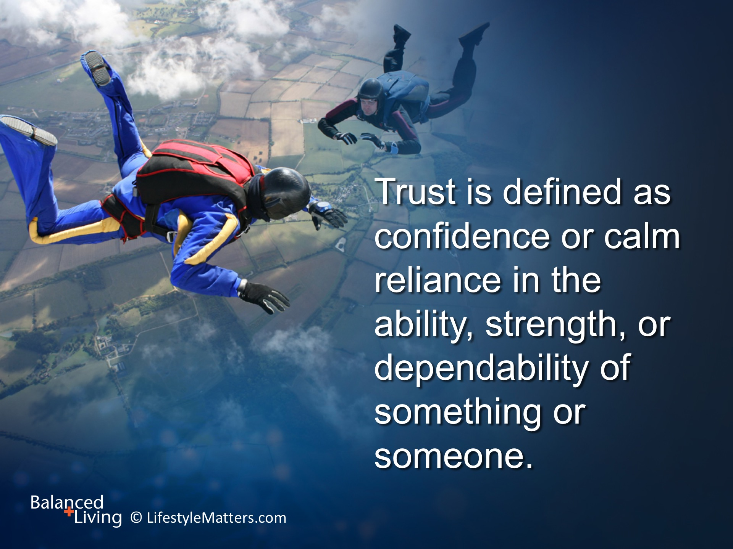
Notes:
Read slide.

Slide 5

Notes:
Read slide.
Trust is hardwired into babies and ideally trust should grow.

Slide 6
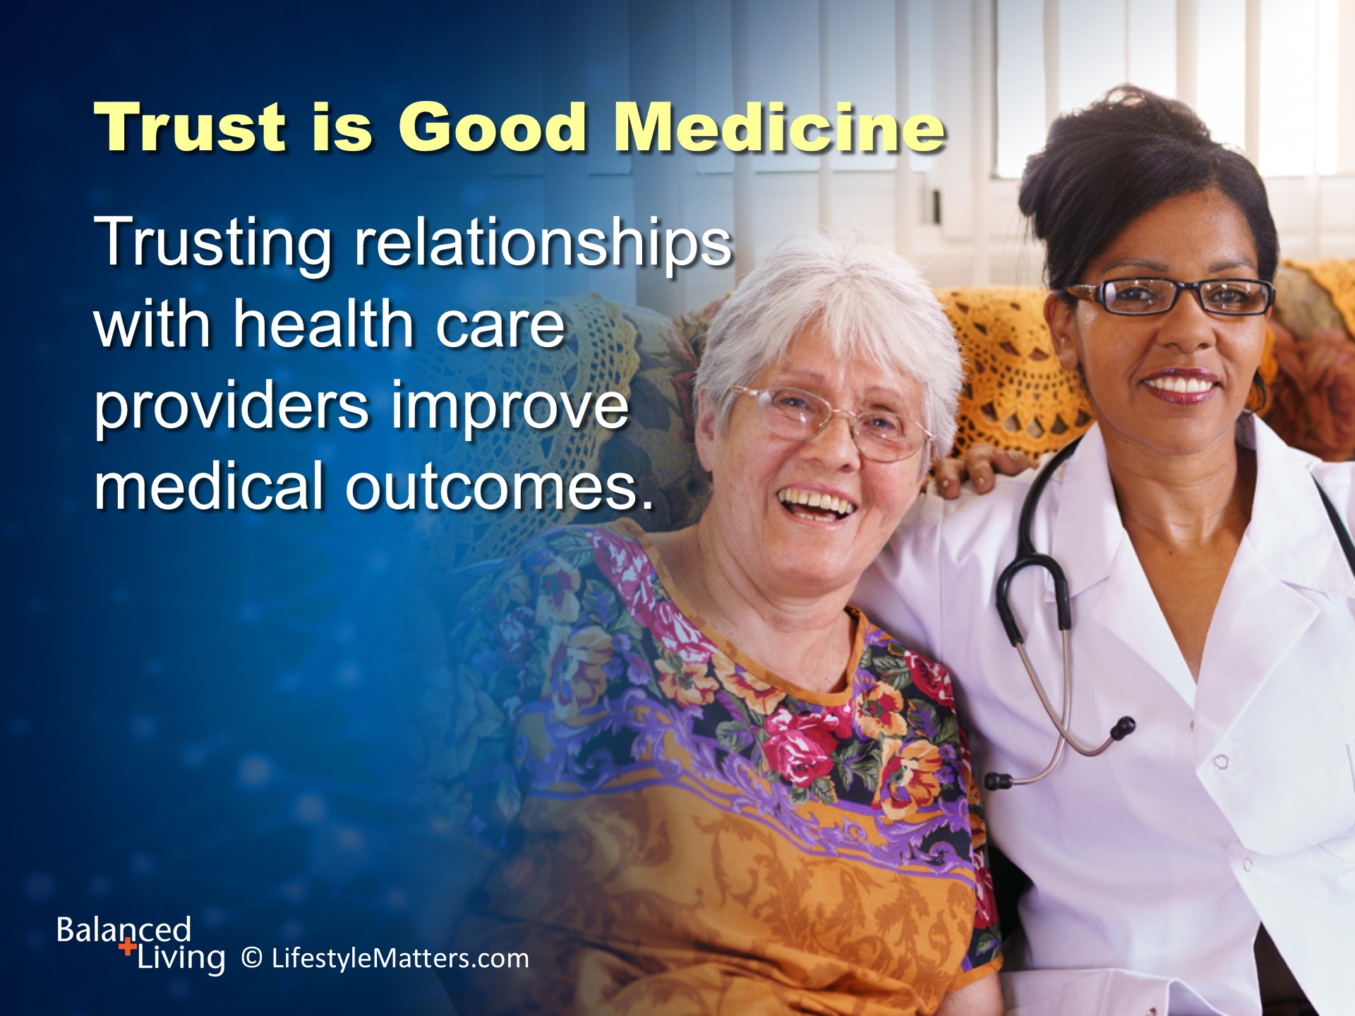
Notes:
Read slide.
Increased trust is also linked to improved immune health, speedier recovery, and fewer accidents…
…and to better overall health and positive social ties. (Source: Health Place 2010;16(5):1022-9.)

Slide 7
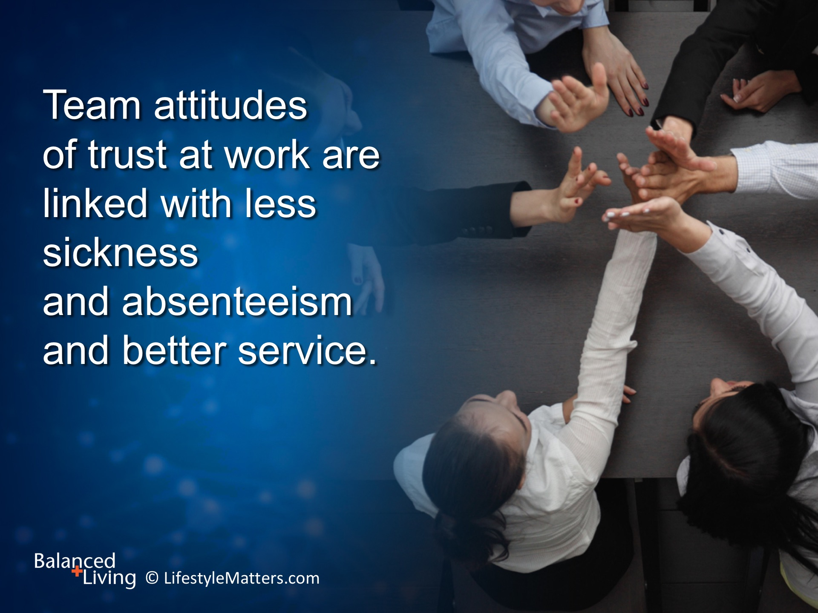
Notes:
Kindness and trust even have a corporate effect! Read slide.

Slide 8
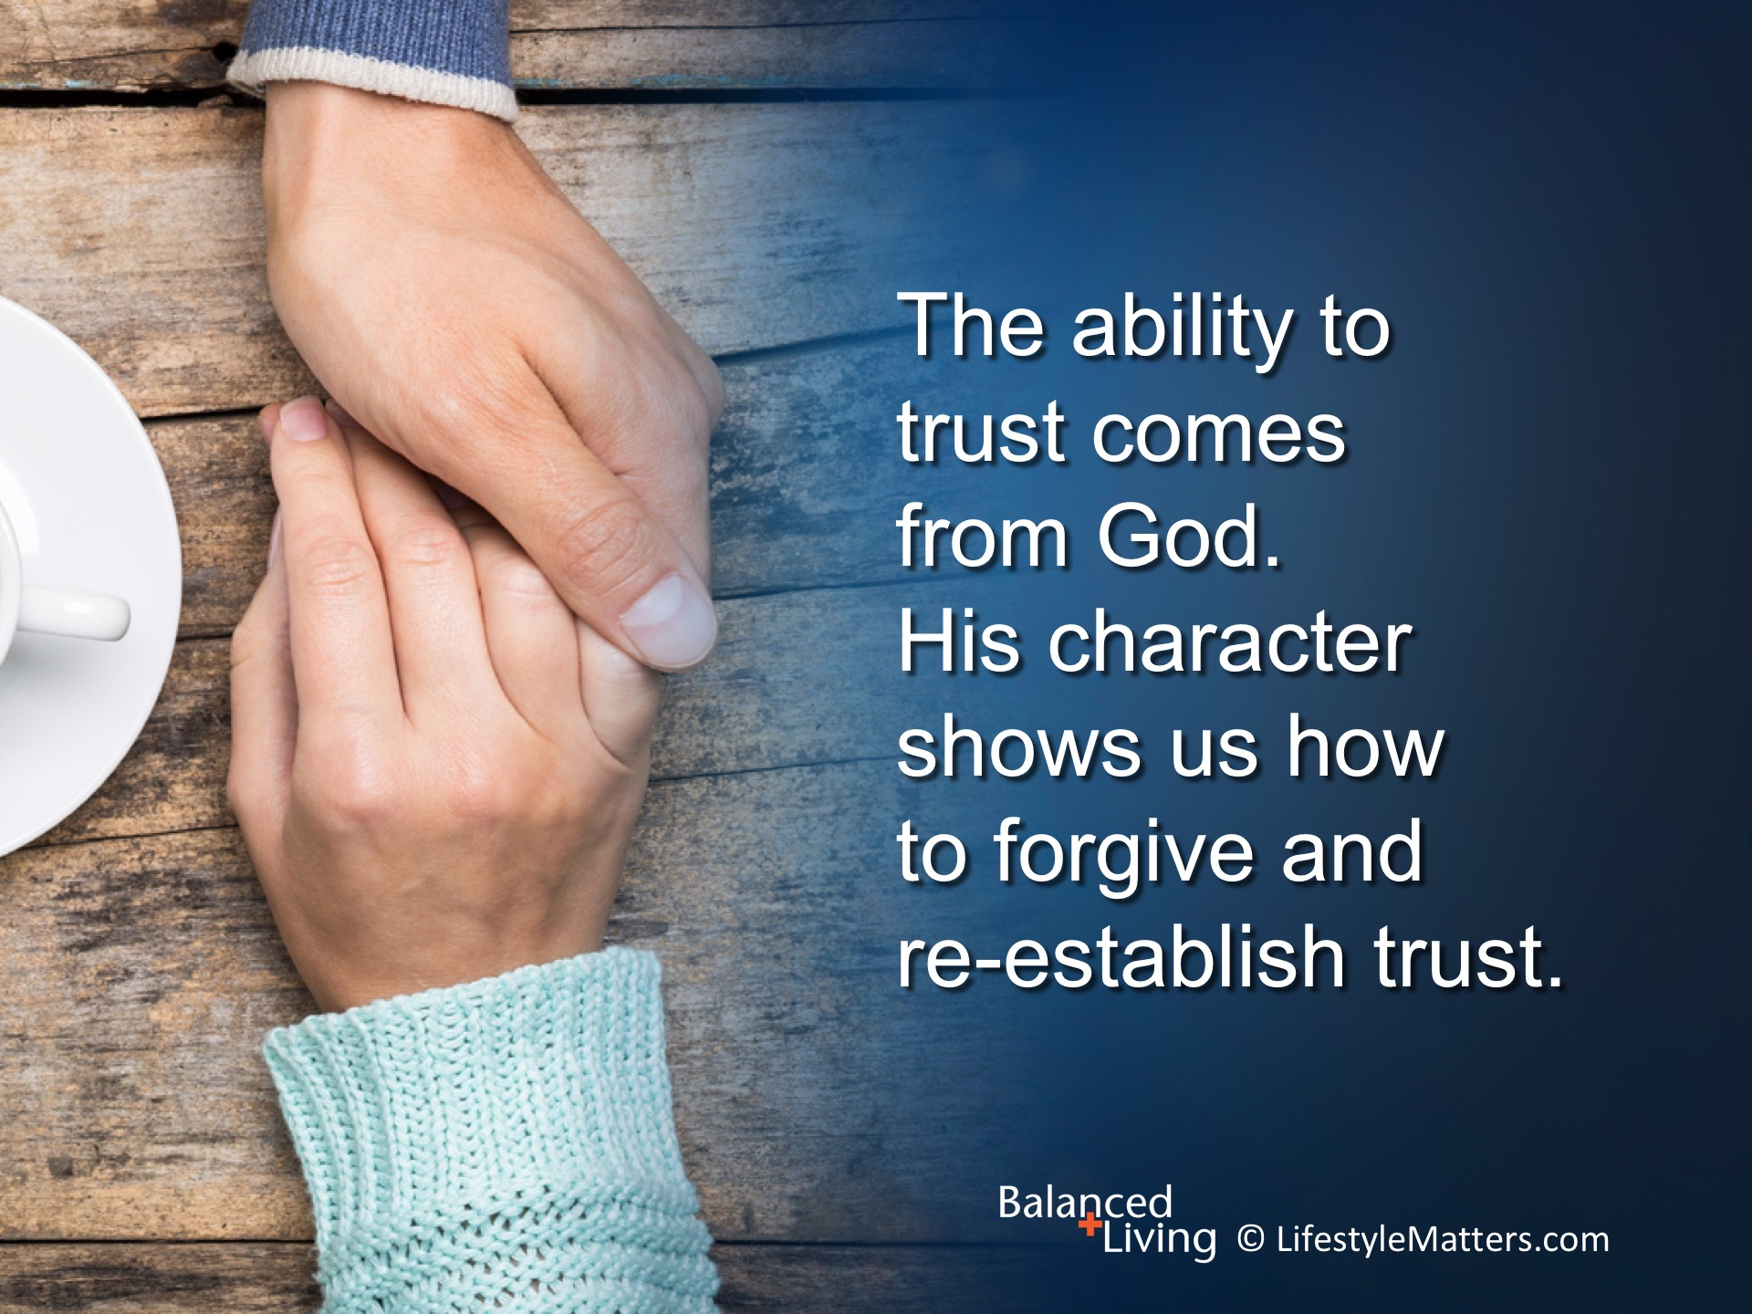
Notes:
Read slide.
Knowing that you can trust God produces an internal joy that is not dependent on things or people or circumstances.

Slide 9
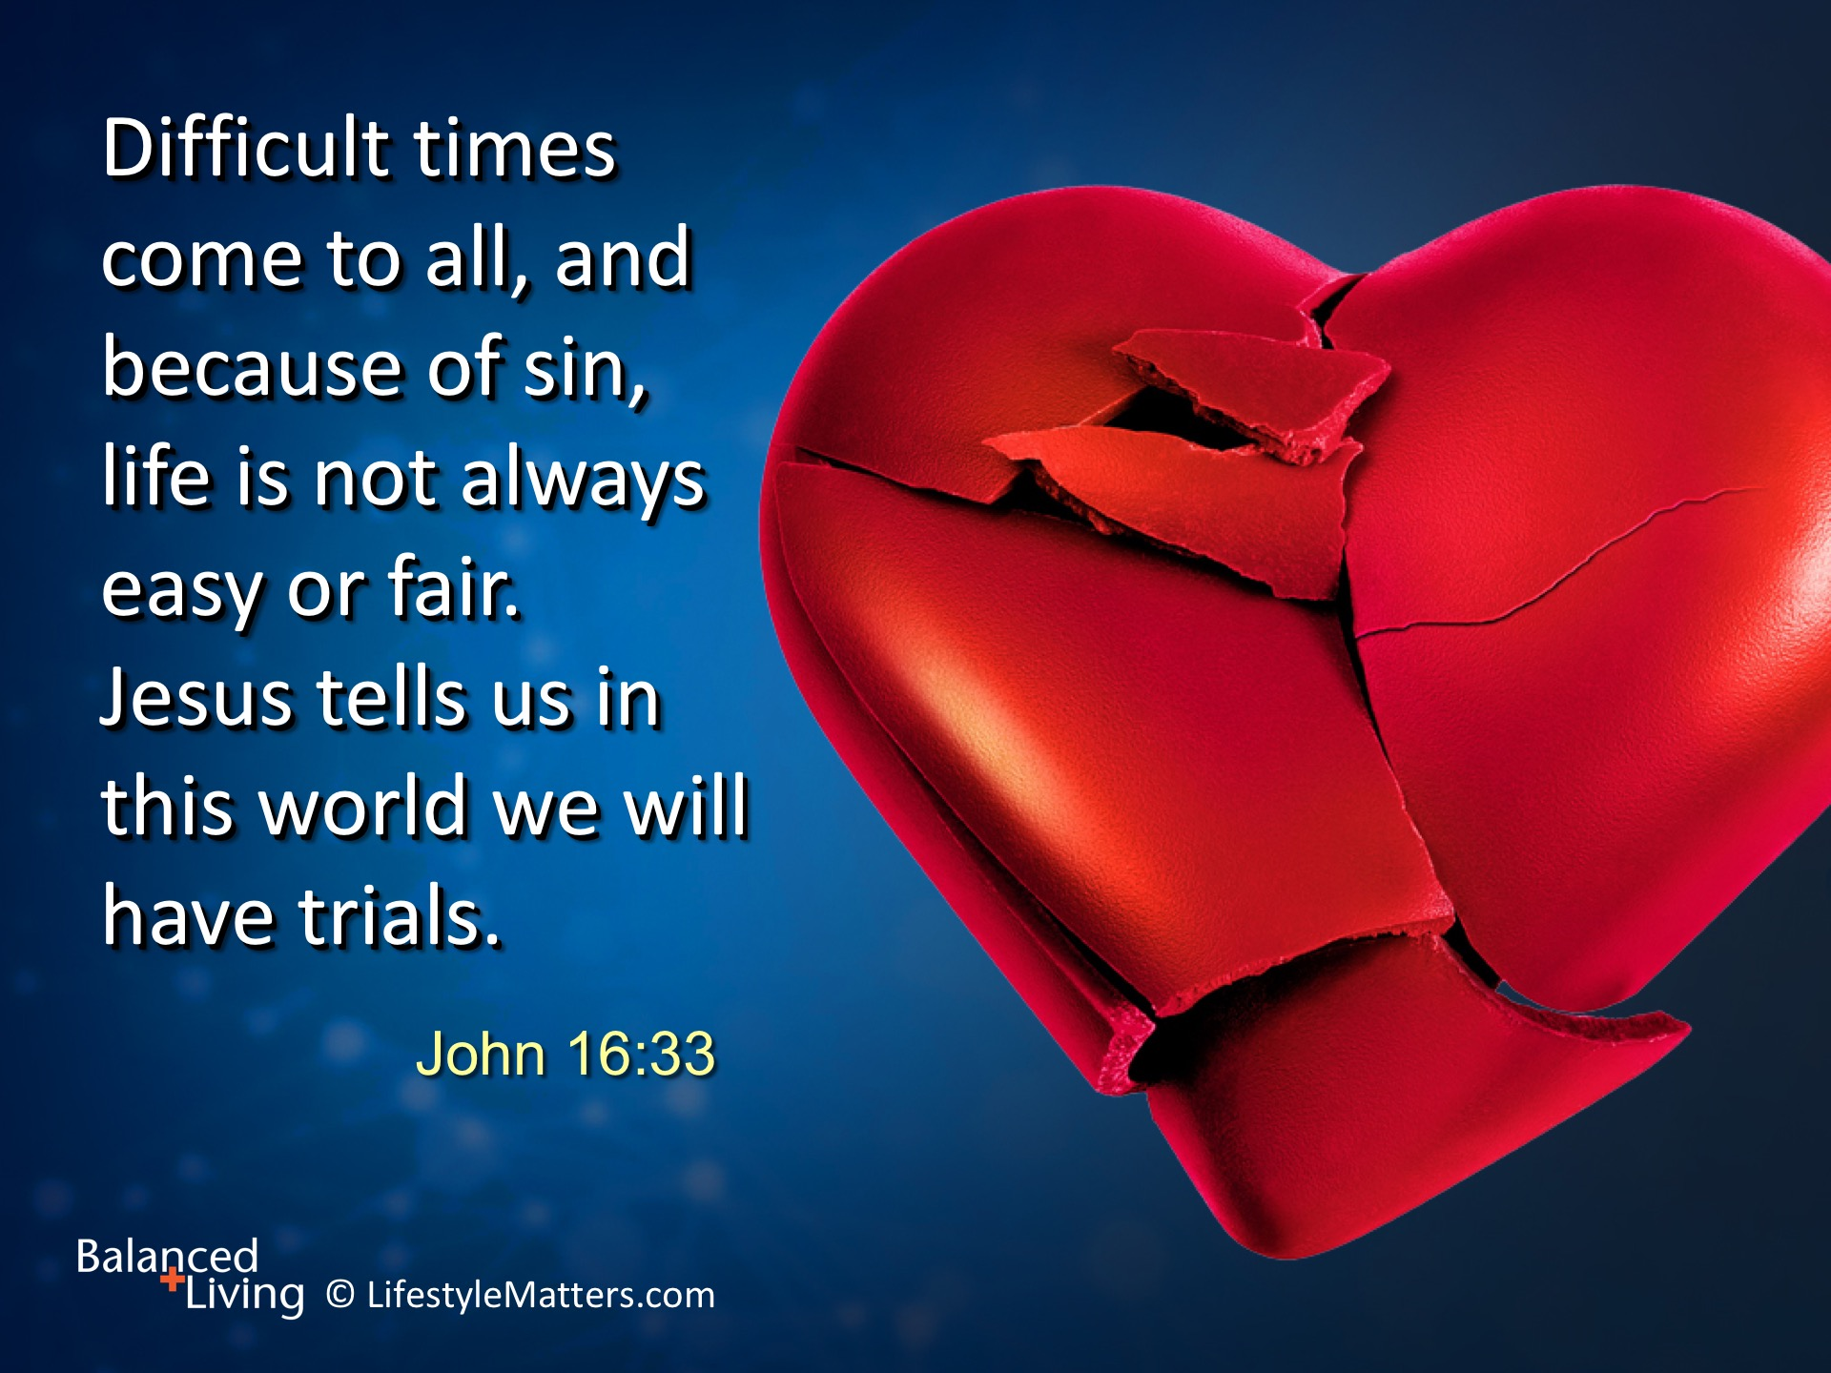
Notes:
God’s transforming power to face the ups and downs of life is remarkable. Read slide
Trusting God even in difficult times will change every part of your life, attitudes, and actions.

Slide 10
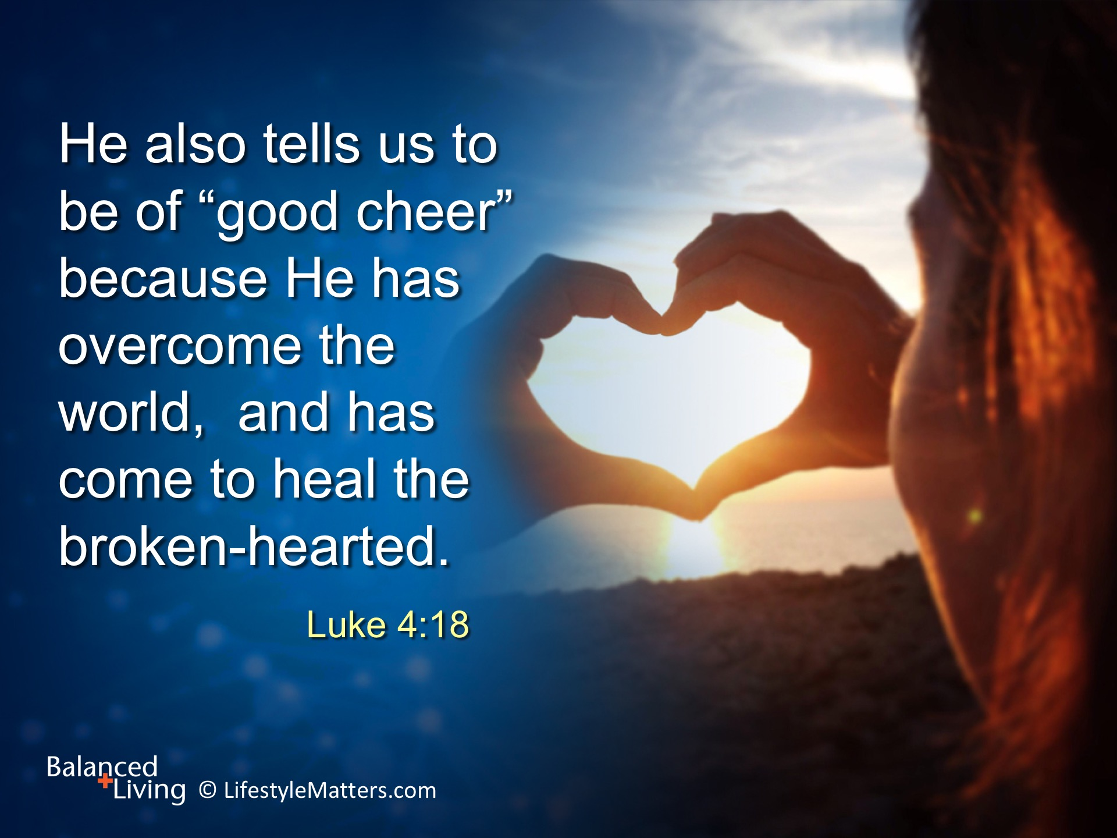
Notes:
Read slide
This is an inside job that goes far beyond external behavior.
It is inner transformation that leads to new strength, desires, attitudes, and actions.
Know that God is in control. He is personally interested in you. He has a plan.

Slide 11
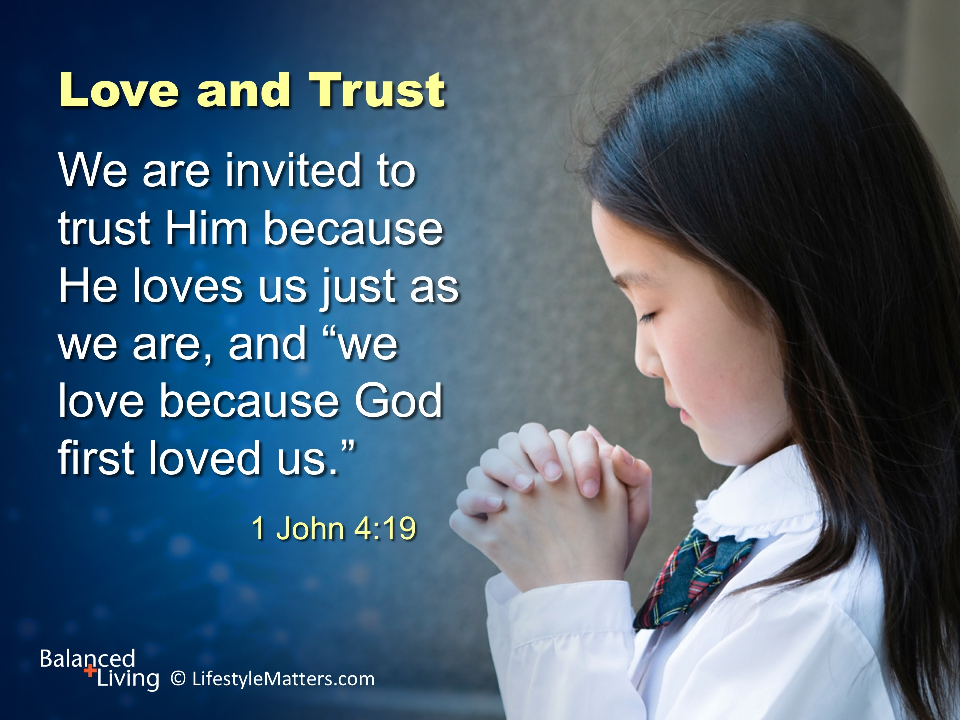
Notes:
Read slide.
You are unique—a child of God and of great value—you are created in God’s image for a holy purpose.

Slide 12
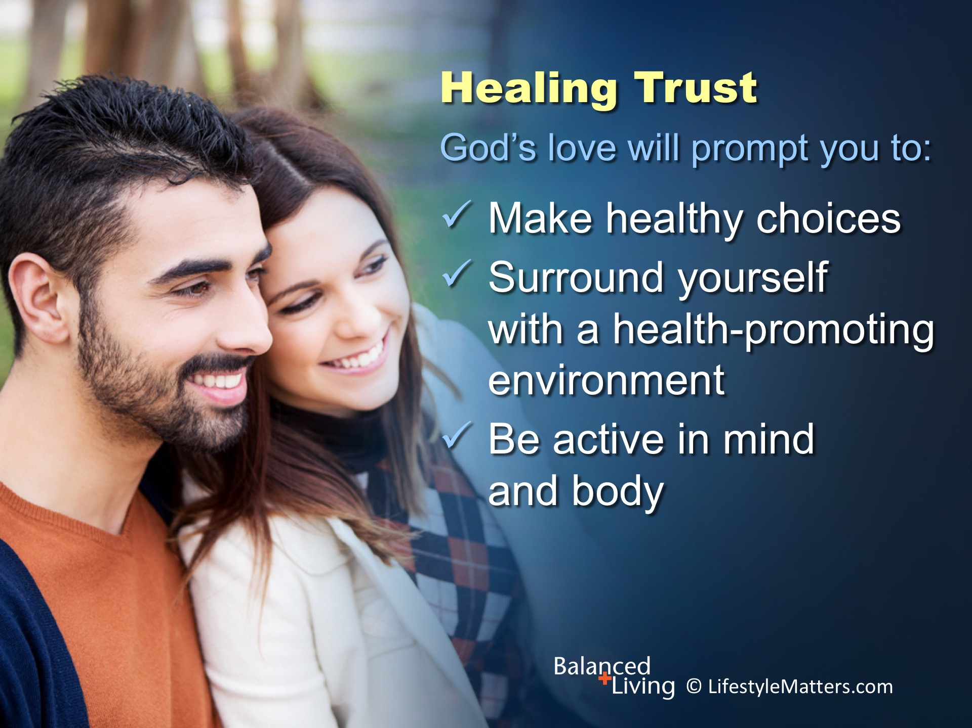
Notes:
When we accept God’s unconditional love for us and wholly trust in His power to transform our lives, amazing things begin to happen!
Read slide.

Slide 13

Notes:
Read slide.
We are energized to take better care of ourselves in order to reflect His character to a needy world.

Slide 14
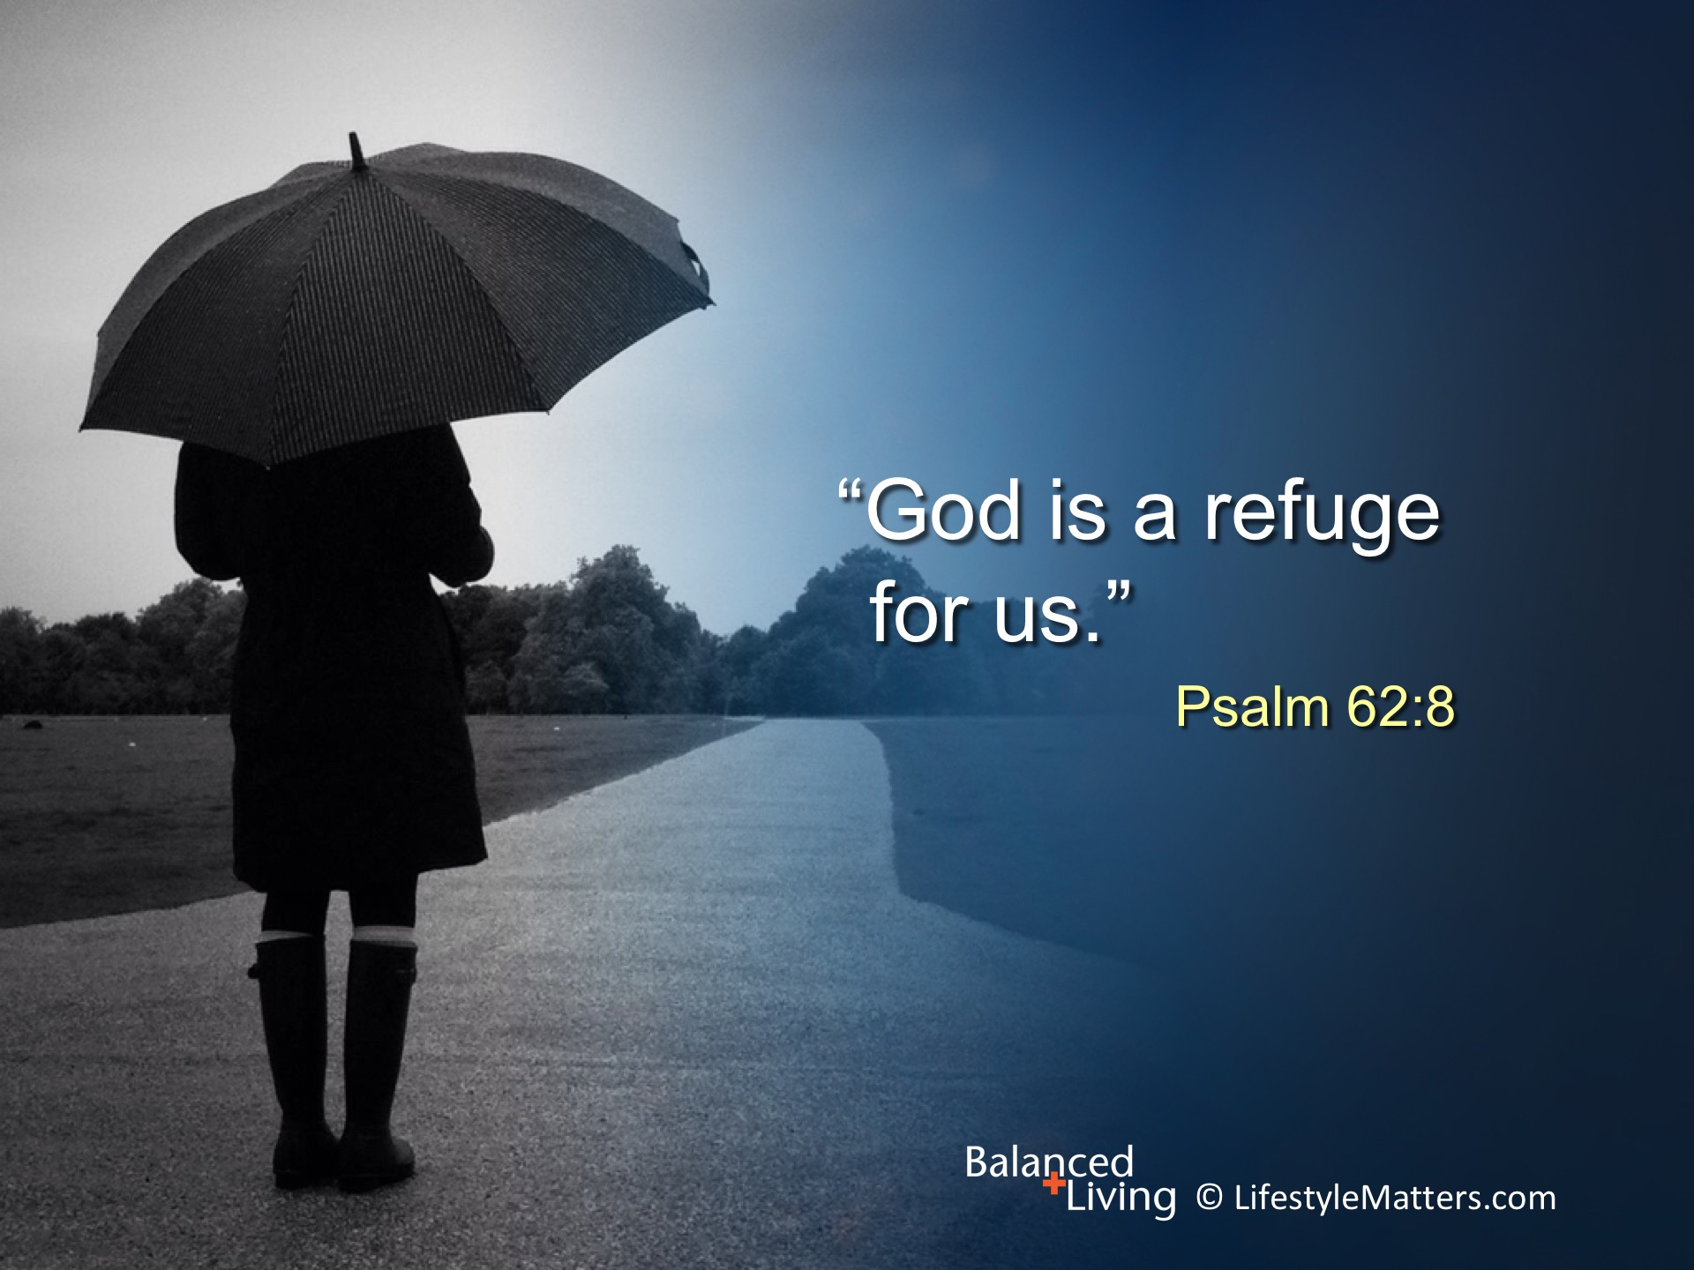
Notes:
Read slide.
When you lean on God you will be enabled to press in to Christ; press through life’s ups and downs; and press on to victory!

Slide 15
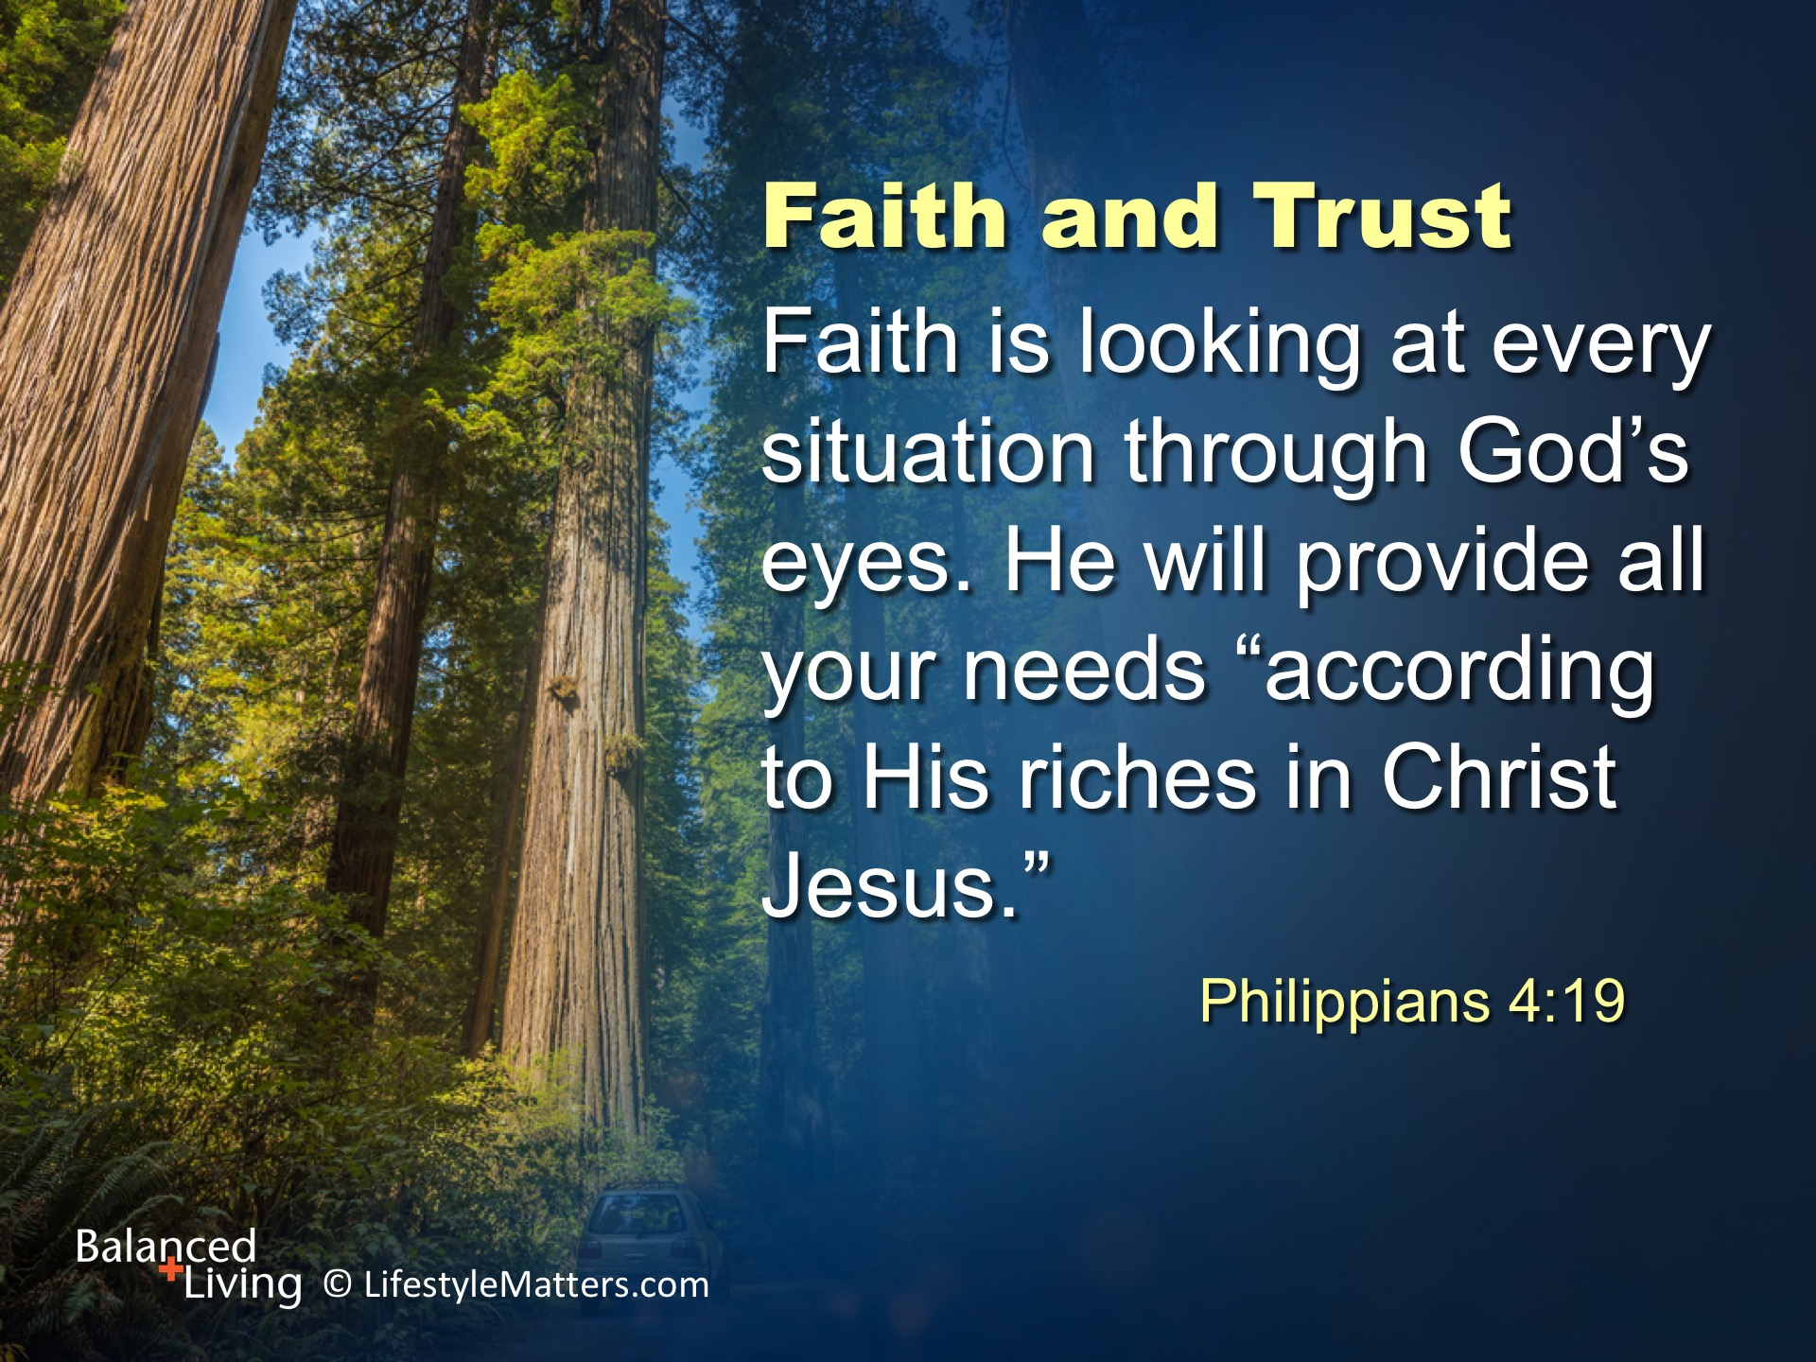
Notes:
Read slide.
The Bible describes faith as the “assurance of things hoped for, the evidence of things not seen.” Hebrews 11:13.
Faith is power for the journey, not a lucky charm to avoid problems.

Slide 16
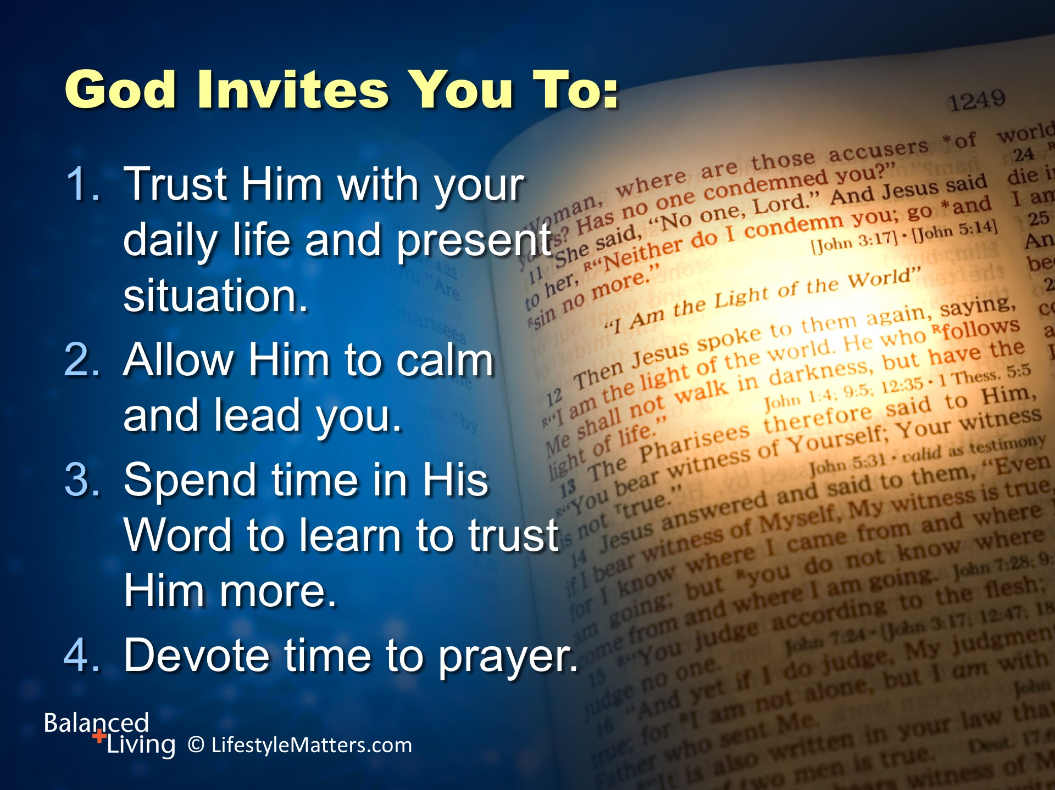
Notes:
Read slide.
These steps of trust have more to do with mental, physical, and spiritual health than many realize.
They are a decision of the will and a discipline of the daily life.

Slide 17
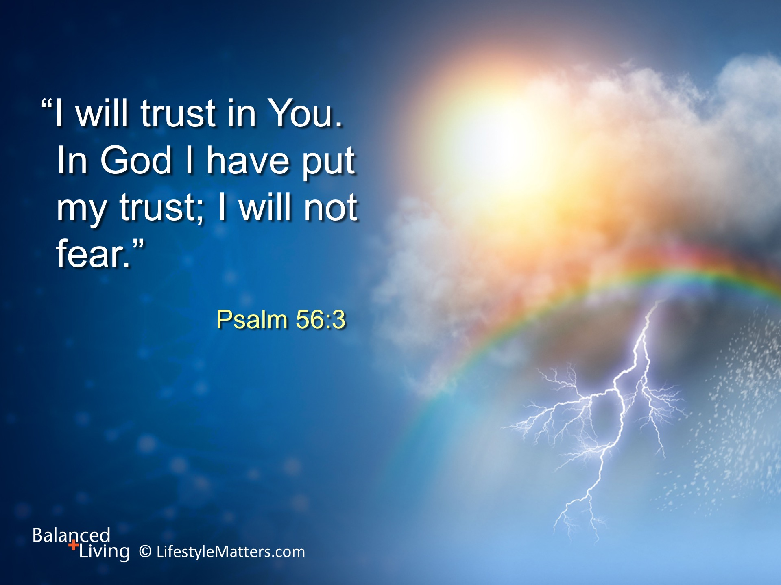
Notes:
Read slide.
Trust in Christ, your Redeemer, to save you, heal you, and lead you.
As God has spoken to your heart, will you make the decision to trust Him with your life and circumstances?
Raise your hand and confirm your choice to trust Him. (Raise hand and wait for responses)

