Slide 1


Images © Alamy
www.alamy.com
Images used in powerpoint presentation are part of the presentation and not to be used out of context of the presentation, may not be used as stand-alone images unless to promote the presentation/event, and may not be resold in singular form or as part of an image library. Images are © Alamy and presentation templates and content therein are © MISDA, any other usage requires written permission from both parties.

Slide 2
Scripture quotations used in Balanced Living PowerPoints are taken from Bibles in the Public Domain which have no USA copyright restrictions. We have indicated which version each quotation is taken from as follows:
KJV - King James Version
BBE - Bible in Basic English
WEB - World English Bible
DBY - Darby's Translation
Any scriptures not otherwise noted are the author's paraphrase of one of these versions.

Slide 3
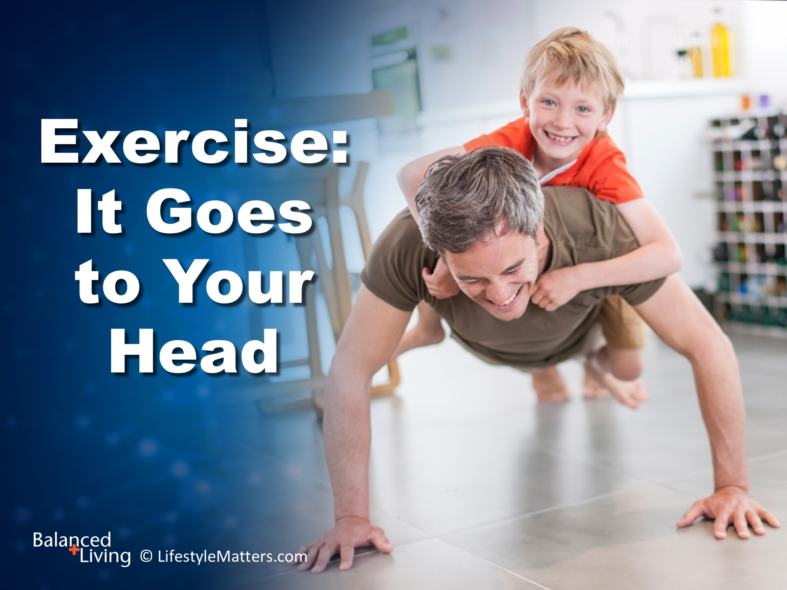
Notes:
Presenter: Please read and study the tract that accompanies this PowerPoint to prepare for this presentation.
Exercise can make us feel better—but why?
In this presentation, Read slide we will focus on the mental health benefits of exercise.
Exercise not only builds and conditions the body—it builds and conditions the brain.
And it’s never to late to start exercising. The benefits are beyond measure.

Slide 4
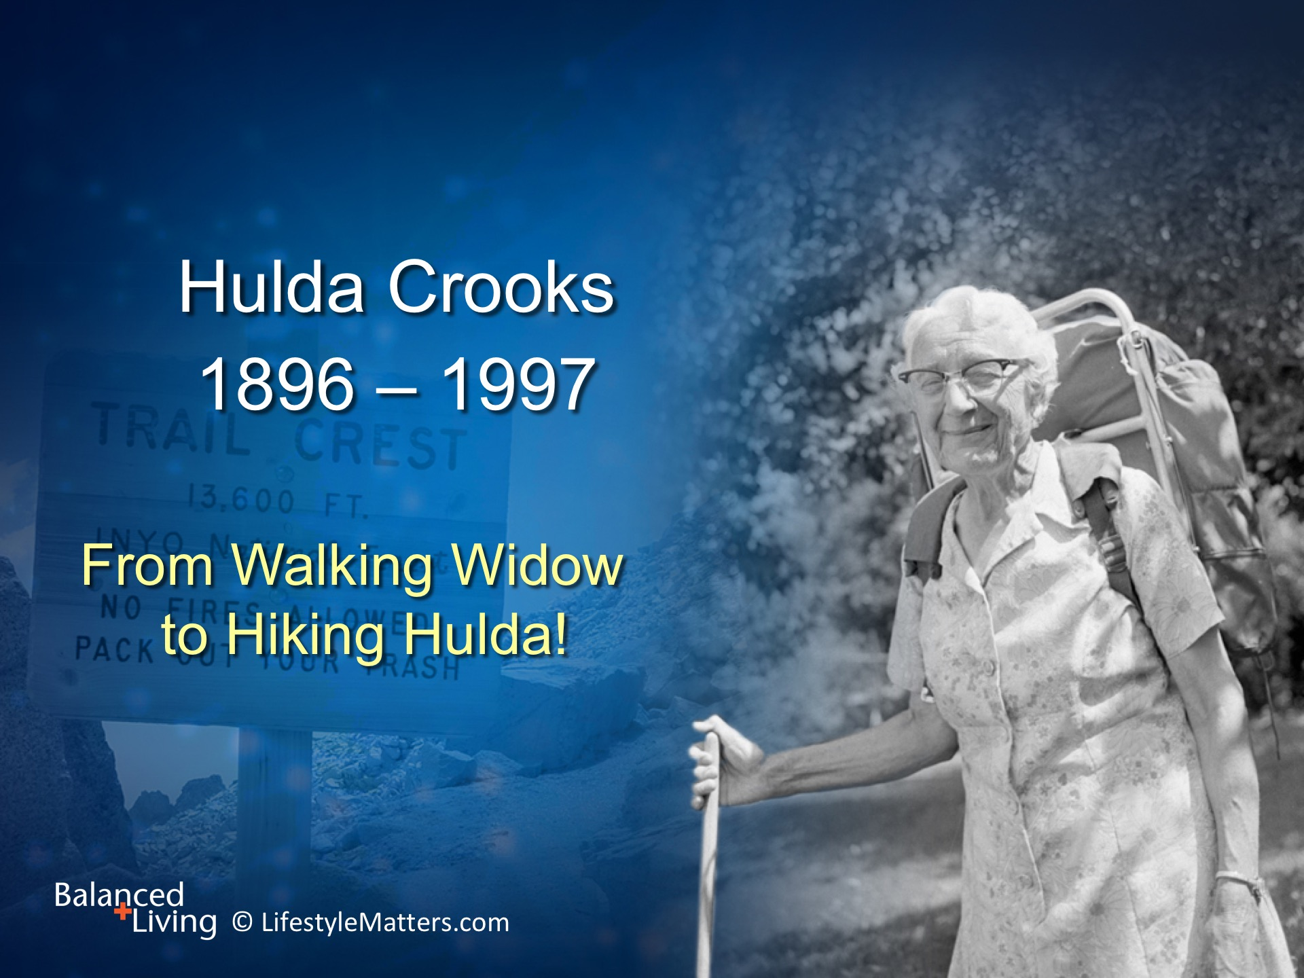
Notes:
Read slide.
Hulda was one of 18 children born to a farming couple in Saskatchewan, Canada in 1896.
She was raised on a Canadian farm with a diet rich in meat, milk, cream, butter, eggs, and candy.

Slide 5
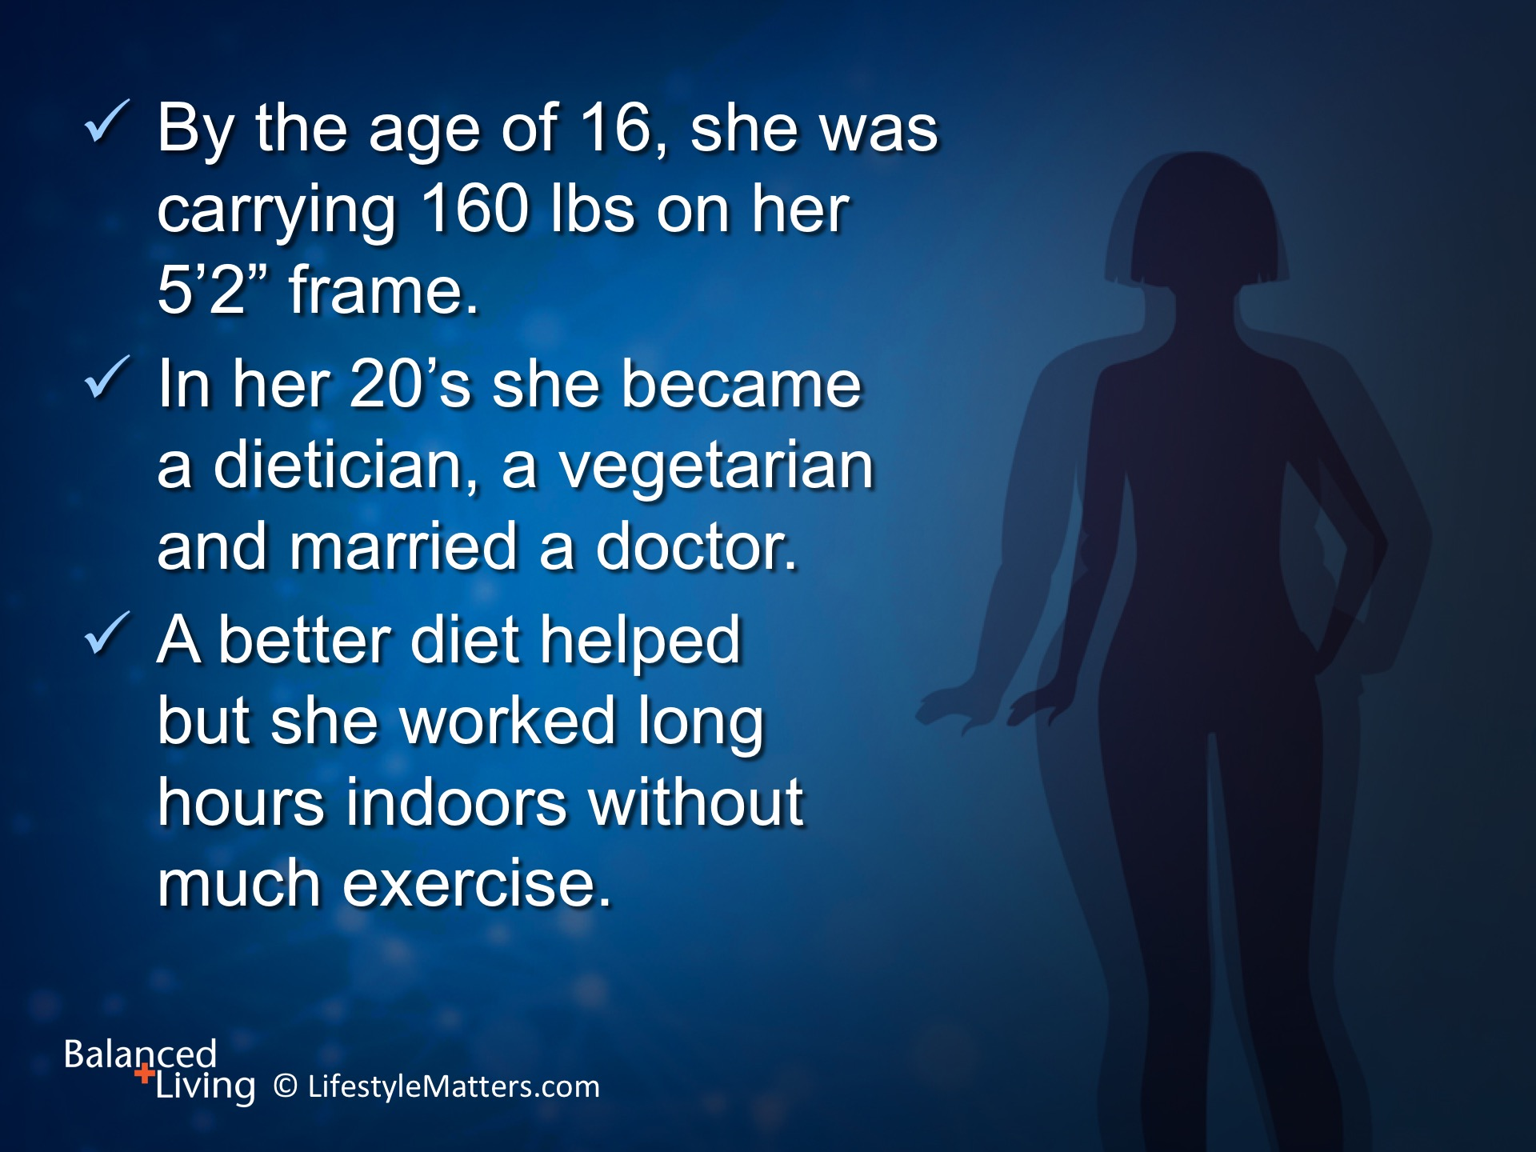
Notes:
Read slide.
Hulda’s long hours of work and study without exercise damaged her health in spite of an improved diet.
She needed a more complete makeover!

Slide 6
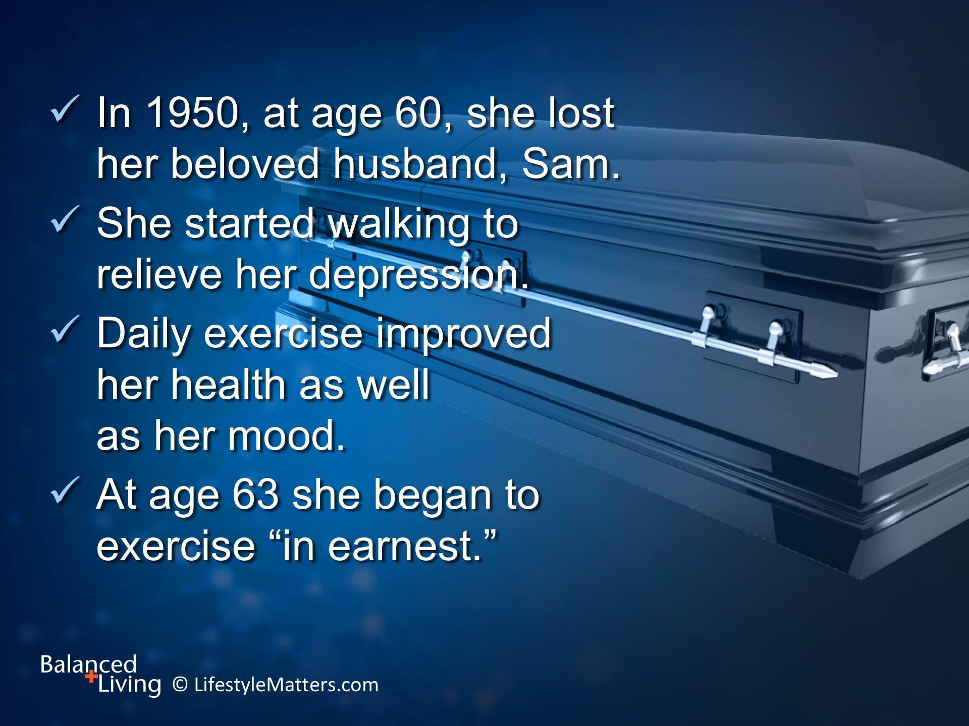
Notes:
In time, tragedy struck:
Read slide

Slide 7

Notes:
Read slide.
(NOTE: Mt. Fuji is 12,388 ft., the highest mountain in Japan.)

Slide 8
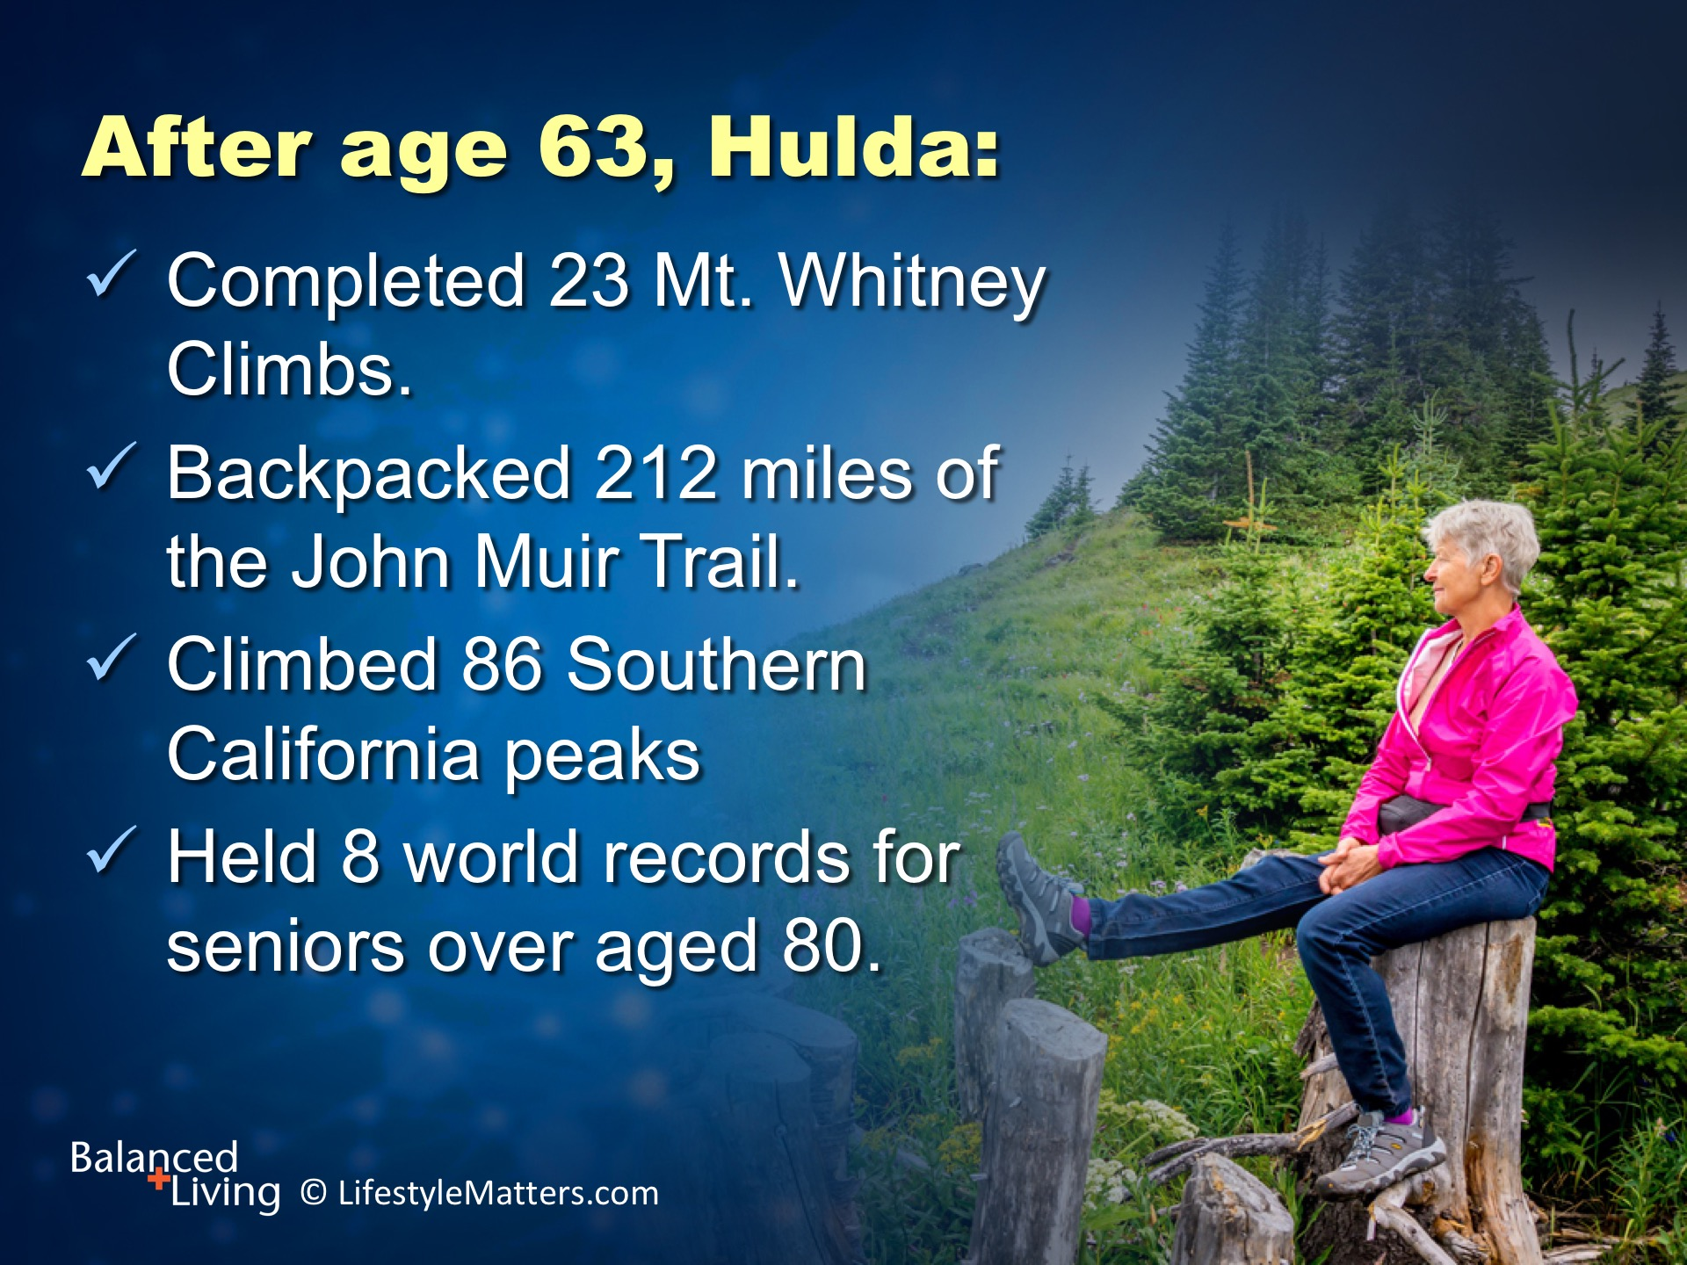
Notes:
Read slide.

Slide 9

Notes:
9
Read slide.
Having reached the summit of Mt Whitney 23 times, she became affectionately known as “Grandma Whitney.”
The mountain peak is named “Crooks Peak” in her honor.

Slide 10
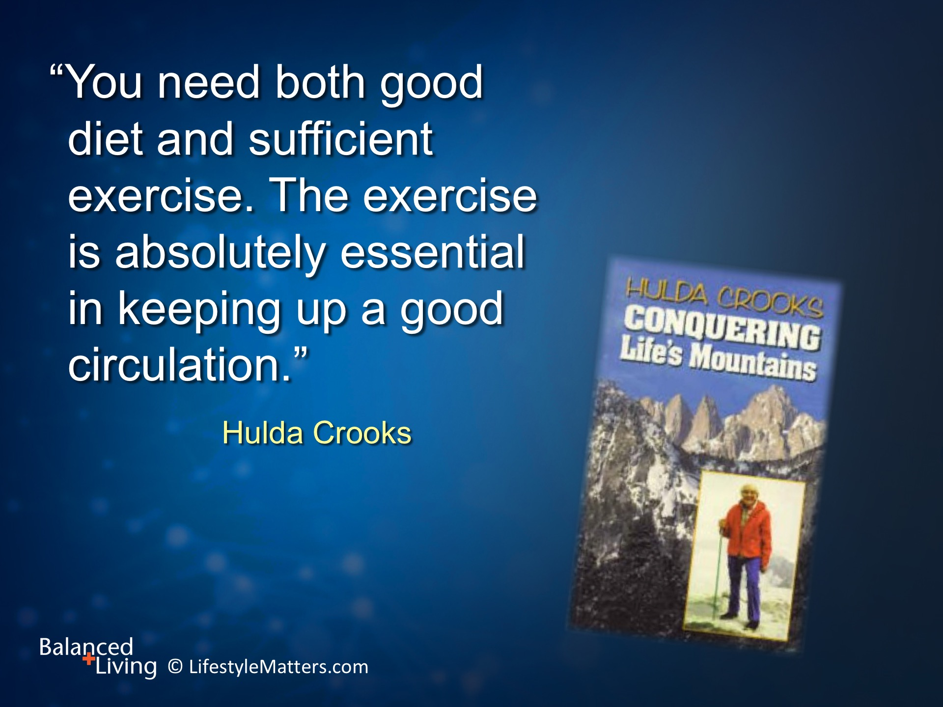
Notes:
Read slide.
When hiking, her standard shoes were a simple, inexpensive pair of Keds tennis shoes!

Slide 11
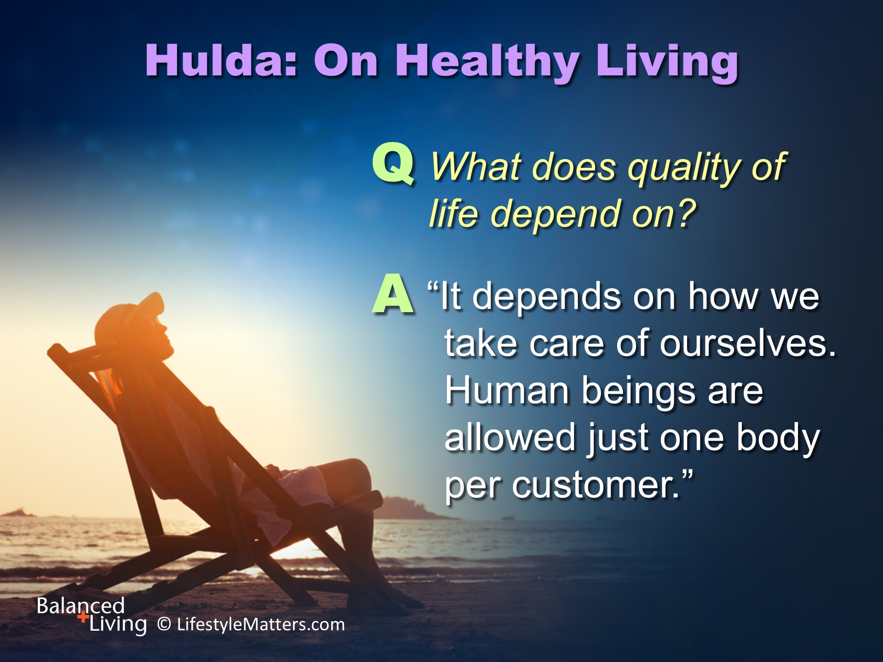
Notes:
Hulda was interviewed on healthy living.
She was asked:
Read slide.

Slide 12
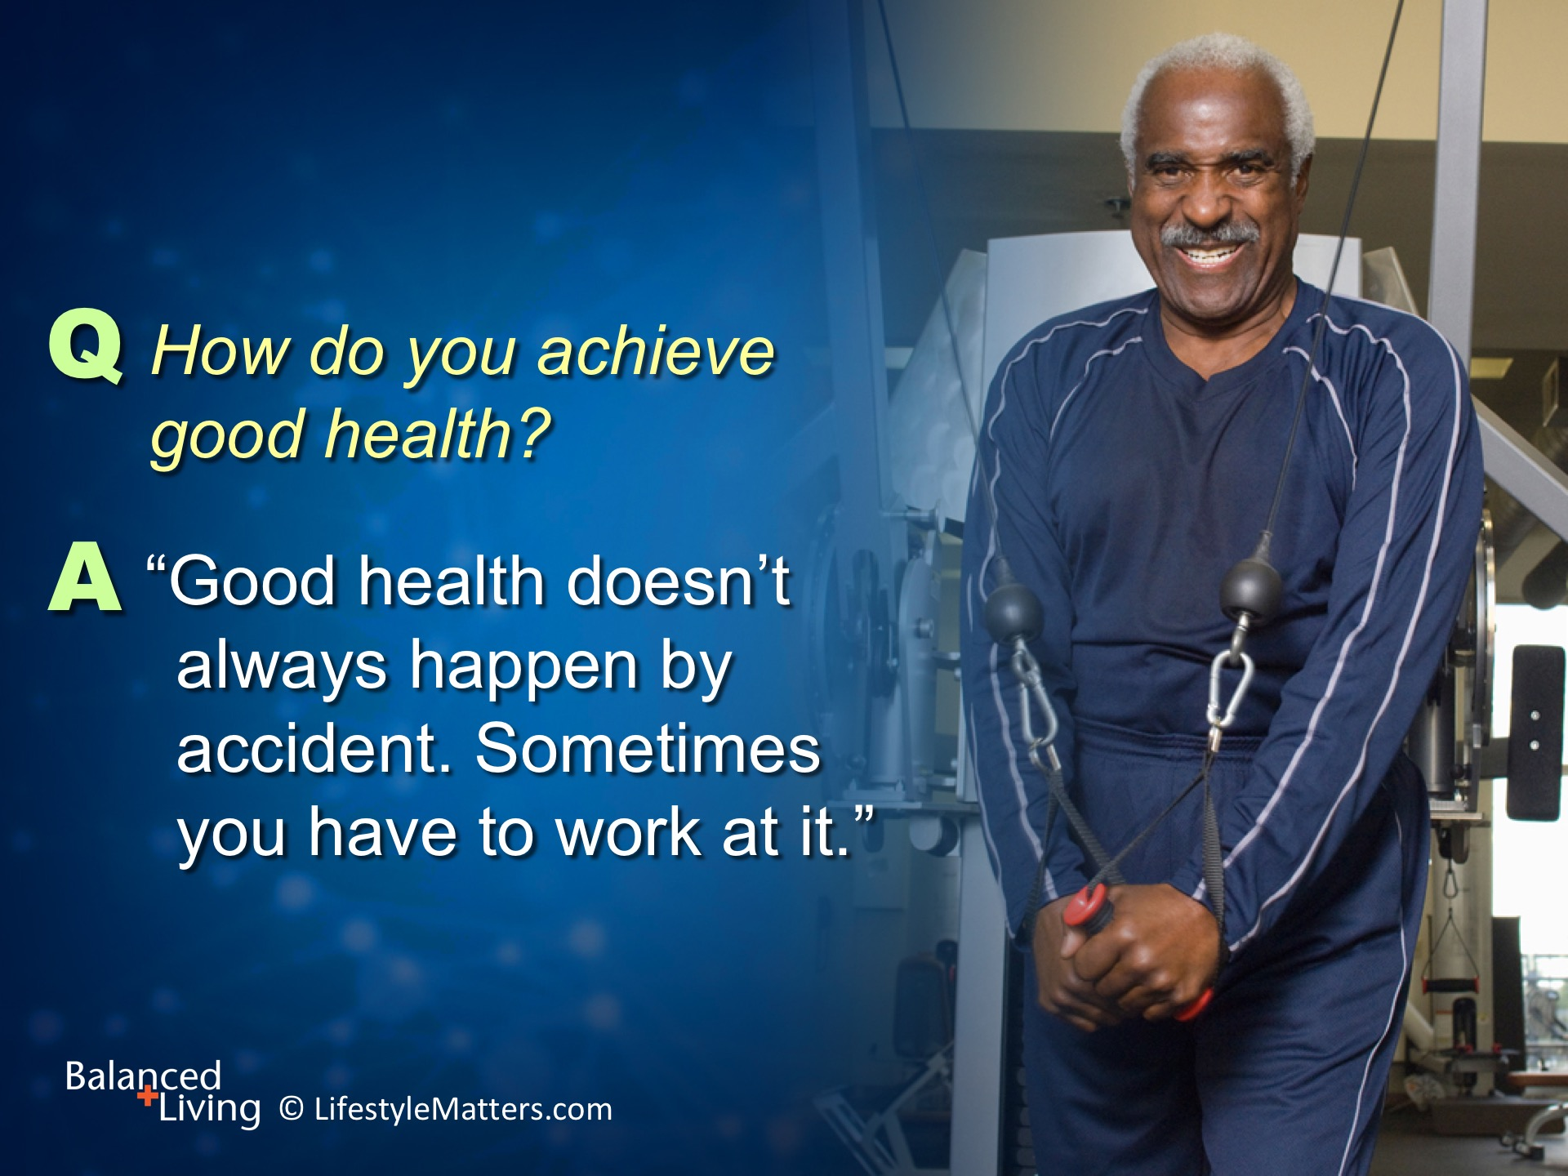
Notes:
Read slide.
Her answer makes us smile—but making healthy choices begins with a decision followed by action.

Slide 13
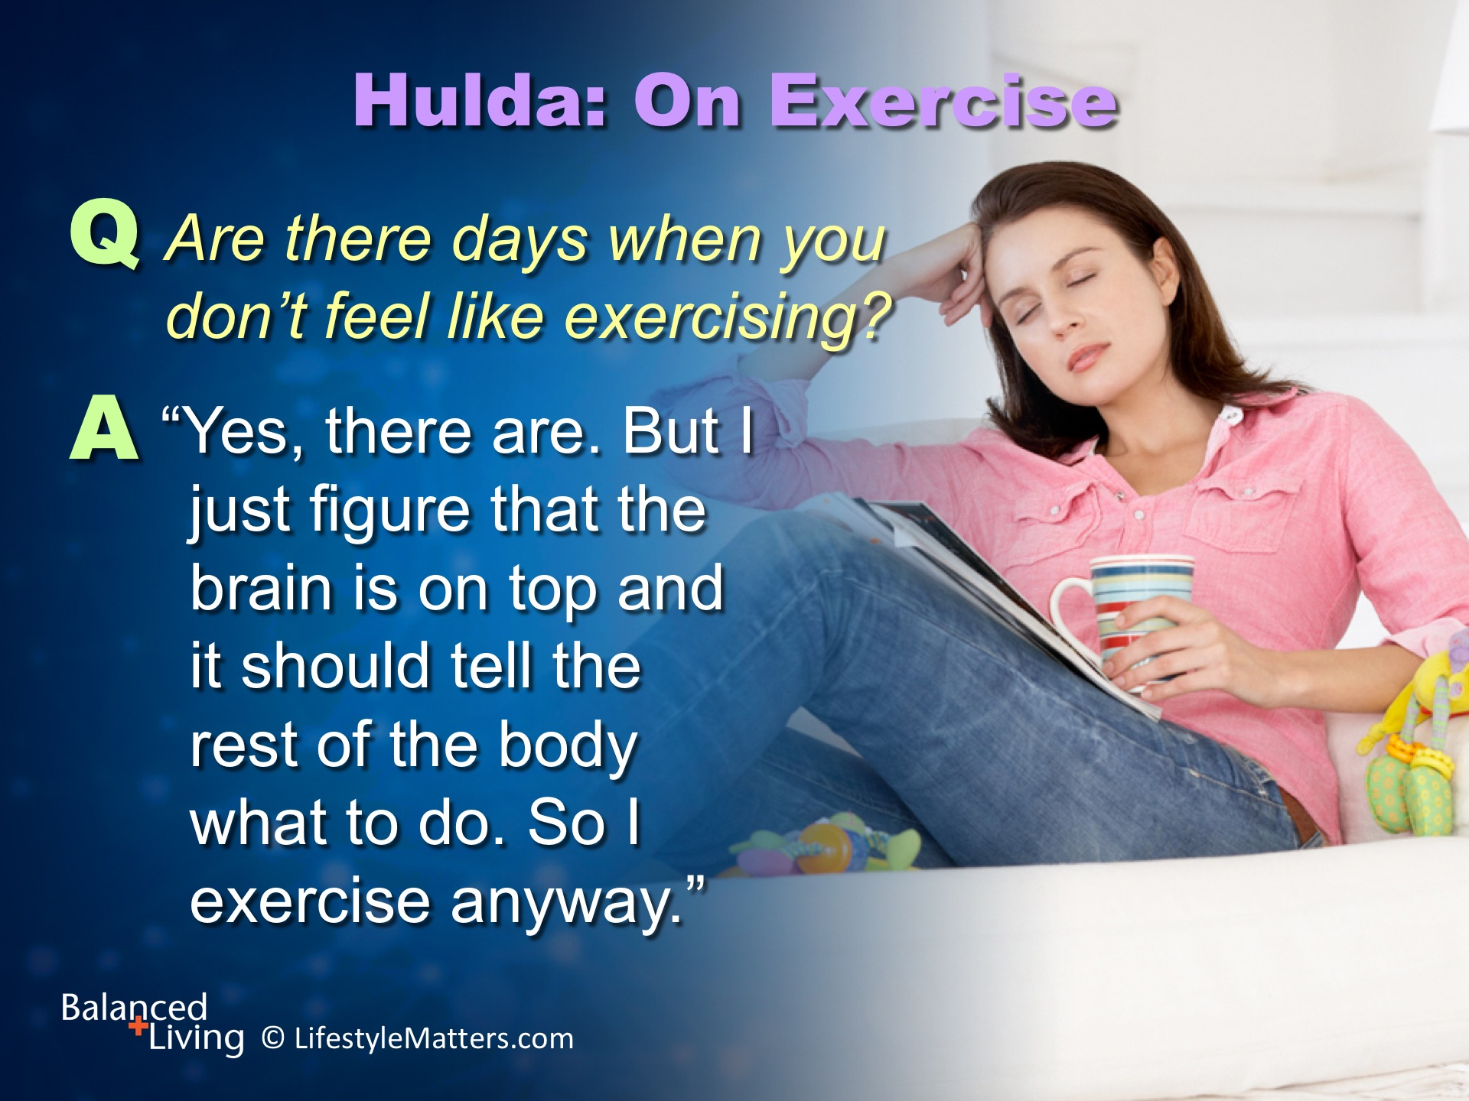
Notes:
Read slide.

Slide 14
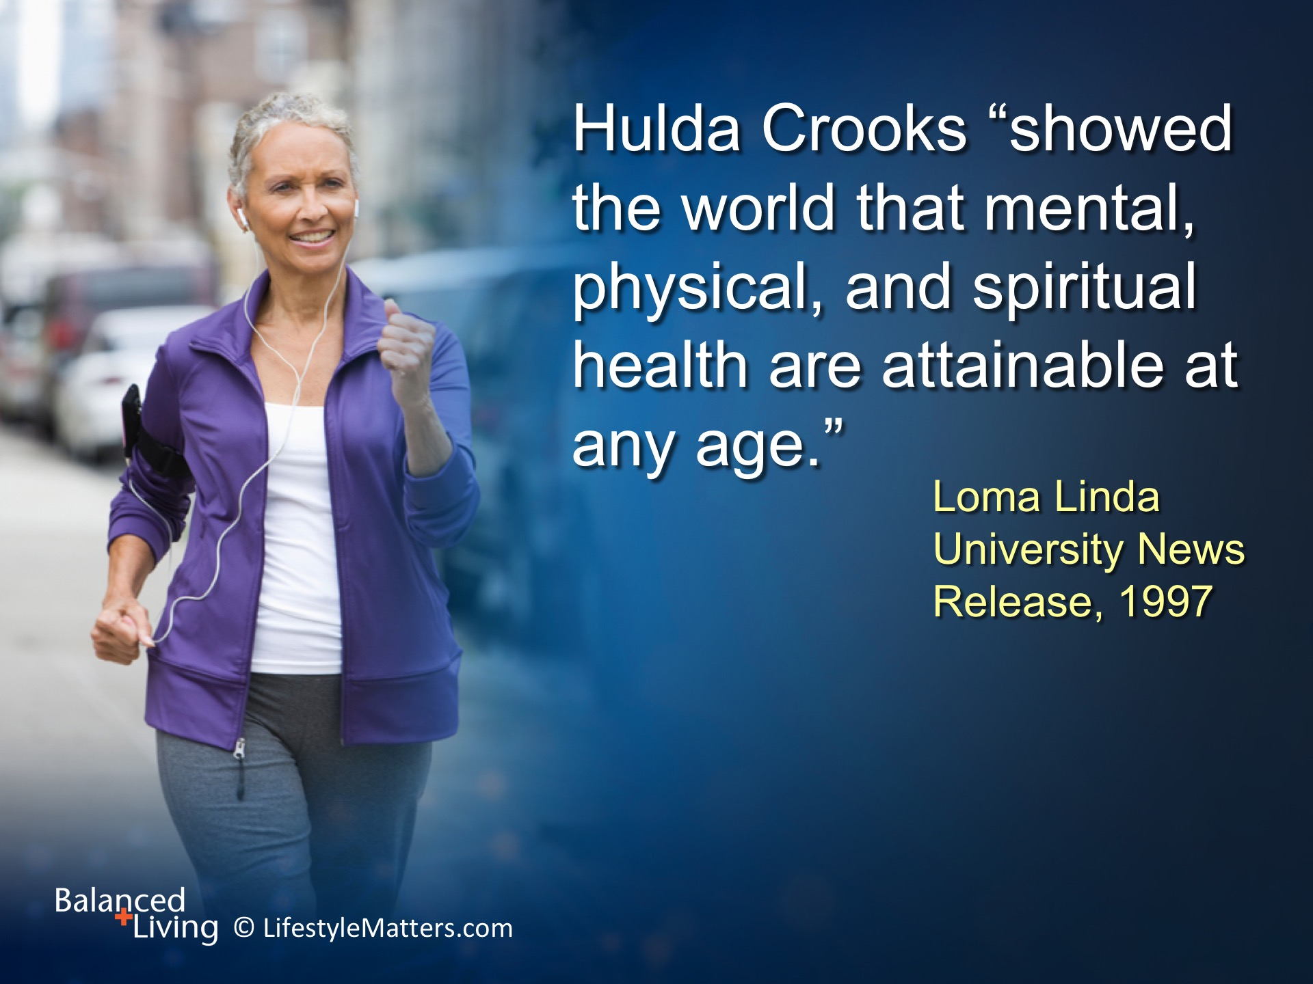
Notes:
A devout Seventh-day Adventist Christian, Read slide.
Have you been tempted to think it’s too late for a fresh start?
Hulda’s story tells us that it is never too late to adopt a healthier lifestyle.

Slide 15
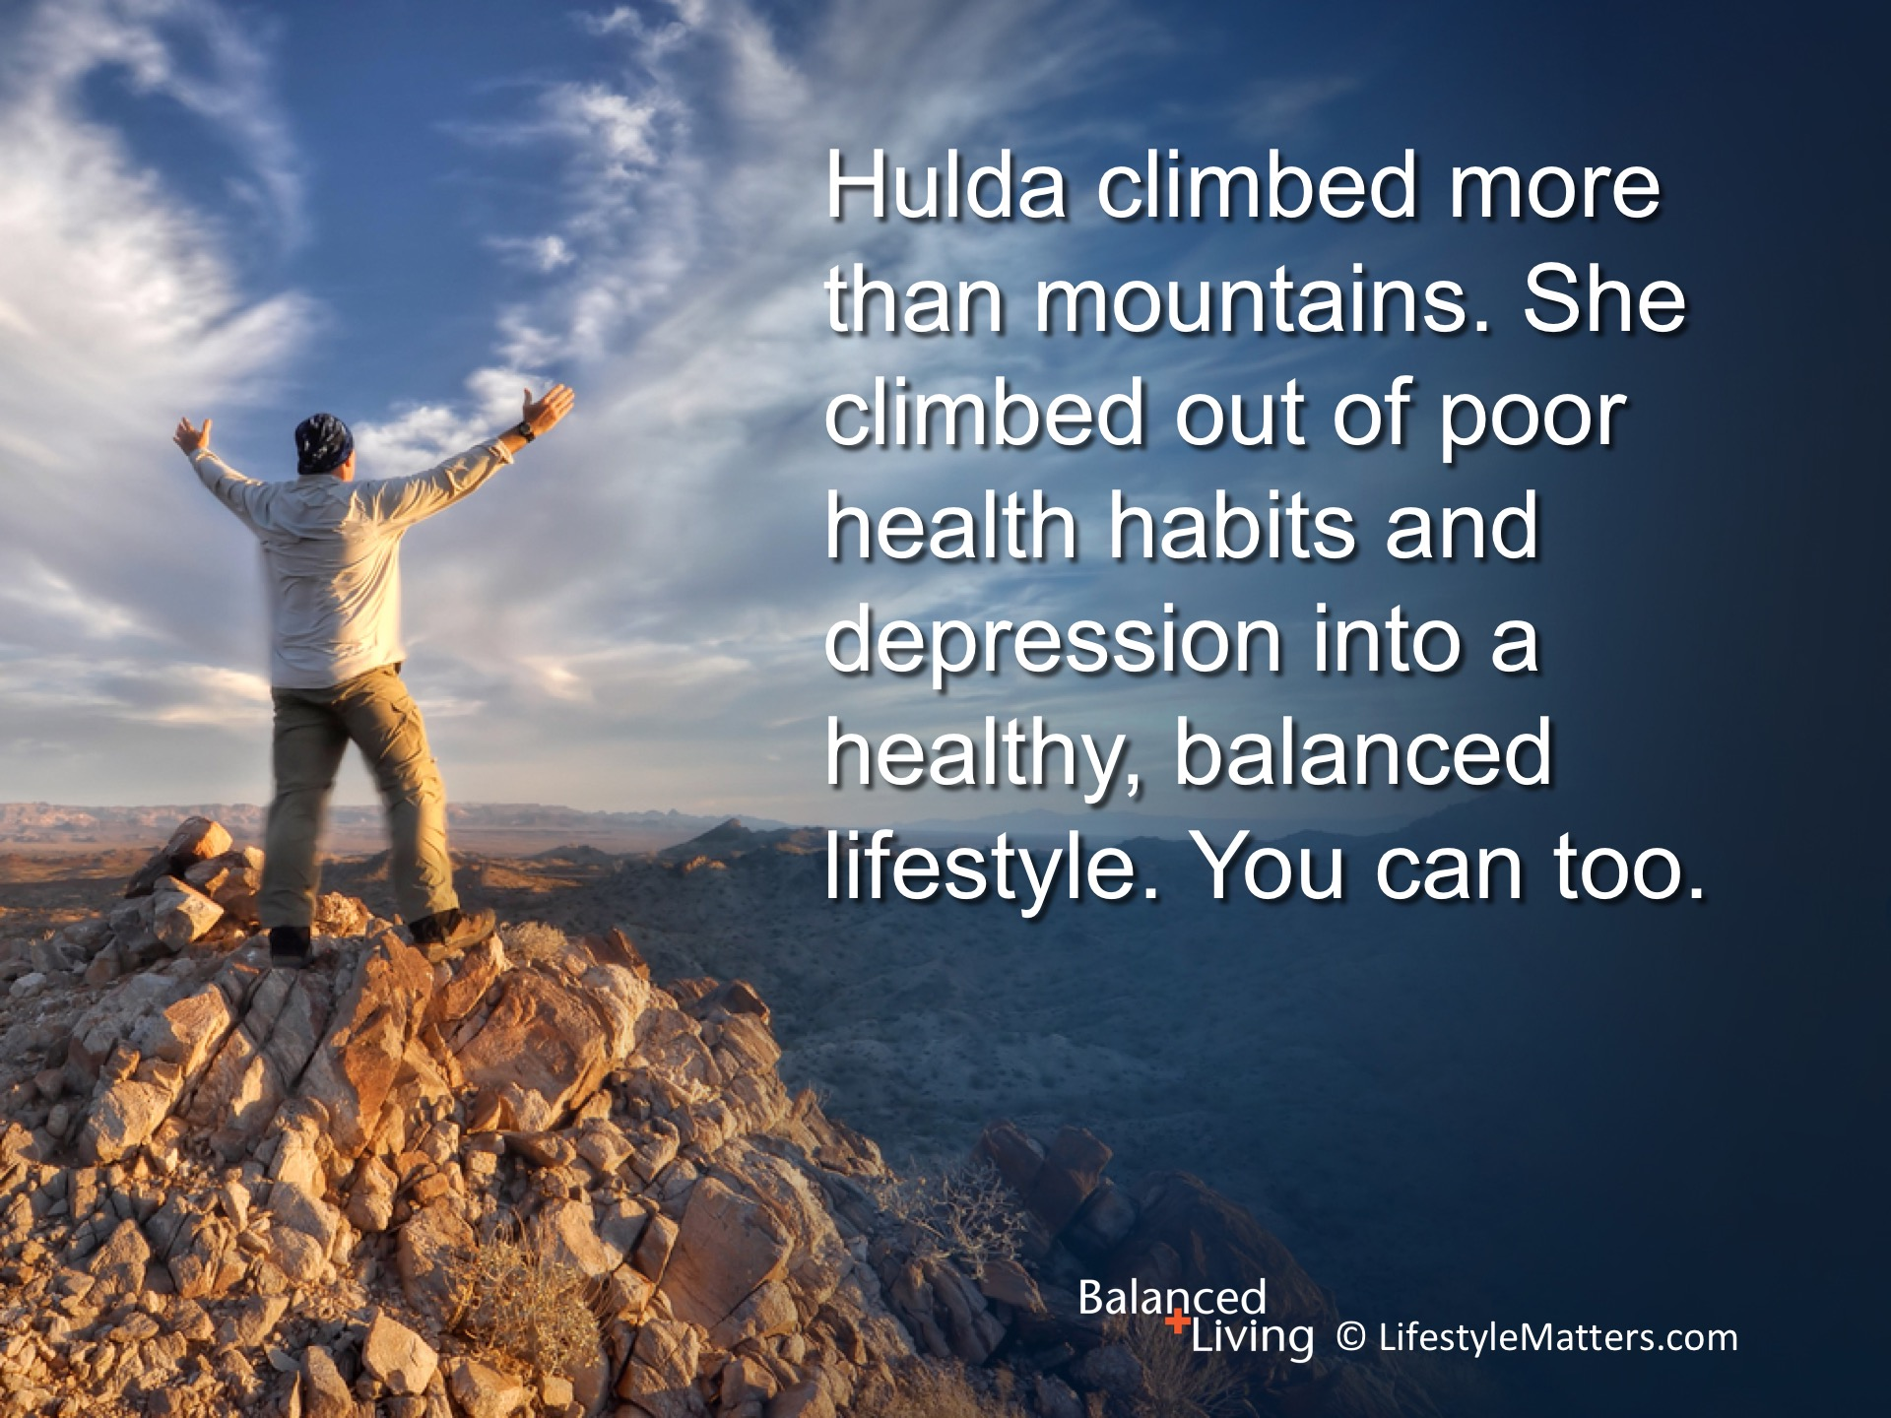
Notes:
Read slide.
Hulda’s story is a great “turn-around” story. That’s what makes it so special.
If you are “stuck” doing less than your best and want to get moving, maybe it is your time for “turn-around” story!

Slide 16
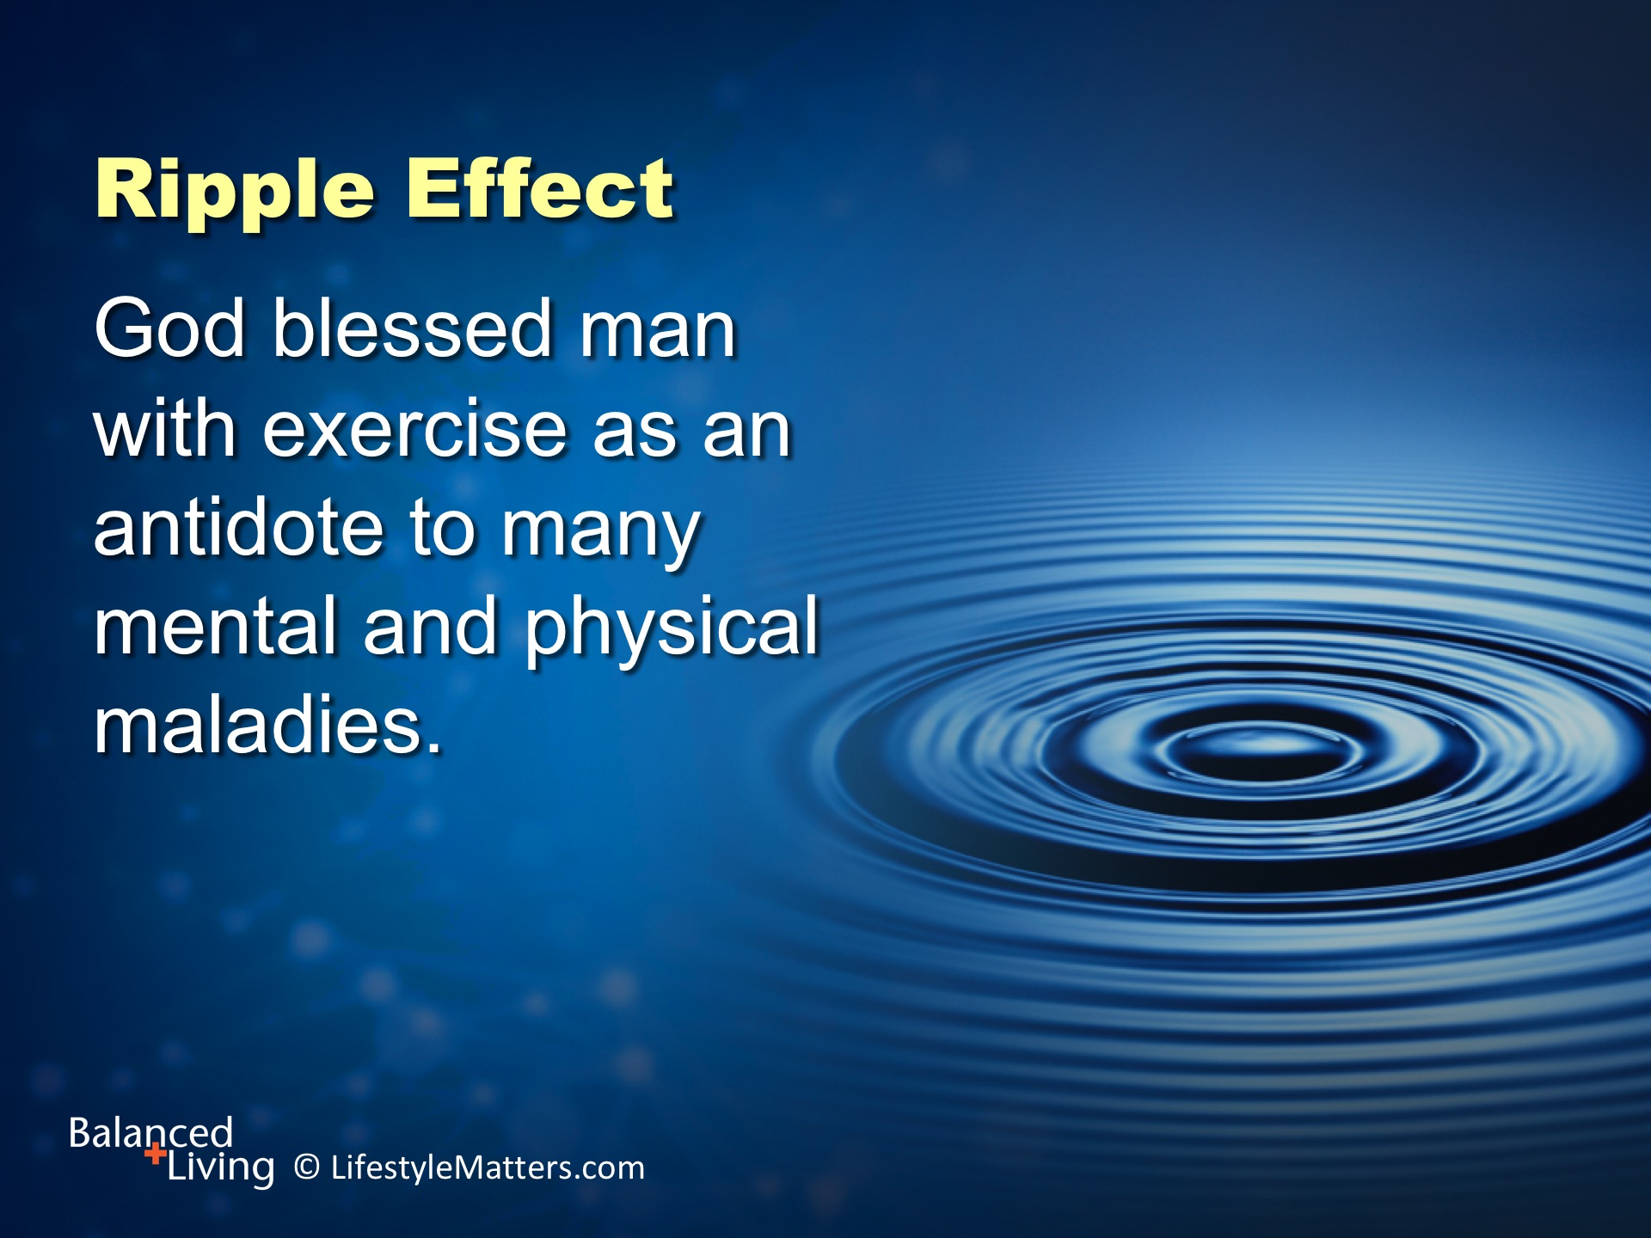
Notes:
Read slide.
God loves “turn around” stories too.
He has designed you for renewal, restoration, and recovery to build physical, emotional, and mental strength.
He can even place new desires and impulses within you.

Slide 17
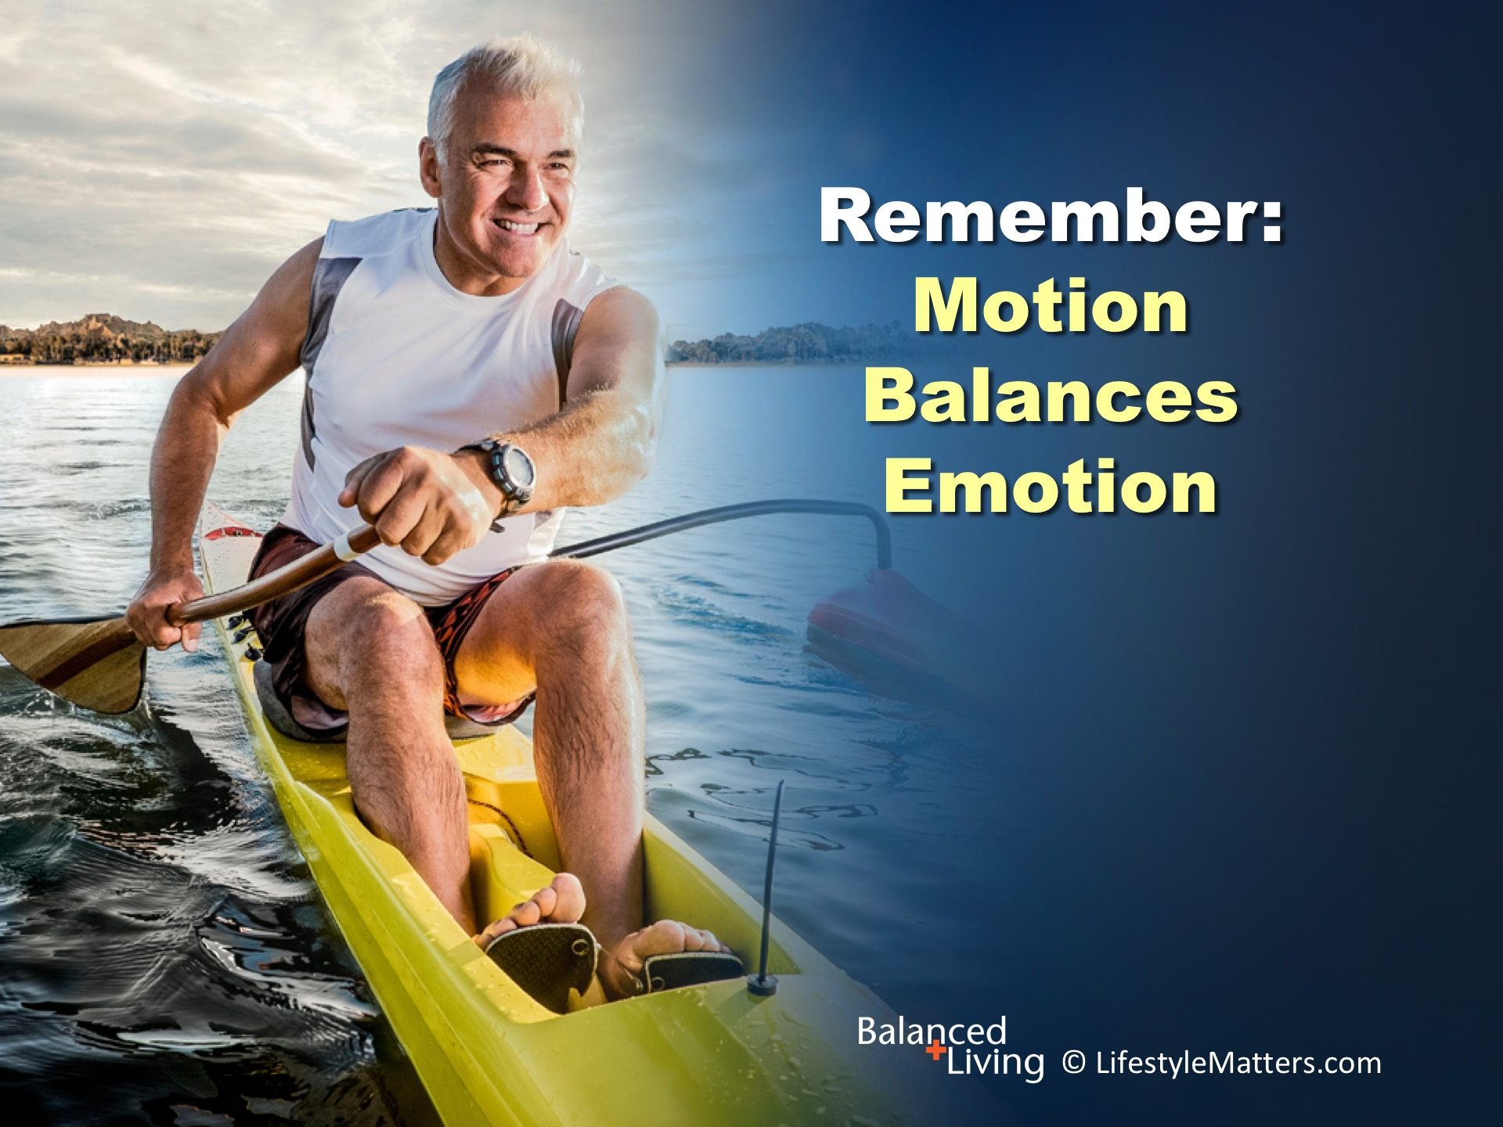
Notes:
Read slide.
The principle is simple.
According to Dr. John Ratey, “the more fit you are, the more resilient your brain becomes and the better it functions both cognitively and psychologically. If you get your body in shape, your mind will follow.”
What is “resilience?” (wait for response) It’s the ability to “bounce back” and work through challenges. It is a factor in emotional stability.
(Reference: John Ratey; Spark, p. 247)

Slide 18
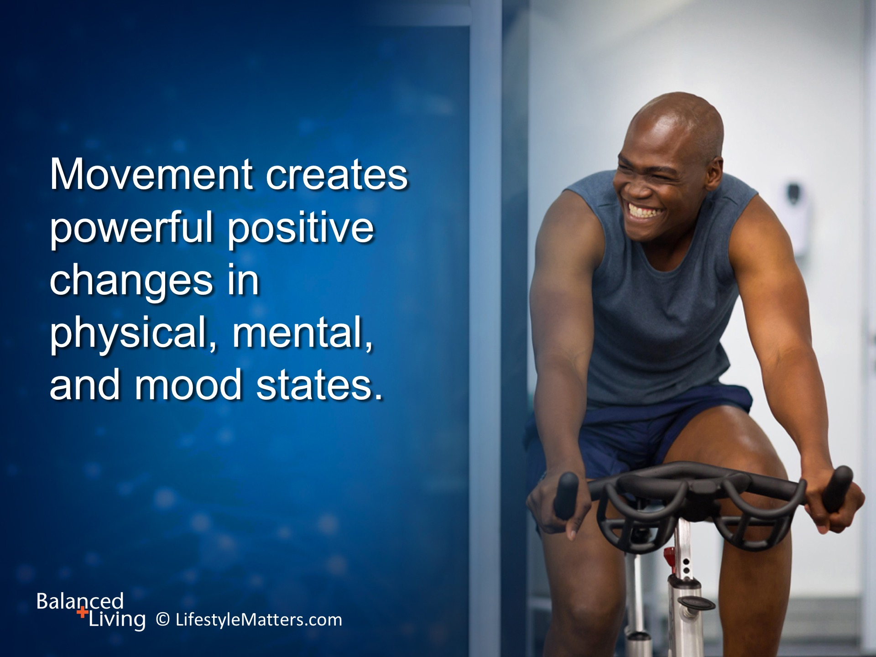
Notes:
Read slide.
Would you agree with me that many of us do not take advantage of this tool as much as we can?
Starting a day with exercise will enhance mood, memory, learning and behavior.
Movement helps shift your mood from depression to more optimism.

Slide 19
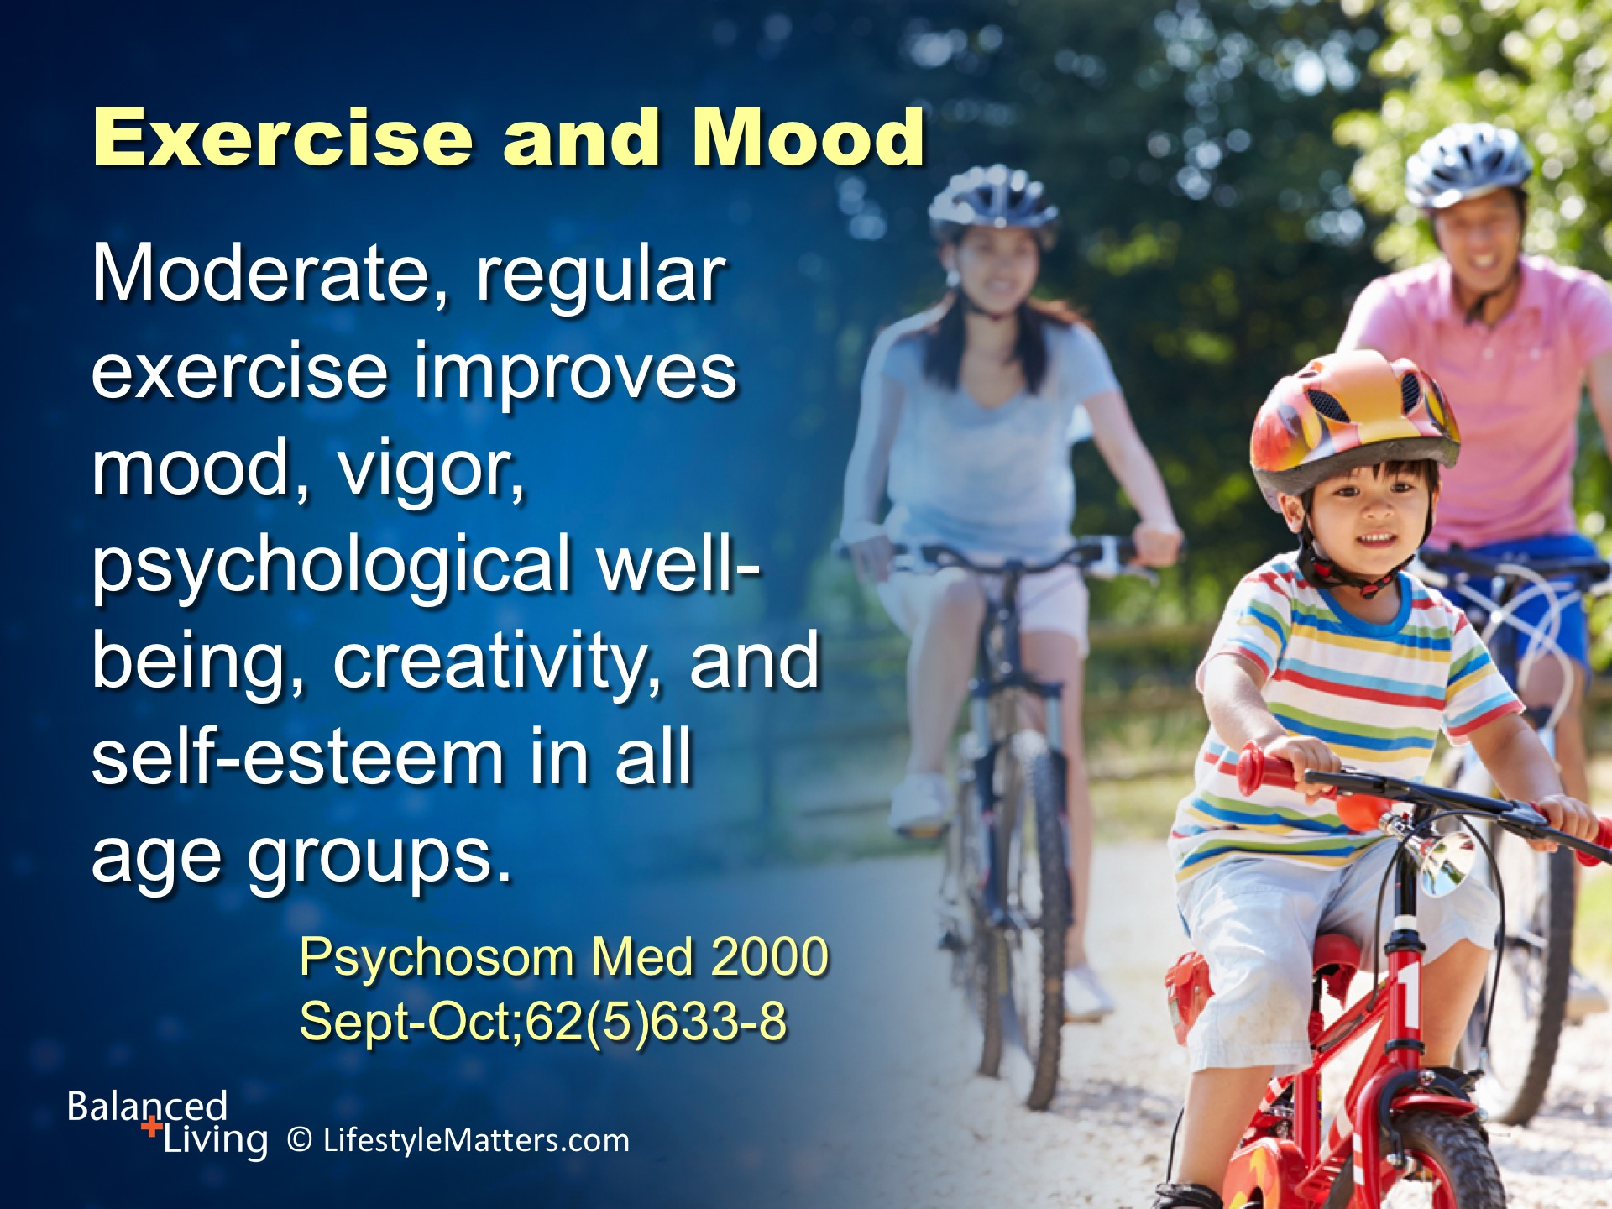
Notes:
Read slide.
Modest increases yield big dividends!
Just 10 minutes of brisk walking can increase your mood for the next hour.
Start with taking a 10 minute walk after meals or maybe adding 10 minutes to your established walking program.

Slide 20
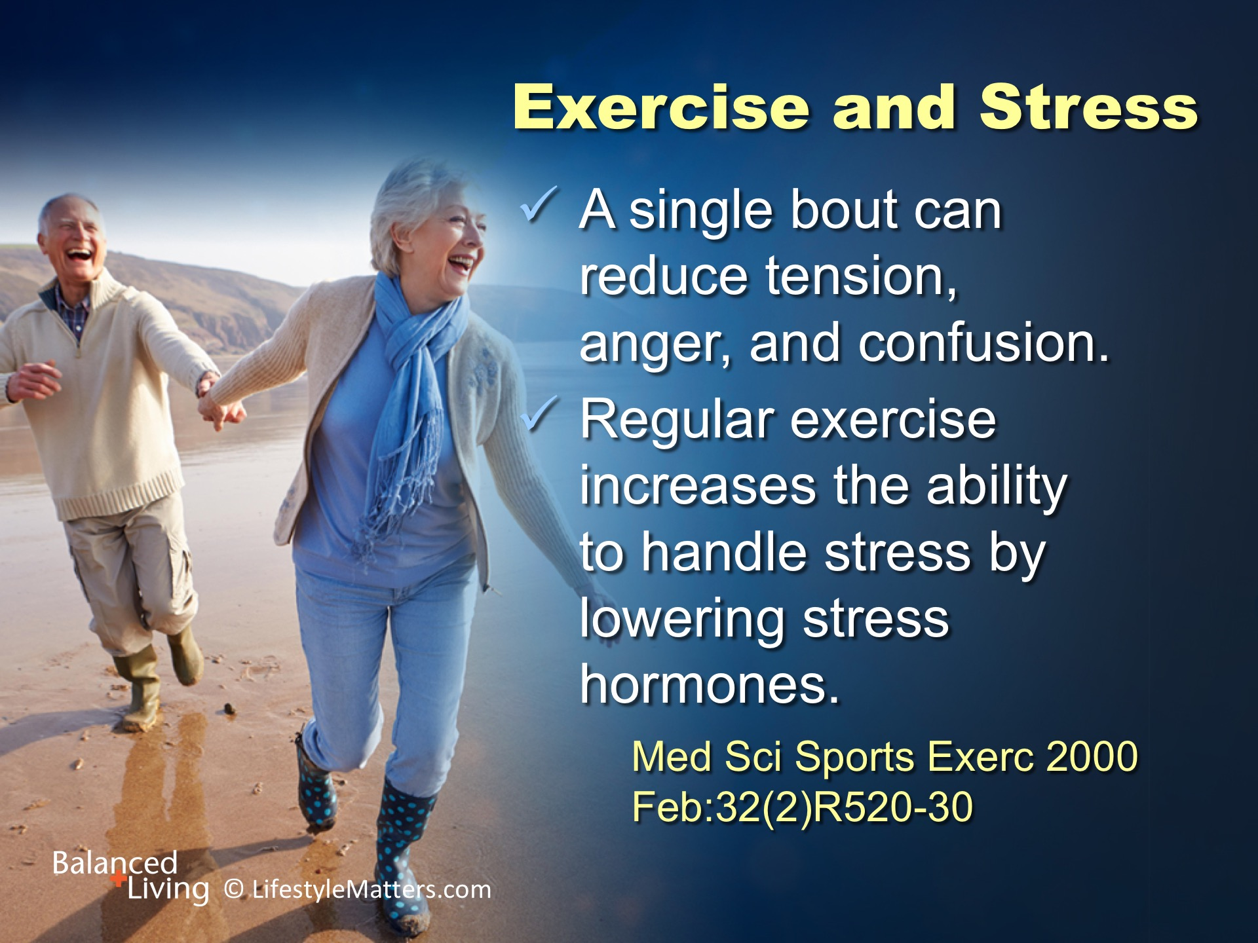
Notes:
Read slide.
Exercise lowers stress hormones and increases hormones linked to well-being.
Exercise early in the day creates resilience to handle stress.
Exercise later in the day helps “burn up” built up stress.
When your blood gets pumping, your brain functions at its best.

Slide 21
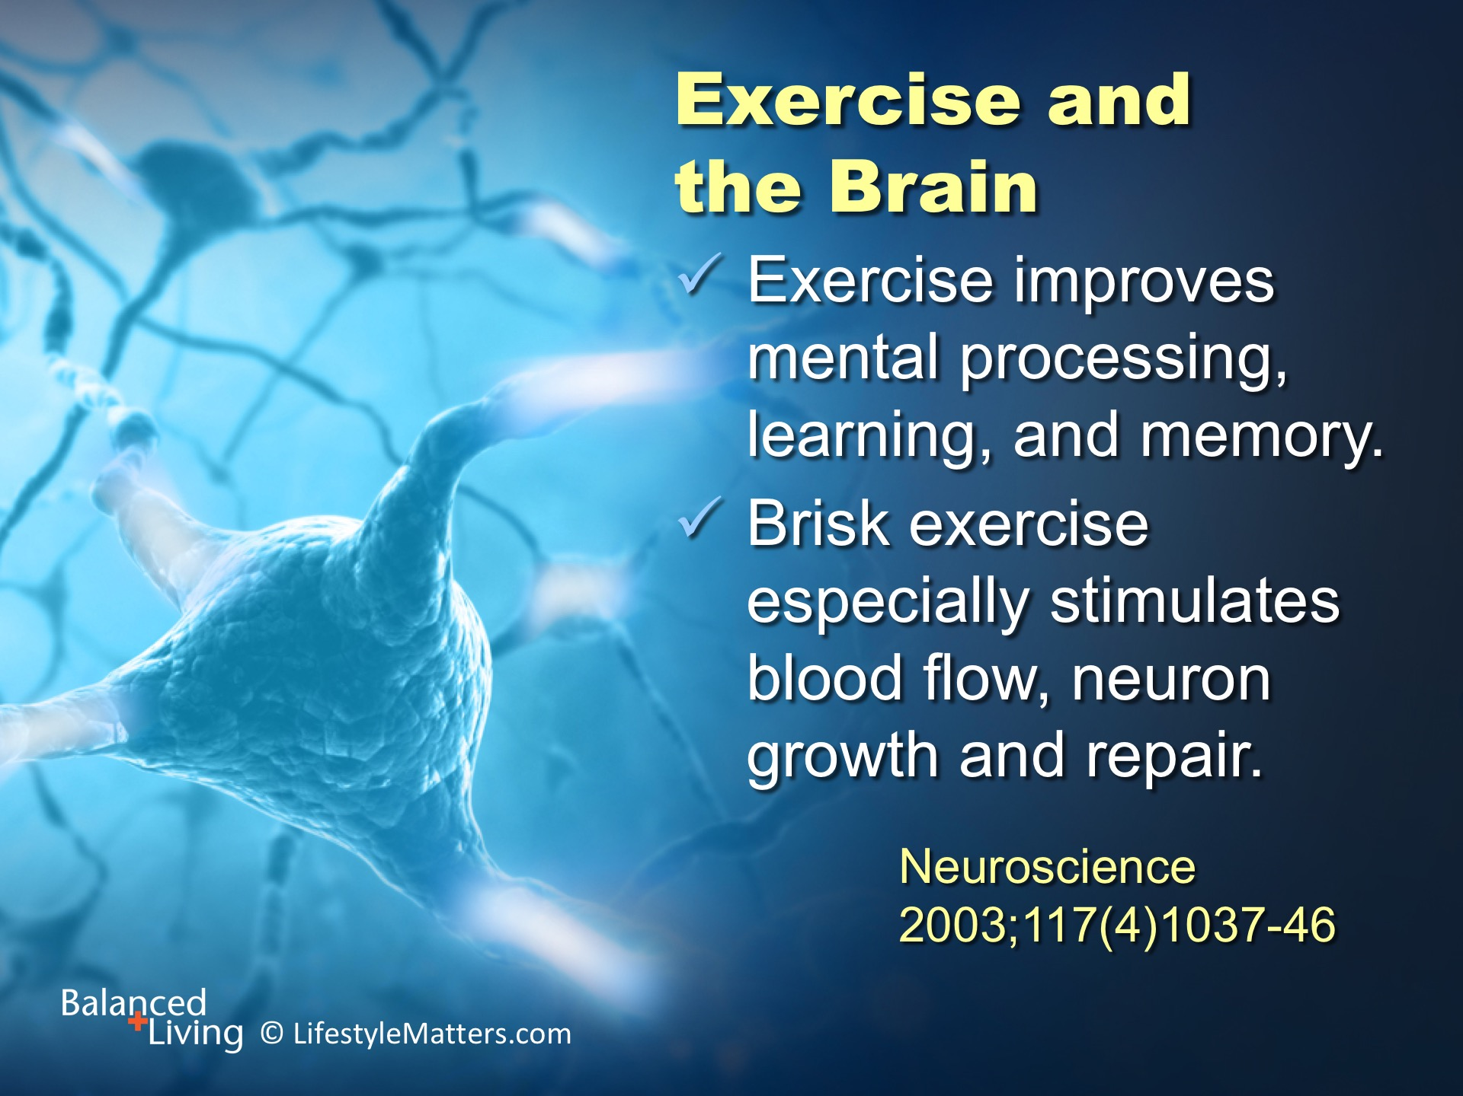
Notes:
Read slide.
Exercise stimulates production of new neurons in the brain. New neurons are born in the hippocampus when you exercise.
We used to think you had all the brain cells that you would ever have when you are born.
Now we know this is not true. Brain cells are born throughout your life, even in older years, with exercise.
Exercise can help reduce risk for dementia and Alzheimer's disease where brain connections have been eroded.
Exercise forces the brain to connect, work, and get back into action.
Learning and memory are sharpened with daily exercise.

Slide 22
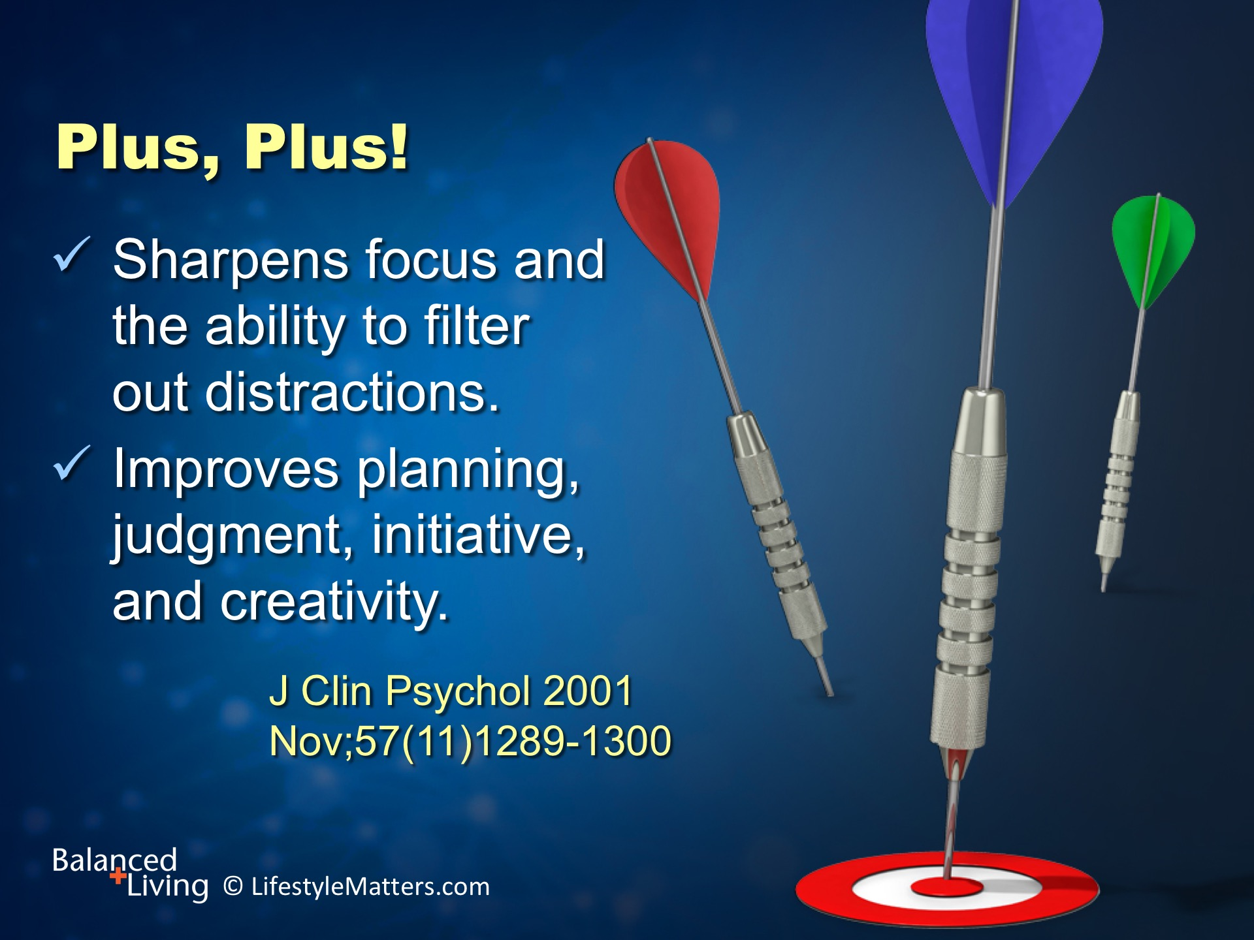
Notes:
Read slide.
Movement helps your brain stay mentally sharp.
Amazingly, the areas of the brain linked to creativity and planning share the same areas of the brain that govern movement!
(Reference: John Ratey; Spark, p. 3)

Slide 23
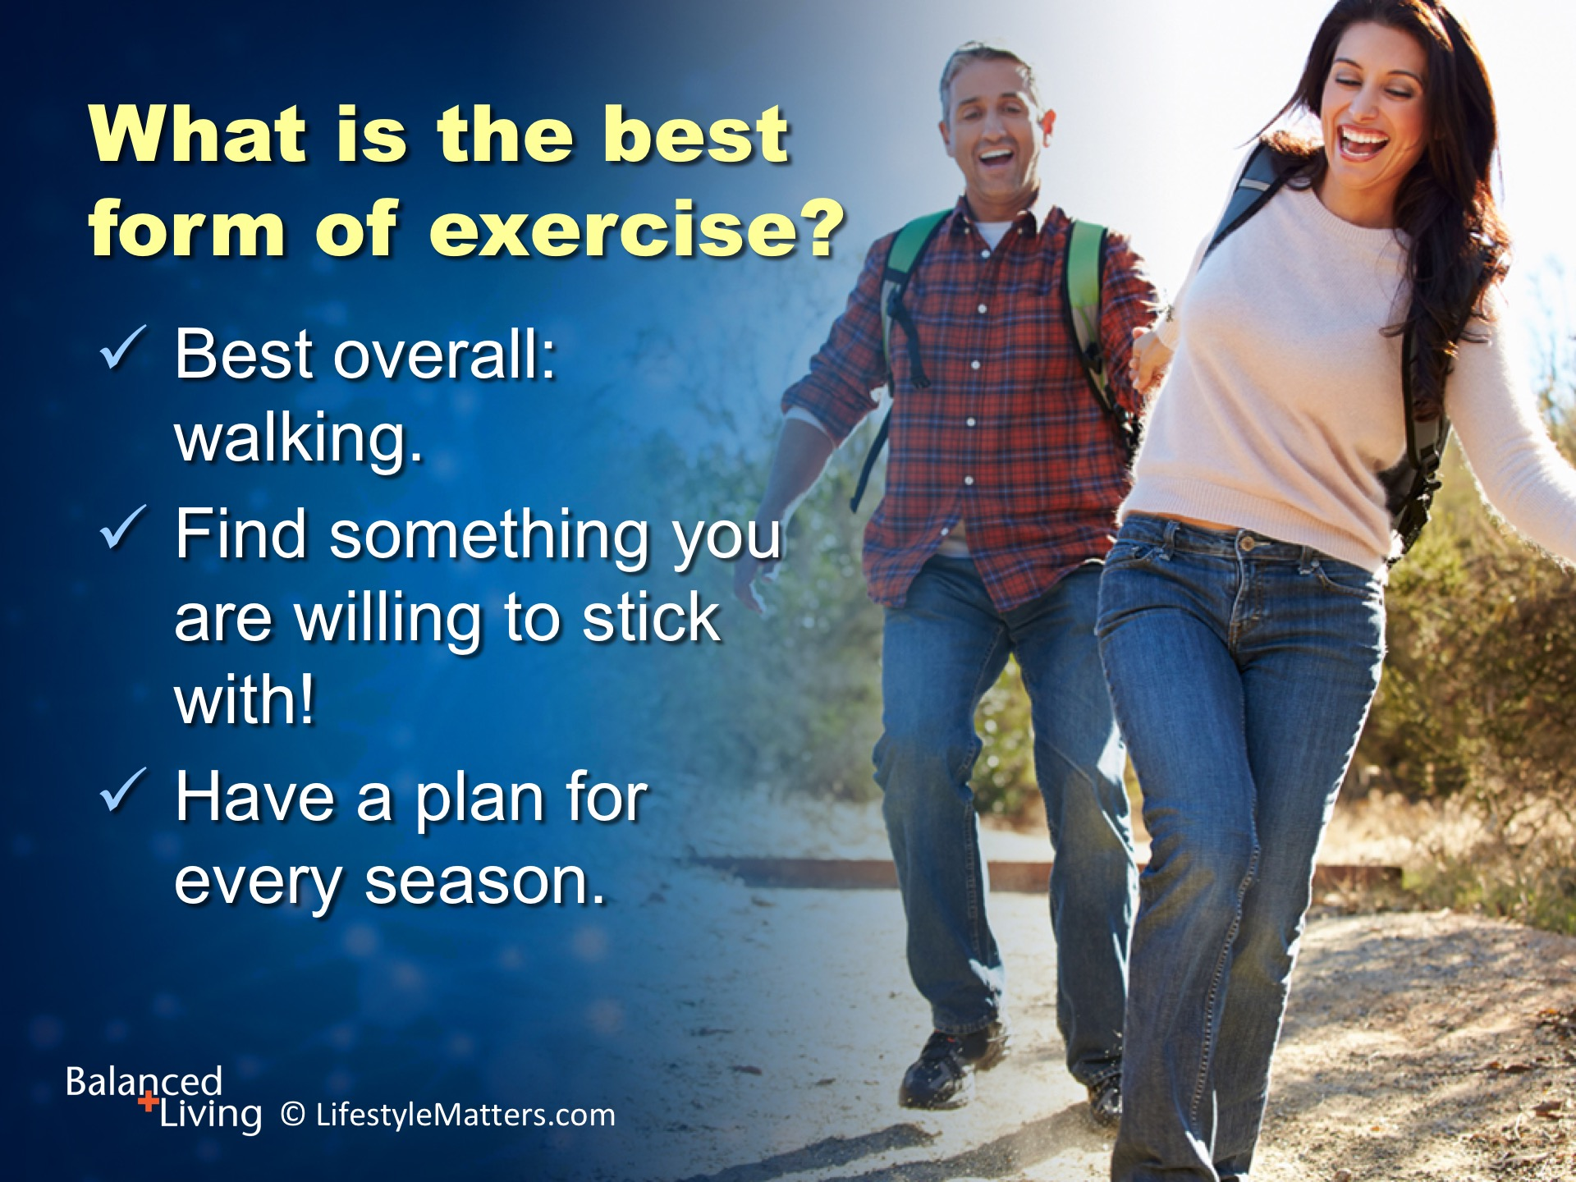
Notes:
Read slide.
What’s the best exercise for you? (wait for response)
Bottom line: it’s the one you will do!

Slide 24
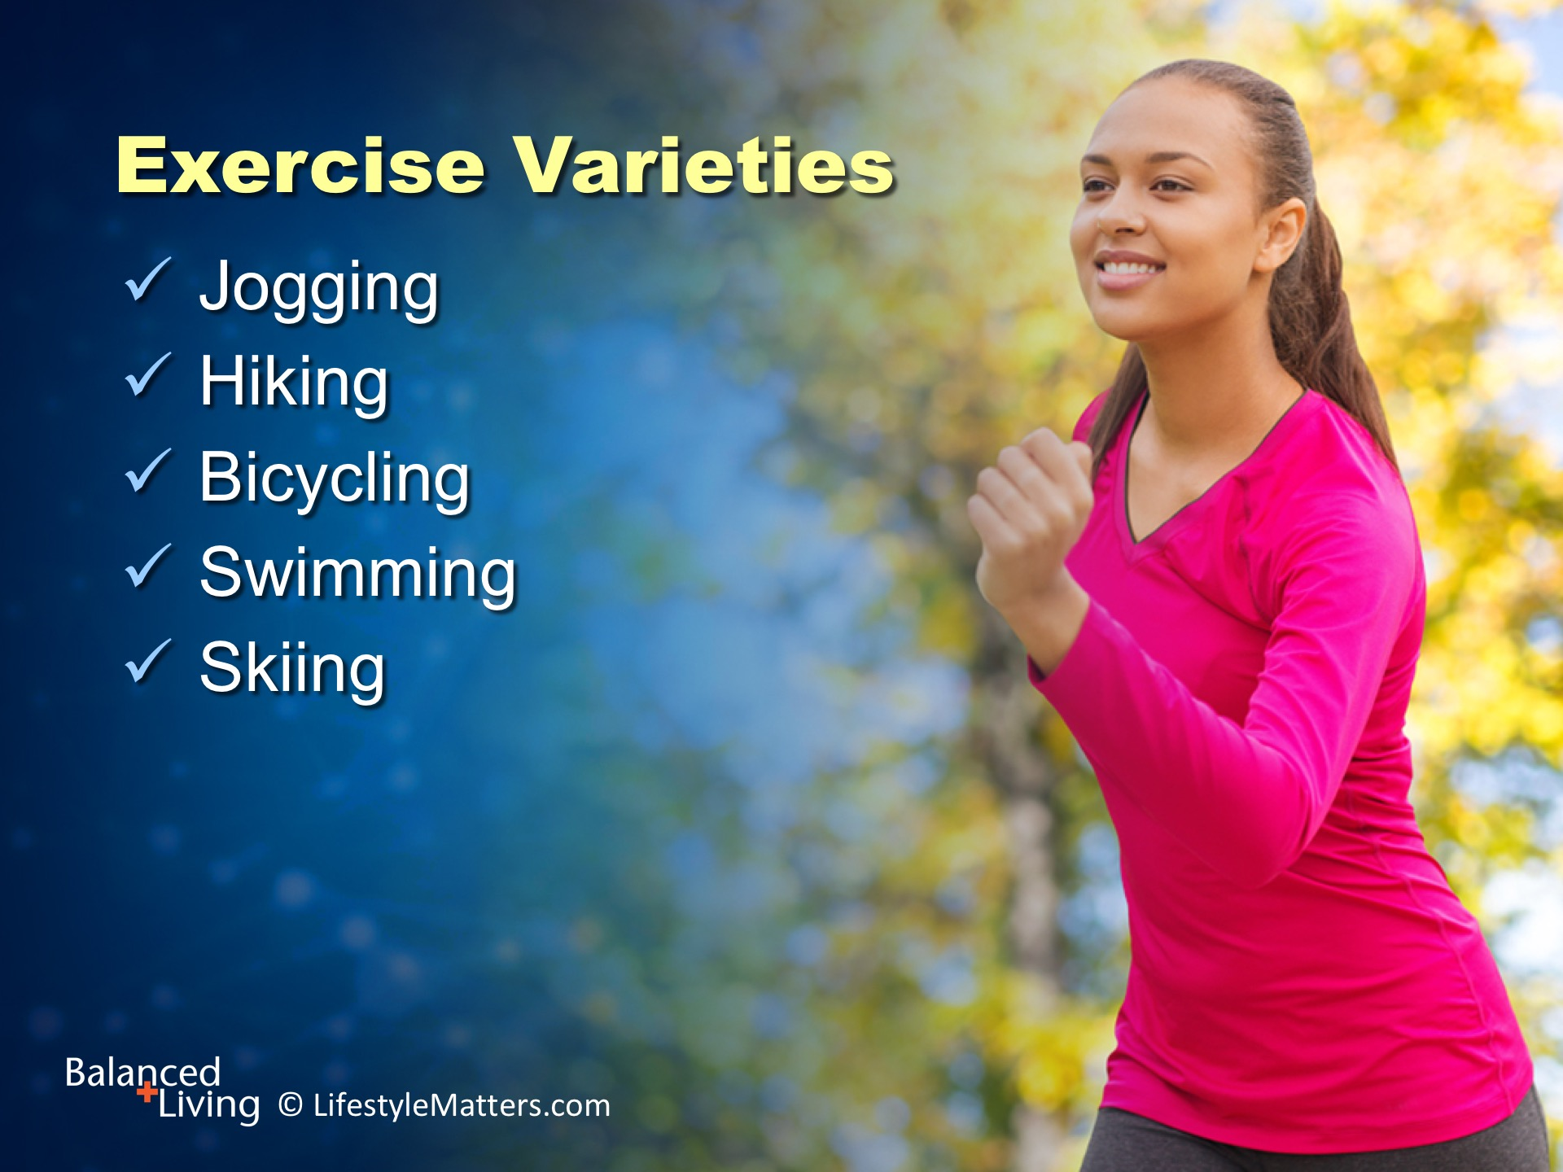
Notes:
Read slide.
The question we need to ask ourselves each day is not “Am I going to exercise, but WHEN and WHERE am I going to exercise!”

Slide 25
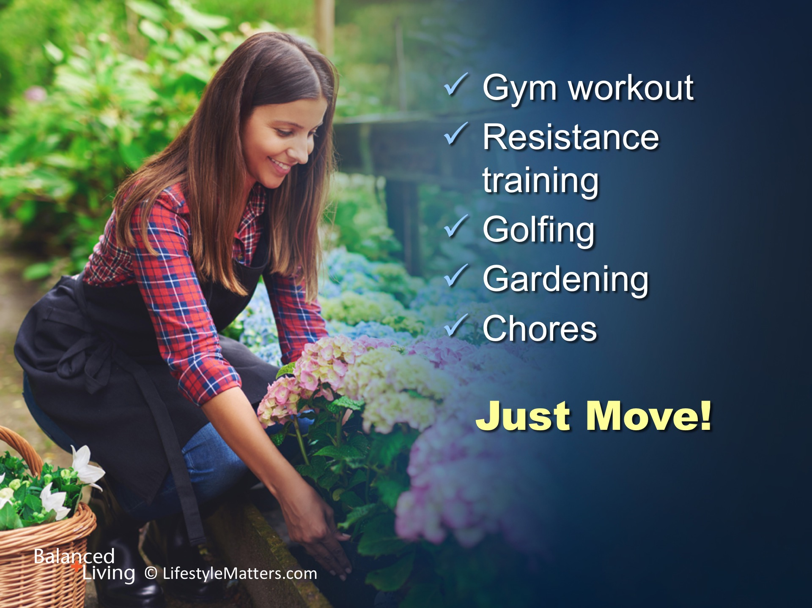
Notes:
Read slide.
Mix it up for variety! That will encourage improvement in strength, flexibility, balance, and aerobic (heart) health.

Slide 26
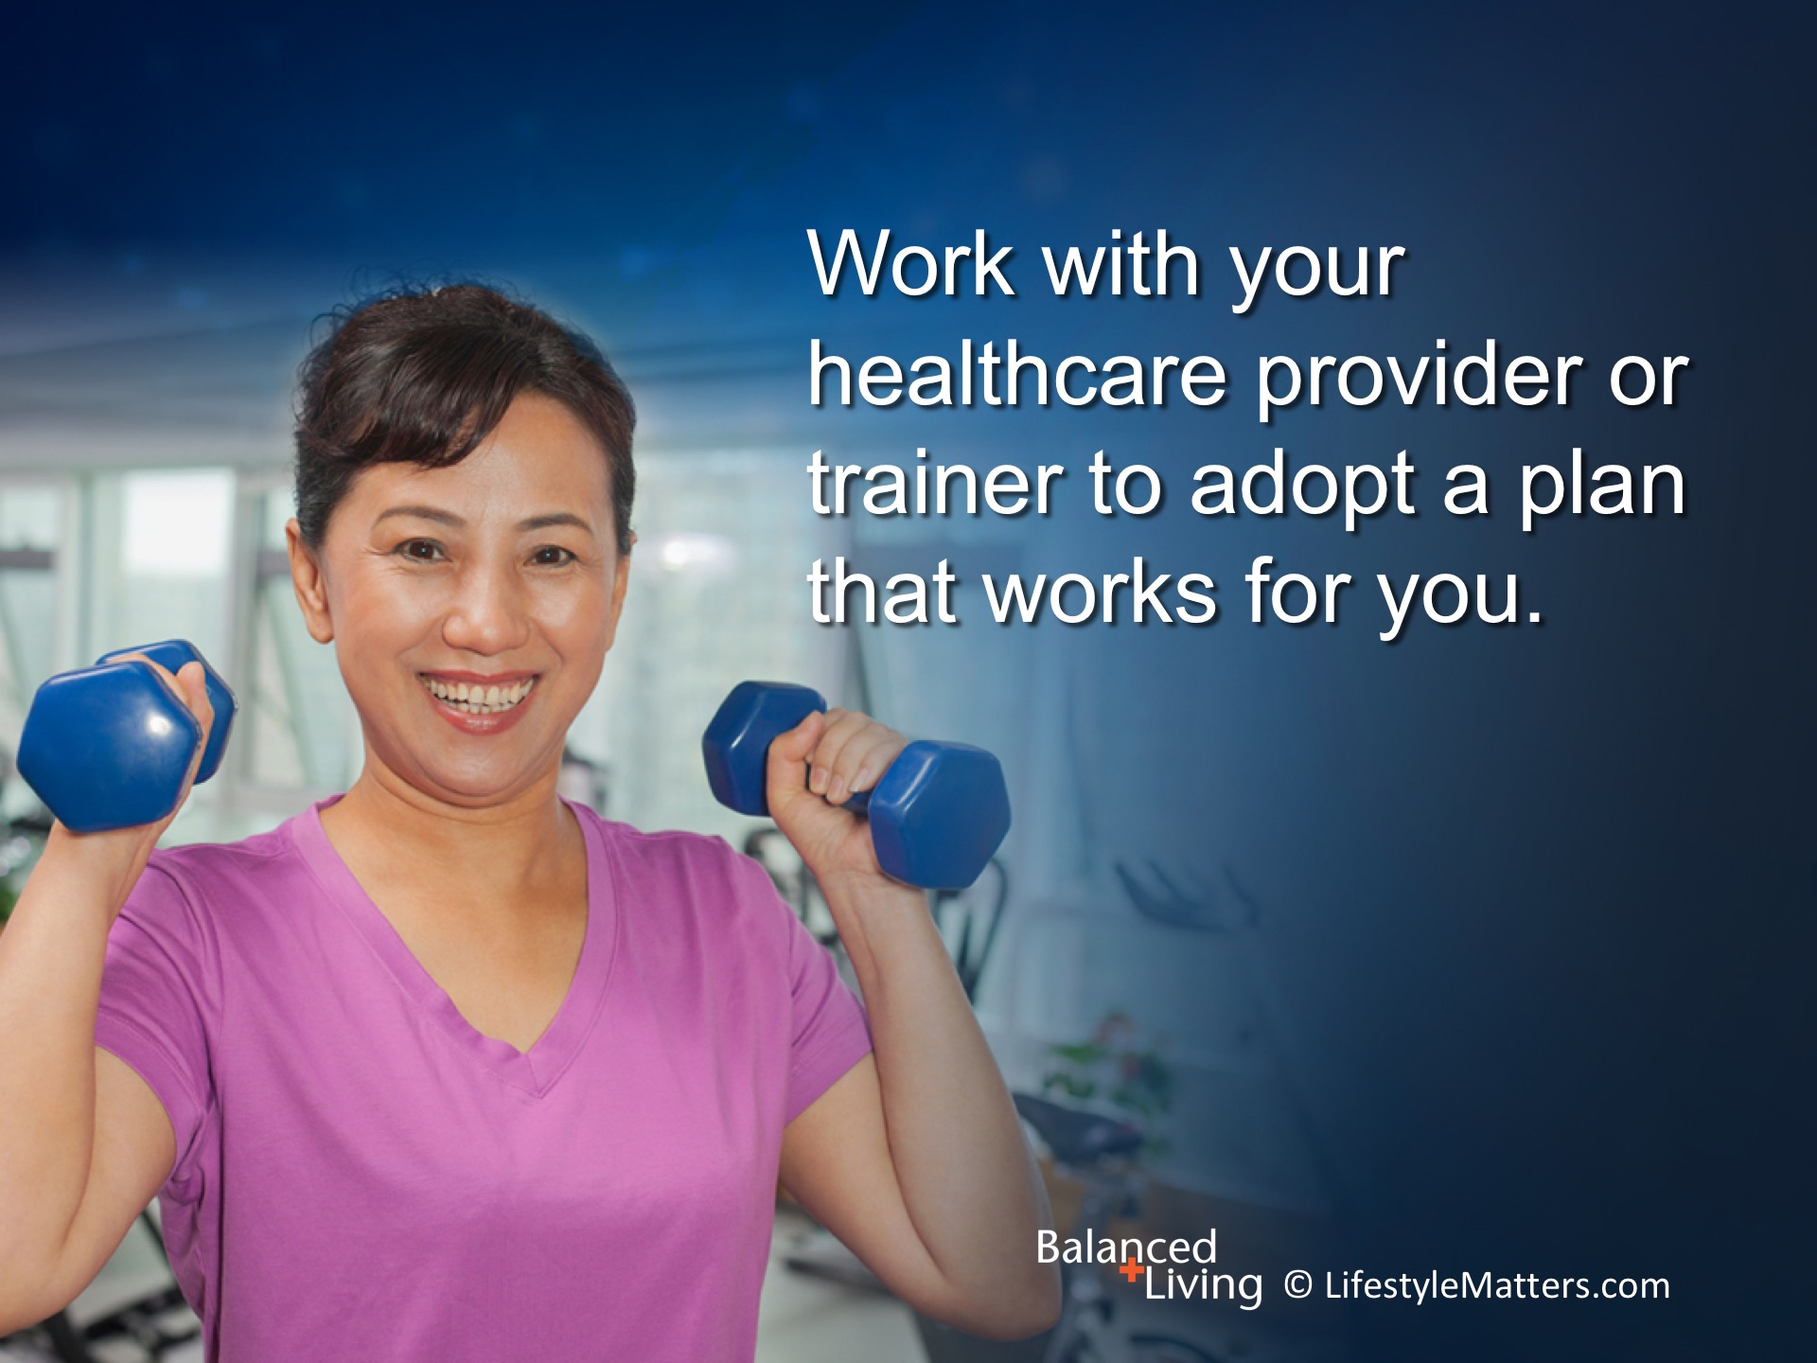
Notes:
Read slide.
About 2,000 steps equals one mile. Do you have device to count your steps?
Track your steps for a couple of days. Then try to add about 500 more steps in your day.
Walk that number of steps a few days and then gradually add more steps.
If you are in good health, a reasonable goal is 10,000 steps a day which is about 5 miles.

Slide 27
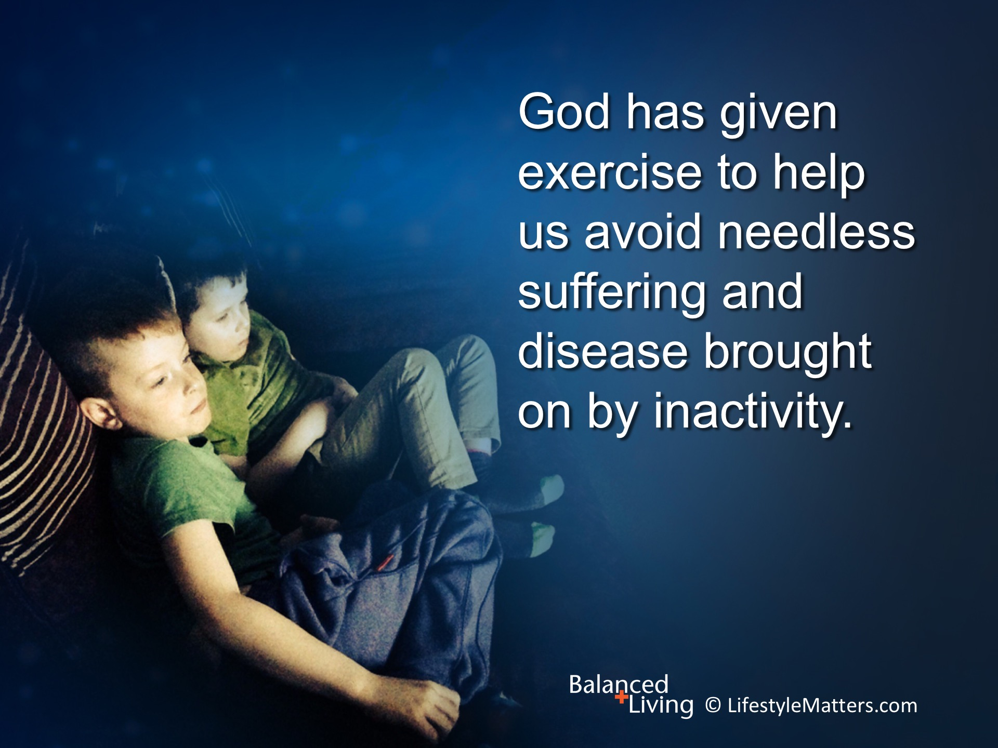
Notes:
Read slide.
Exercise also helps control appetite and reduce cravings for snacks and sweets.

Slide 28
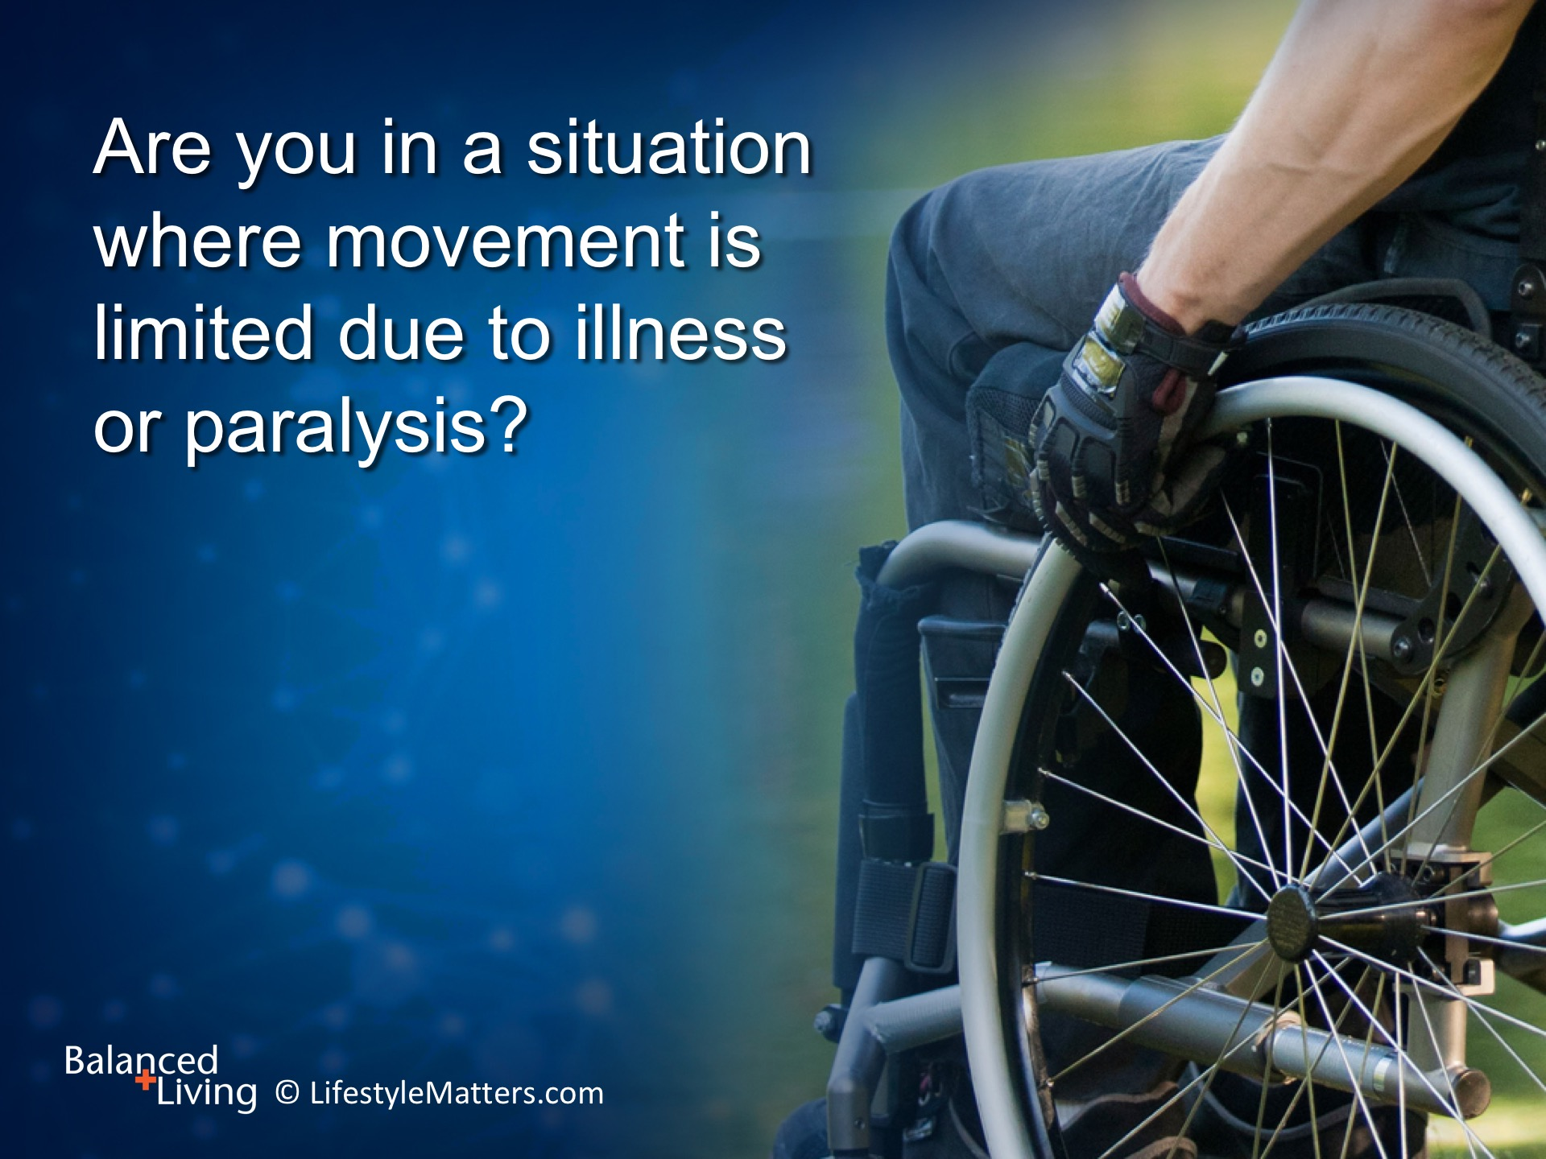
Notes:
Read slide.
You may be in a situation of limited movement.
Fix your focus on what you CAN do, not what you can’t.
If your legs are limited, exercise with your arms. Work with a physical therapist to design a program tailored to your need.

Slide 29
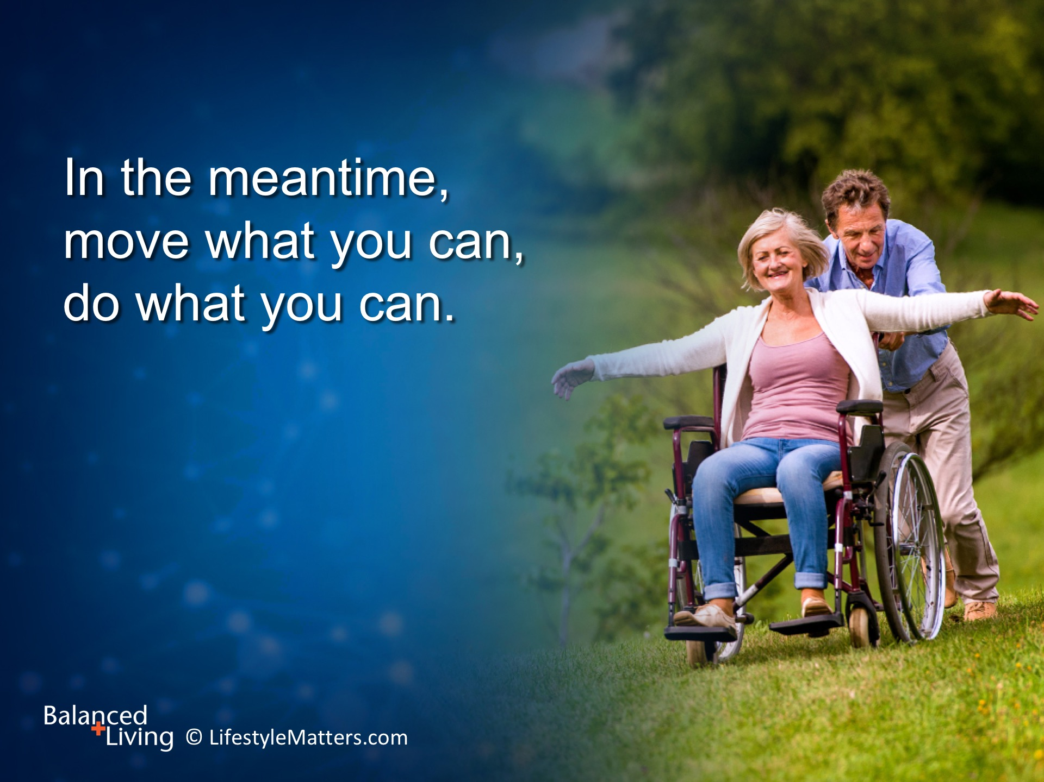
Notes:
Read slide.
God is waiting to give you the will and desire to live a better life.
He died for you and He has a plan. He wants to import will-power; way-power; and Word-power!
What might your life look like if you take Him up on His offer? (wait for response)
God wants to add value to the life you have now—but there is more…

Slide 30

Notes:
Read slide.
Exercise is vitally connected with lifestyle and nutrition.
From the beginning, we were designed to move.
What exercise are you going to enjoy this week? (wait for response)
God blessed man with exercise as an antidote to many mental, physical, and emotional maladies, and He will help you improve—as you get up and move!

