Slide 1


Images © Alamy
www.alamy.com
Images used in powerpoint presentation are part of the presentation and not to be used out of context of the presentation, may not be used as stand-alone images unless to promote the presentation/event, and may not be resold in singular form or as part of an image library. Images are © Alamy and presentation templates and content therein are © MISDA, any other usage requires written permission from both parties.

Slide 2
Scripture quotations used in Balanced Living PowerPoints are taken from Bibles in the Public Domain which have no USA copyright restrictions. We have indicated which version each quotation is taken from as follows:
KJV - King James Version
BBE - Bible in Basic English
WEB - World English Bible
DBY - Darby's Translation
Any scriptures not otherwise noted are the author's paraphrase of one of these versions.

Slide 3

Notes:
Read slide.
In this session we are talking about a topic that can really put people on edge!

Slide 4

Notes:
You guessed it—we’re talking about caffeine—and we are asking the question: Read slide.
Is caffeine harmless, or can it constitute an addictive drug?
We will also take a look at sugary drink consumption and consider some healthy alternatives.

Slide 5
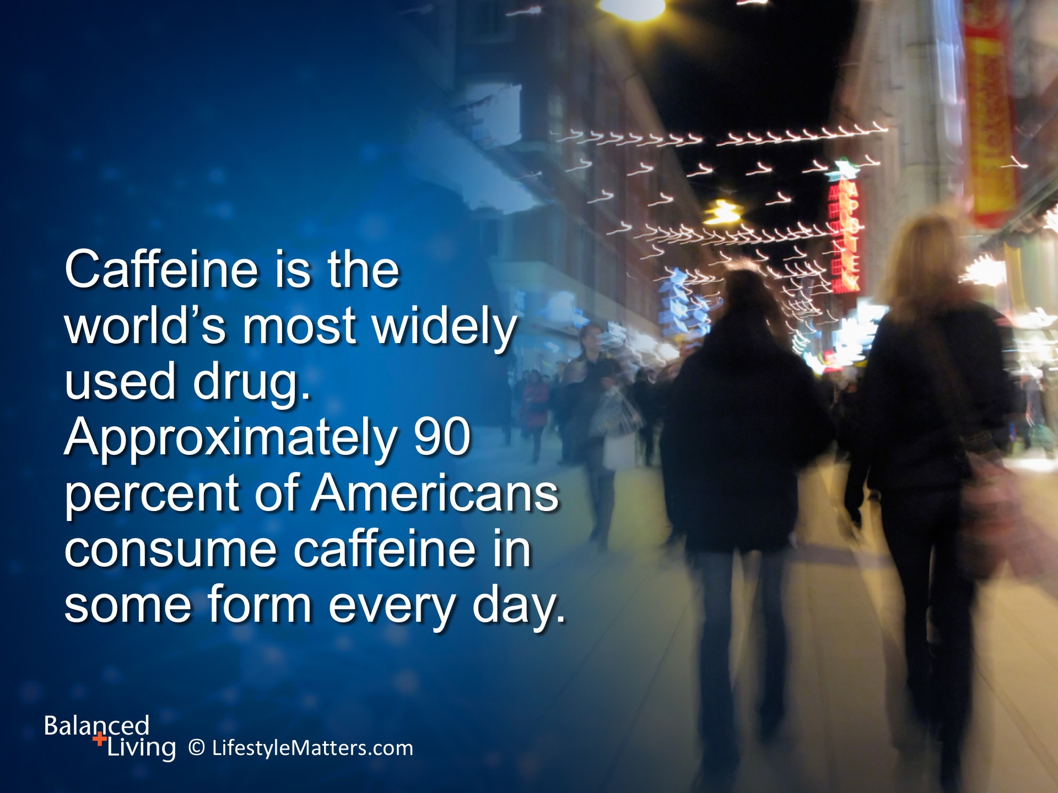
Notes:
Read slide.
When it comes to caffeine consumption, it’s a real game of “RUSHING ROULETTE.” Why?
Just one cup of coffee a day can create dependency and cause withdrawal symptoms.
It has been dubbed the “bad habit glue” because it can make other drugs like nicotine more addictive.

Slide 6
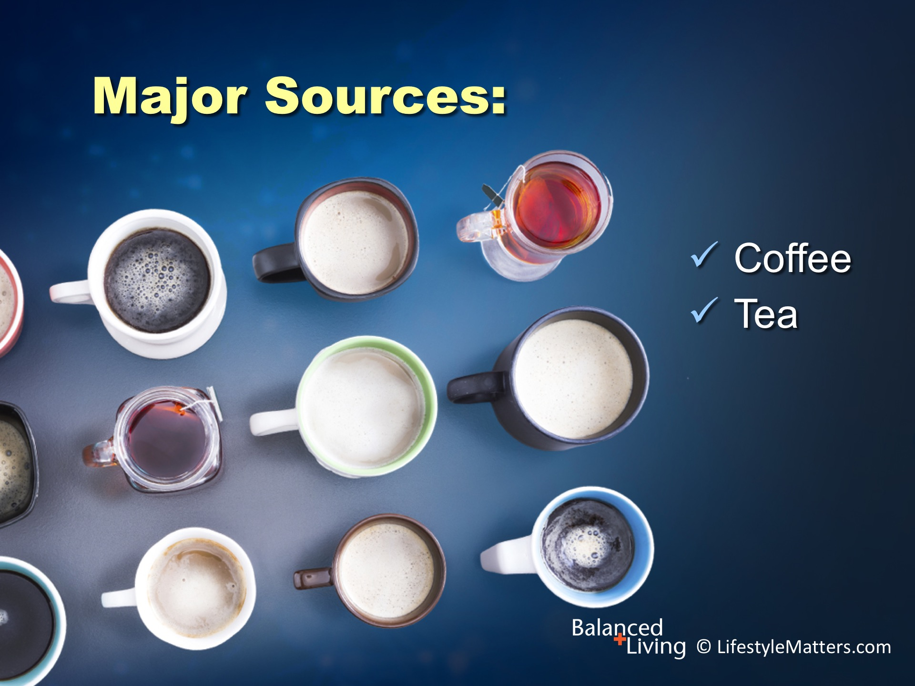
Notes:
The major sources of caffeine among adults are: Read slide.
Americans consume 587 million cups of coffee per day, or about 3 cups per person.
The daily intake of more than half of Americans is 300 mg per day, and 30 percent consume more than 500 mg.

Slide 7

Notes:
We are now also seeing a dramatic increase in the use of highly caffeinated: Read slide.

Slide 8
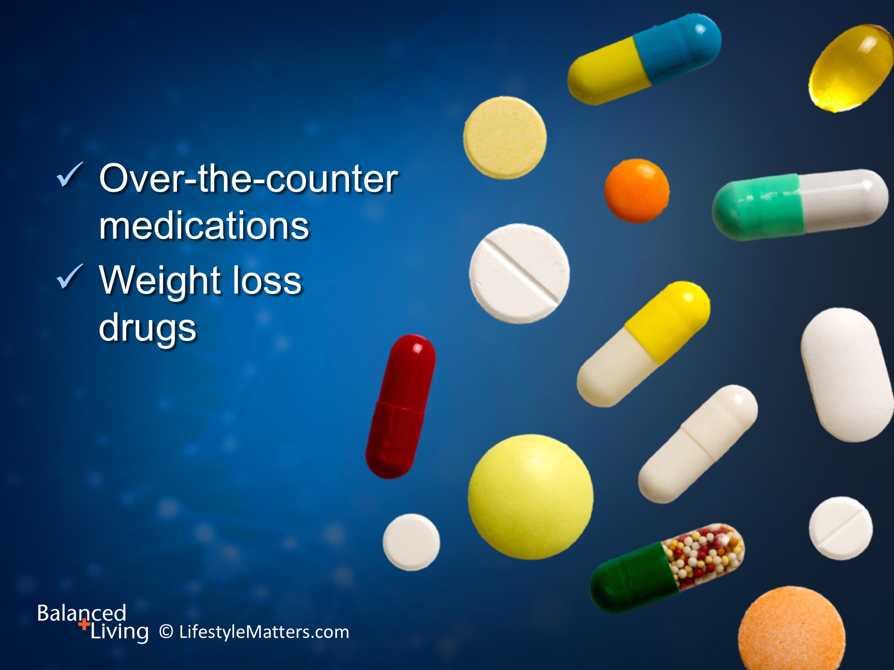
Notes:
Caffeine is also readily available in: Read slide.

Slide 9
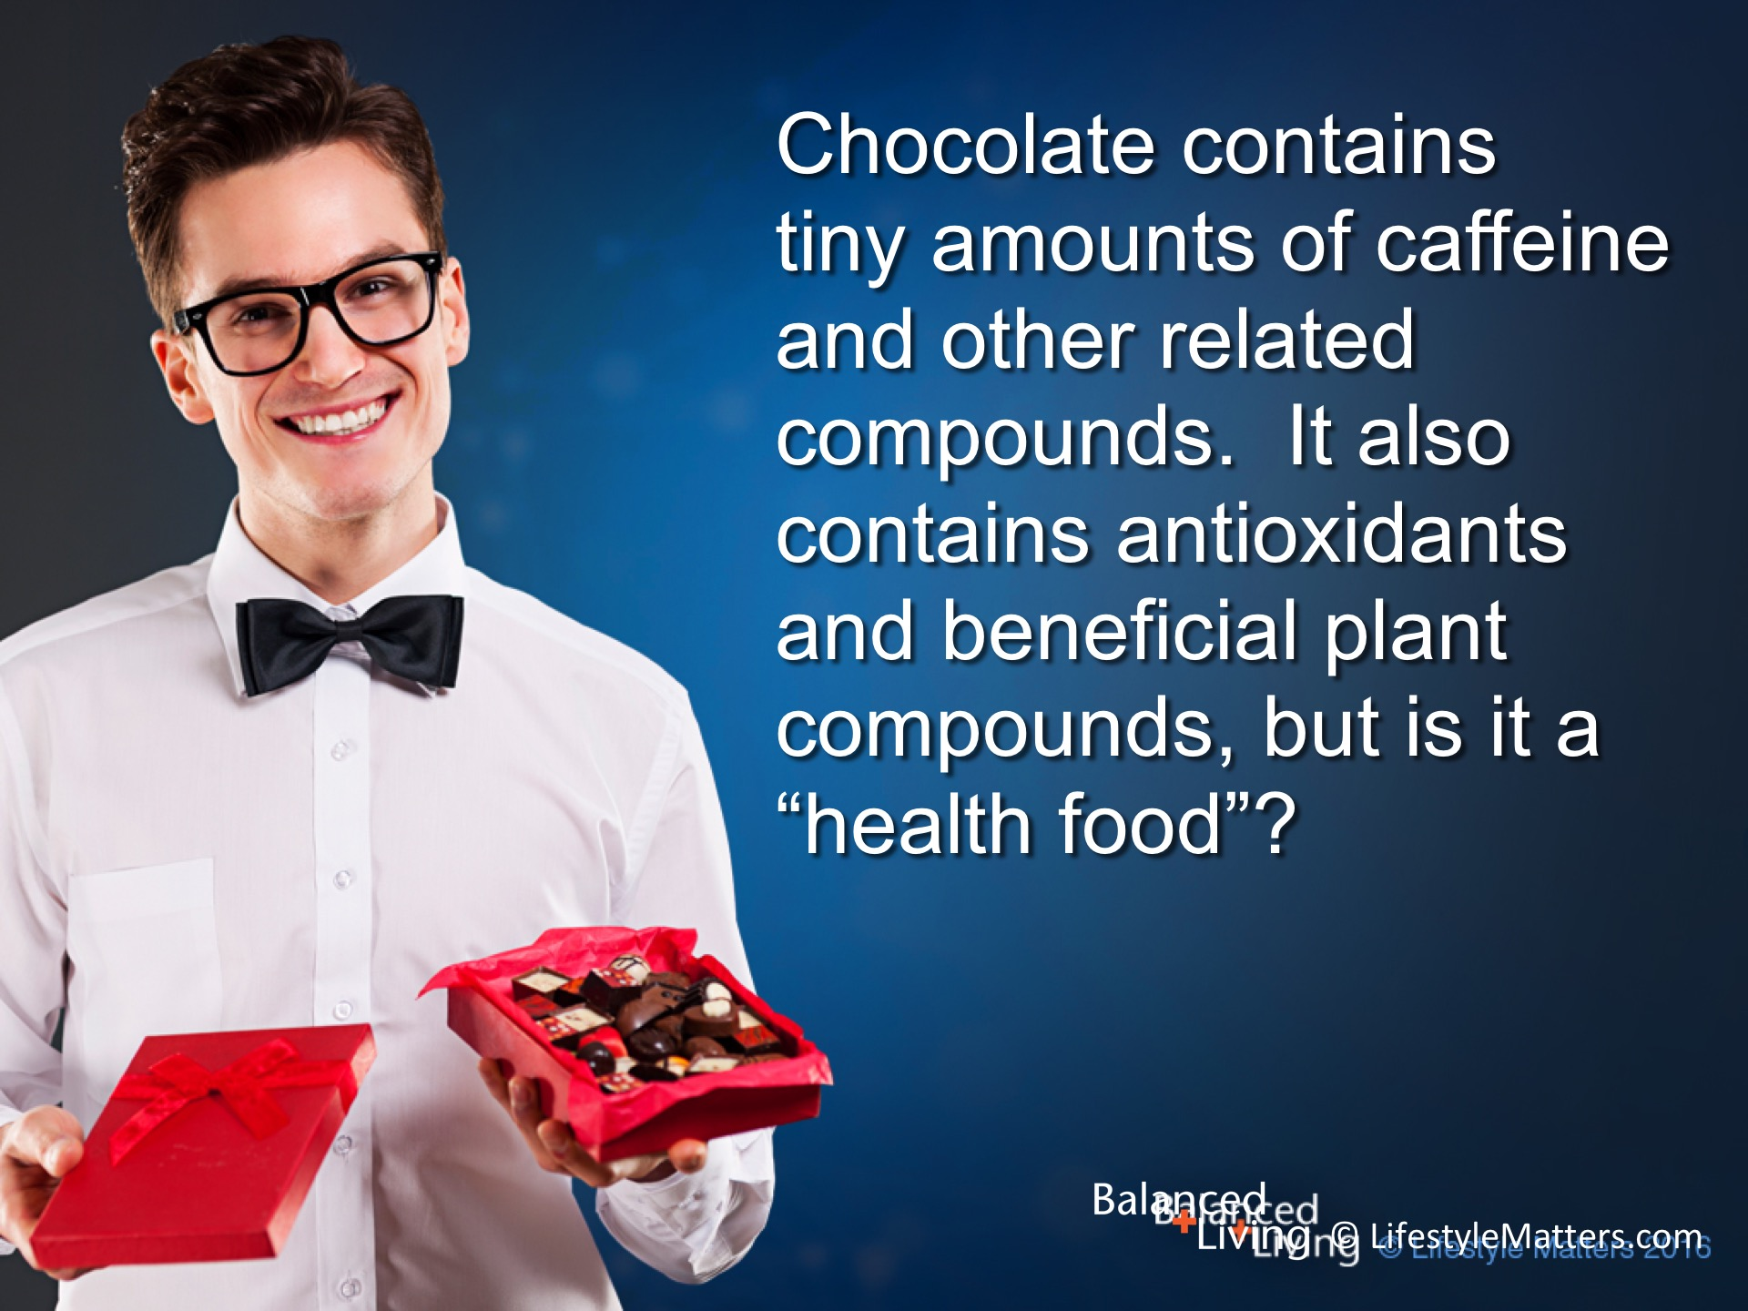
Notes:
What about chocolate? Read slide.

Slide 10
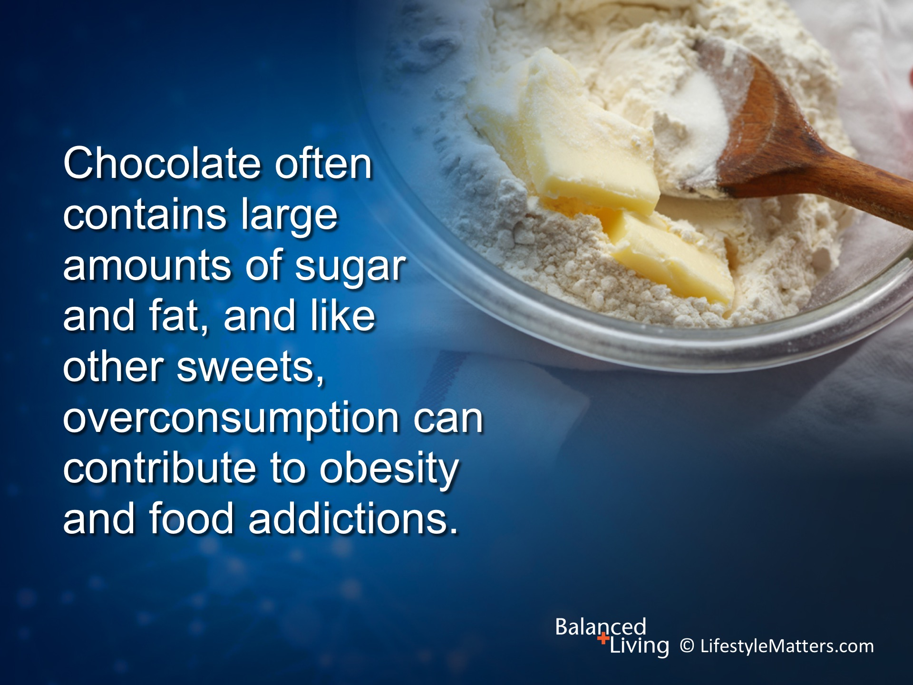
Notes:
Read slide.
Chocolate is not a health food—it is more in the category of an occasional “treat.”
Some people enjoy small amounts of dark chocolate from time to time.
Others prefer carob products as an alternative.

Slide 11
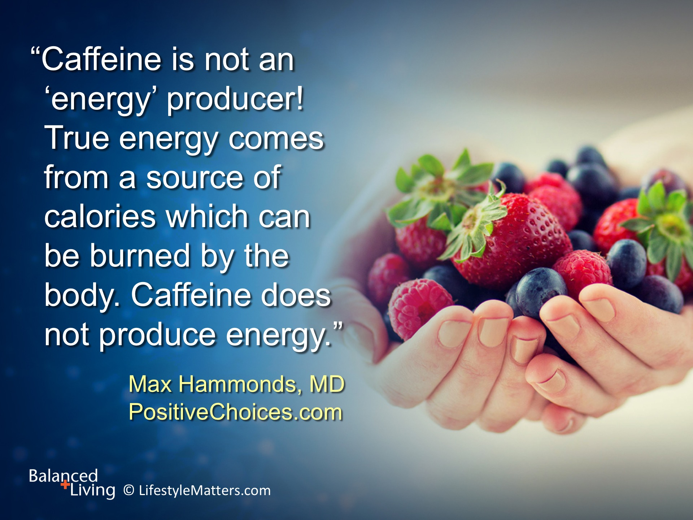
Notes:
The bottom line is: Read slide.
Caffeine gives a sense of alertness and energy but then saps the energy bank account with interest.
It floods your body with stress hormones that may make you feel a rush but then robs you of the deep sleep needed to rejuvenate cells, memory, and immune health.
It’s effects can be likened to a “plastic millionaire” who uses credit cards to live lavishly—but sooner or later the bill comes with greatly inflated interest rates, leaving the spender in debt.

Slide 12

Notes:
Read slide.

Slide 13
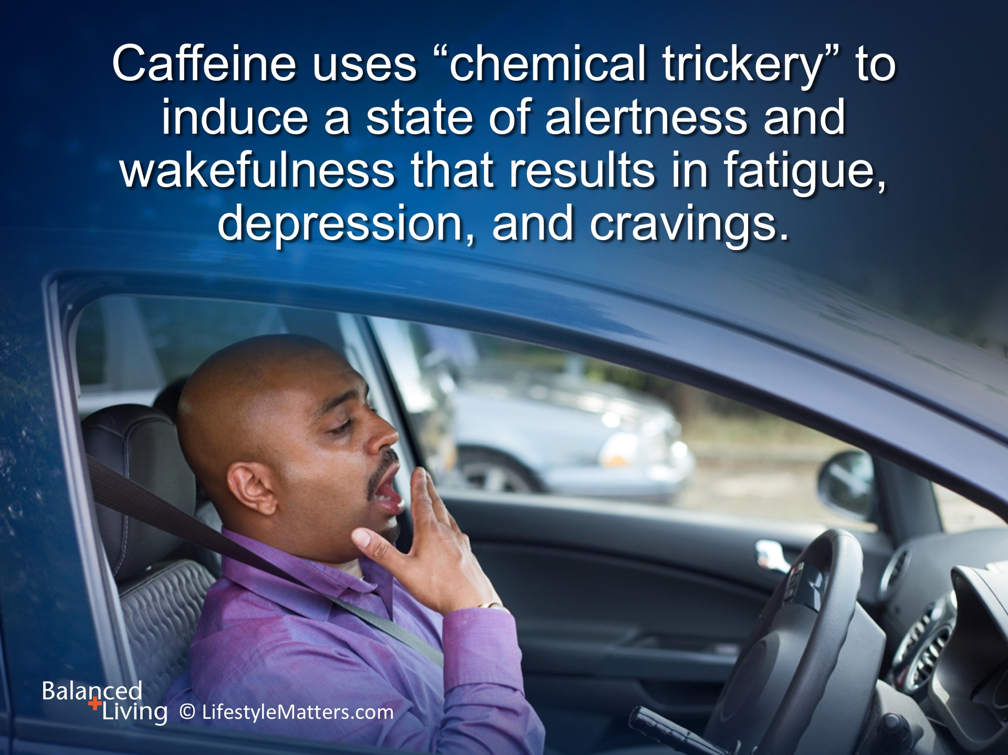
Notes:
Read slide.
Caffeine causes “metabolic mayhem” by injecting stress hormones into the system.
It manipulates dopamine for a quick lift, but the result is often mental fog and depressed mood—even flu symptoms—later on as the drug wears off.
This is one reason why caffeinated drinks often create a strong dependence. The sugar in caffeinated beverages can also add a kicker that calls for more.

Slide 14
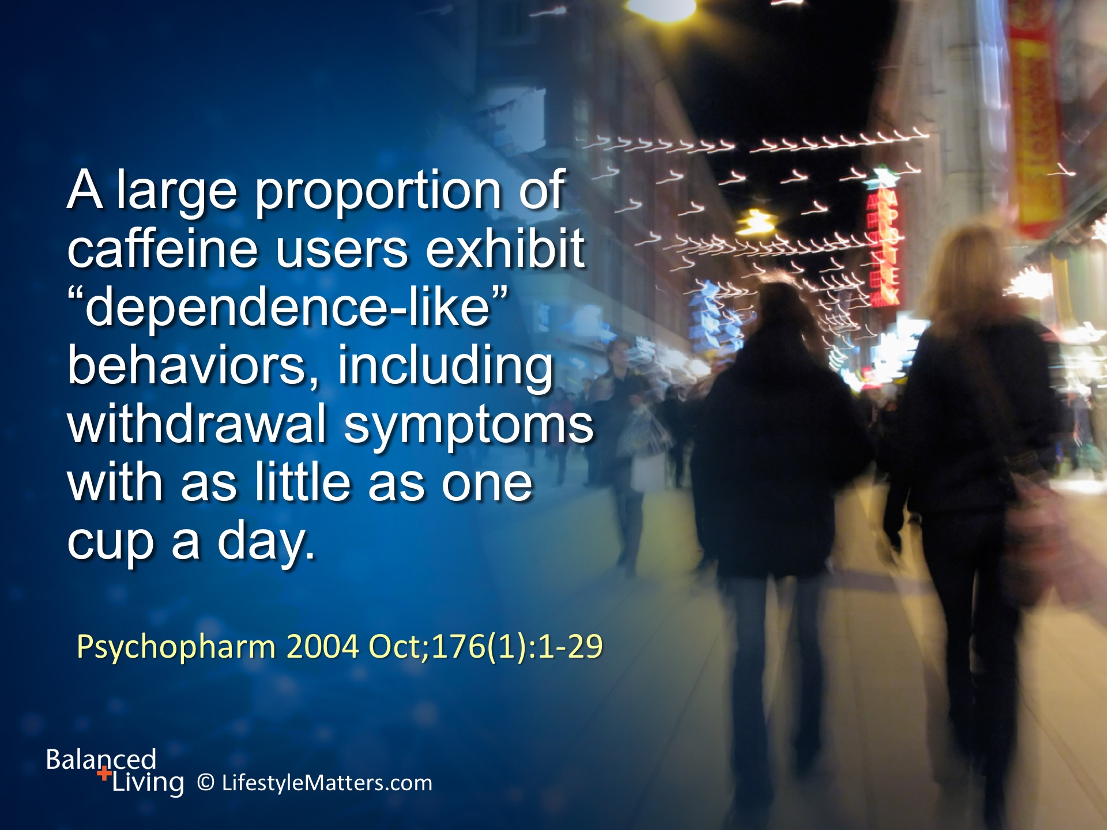
Notes:
Read slide.
What are some of the withdrawal symptoms linked to caffeine? (wait for response)

Slide 15
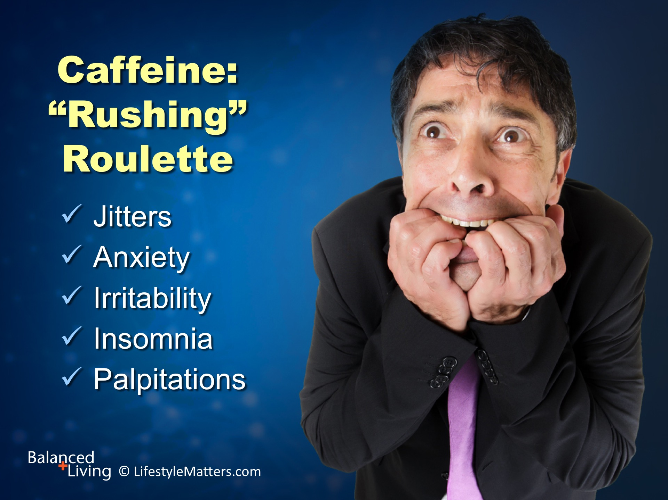
Notes:
Yes, and the list includes (next two slides): Read slide.

Slide 16
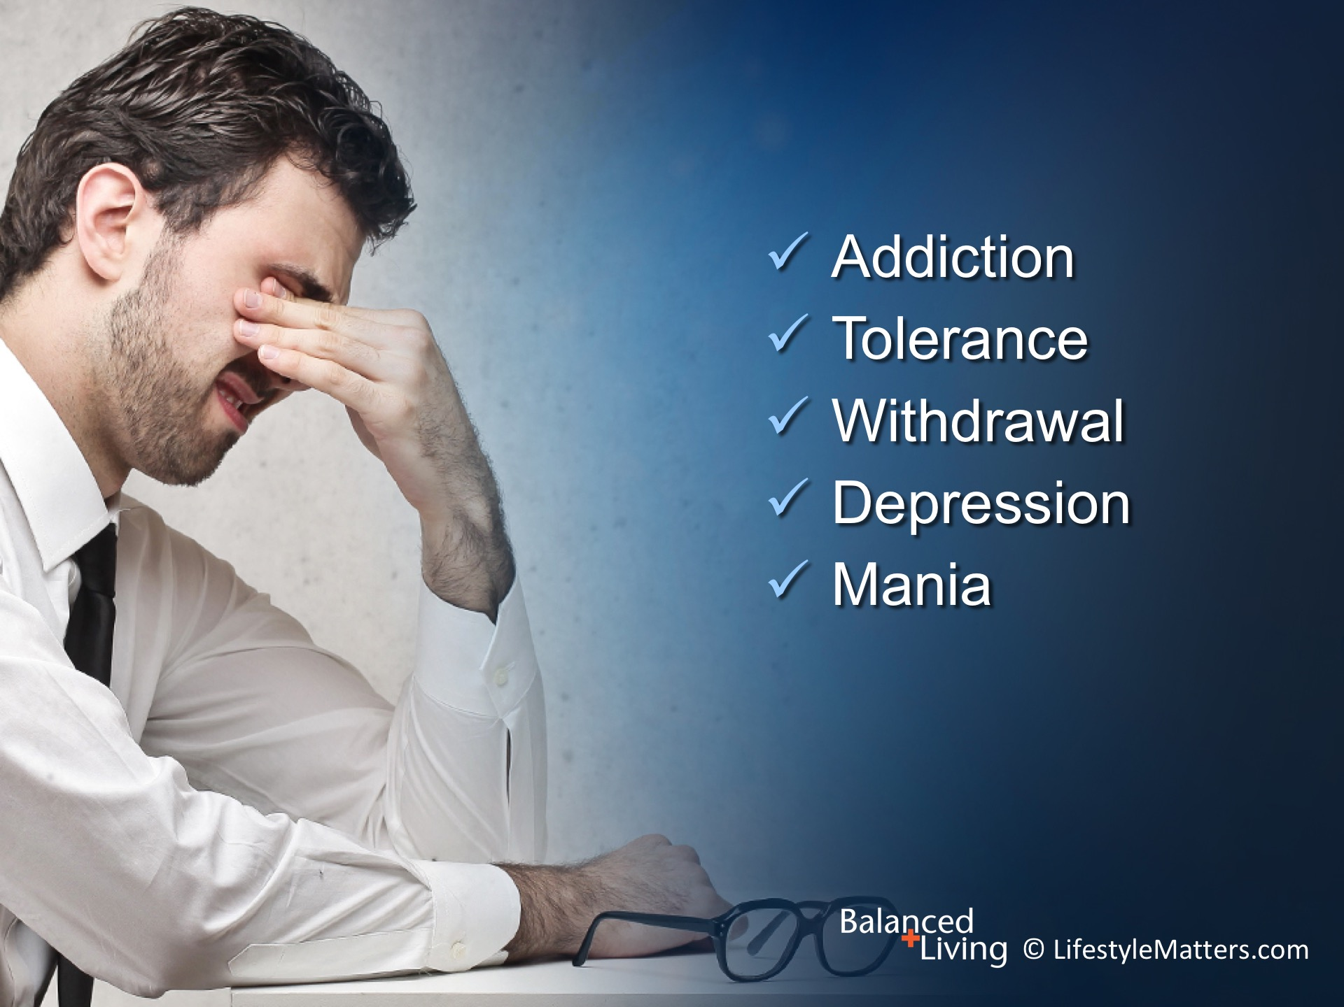
Notes:
Read slide.
Fortunately, those symptoms don’t last forever. The worst is usually over in a few days to a week.
Healing is possible, and full, vibrant natural energy is available!

Slide 17
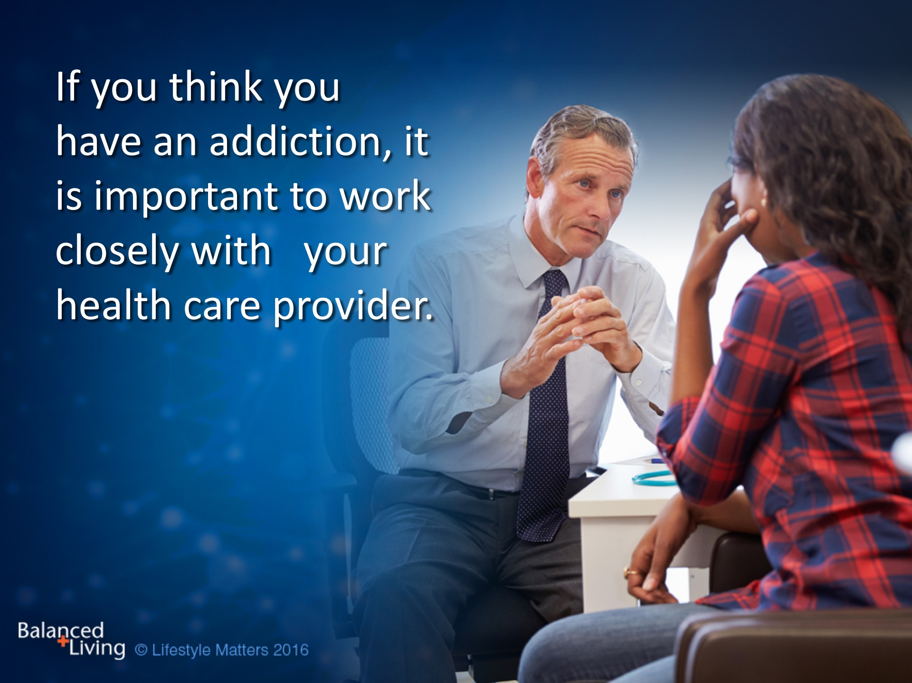

Slide 18
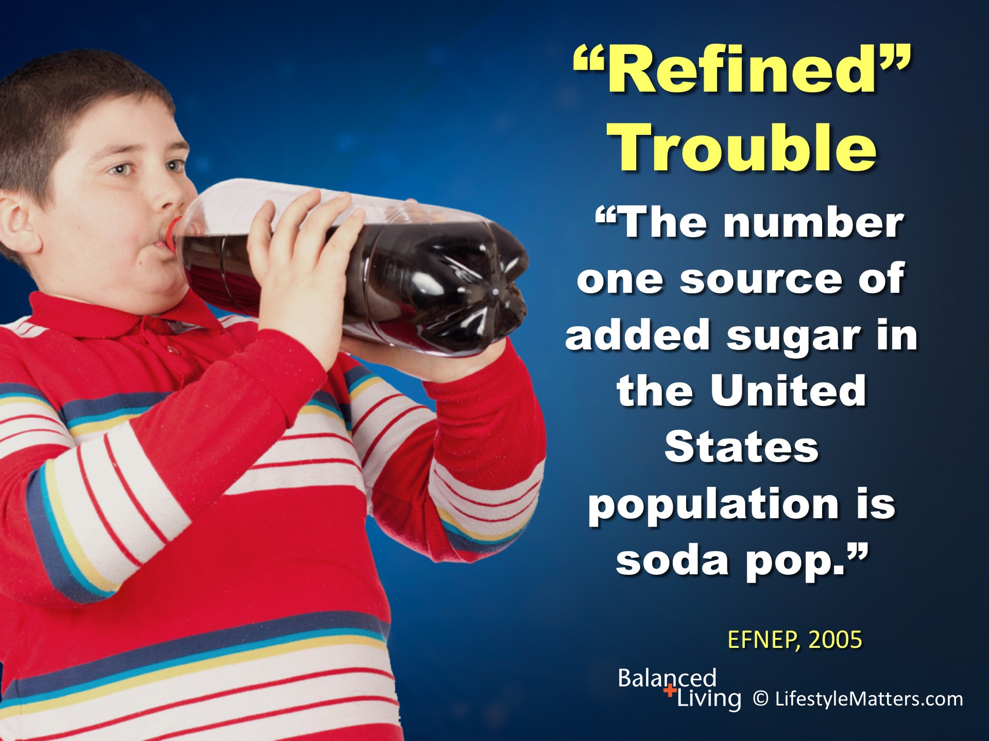
Notes:
Caffeine dependency can form at a young age. However, with or without caffeine, we’ve got: Read slide.
The mix of phosphoric acid, sugar and often caffeine is not good for the brain, bones, or body at any age.
A daily 12 ounce soda increases obesity risk in children by 60 percent, and can double the risk of diabetes in adults.
Teen consumption is the highest with males drinking an average of three 12-ounce cans (36 oz. or 4+ cups) a day.

Slide 19
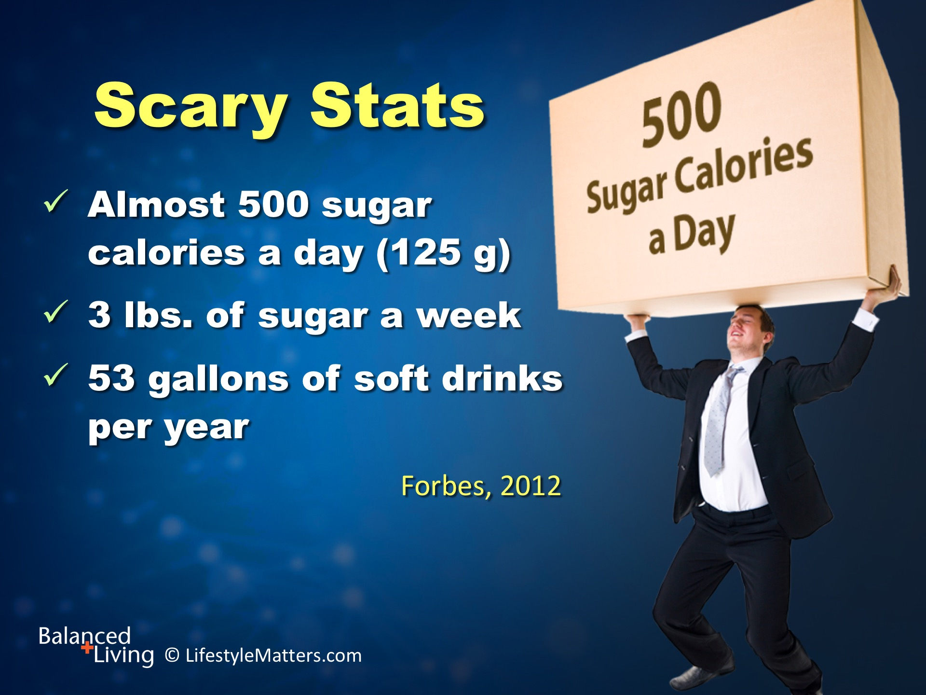
Notes:
According to data from multiple surveys reported in Forbes in 2012, Americans consume, Read slide.
This average lifetime amount of 3,550 lbs. of sugar amounts to a fully loaded industrial dumpster!
An occasional small treat is a far cry from our daily consumption patterns.
500 calories of sugar a day translates into 125 grams. The recommendation is to limit sugar to 25-35 grams per day.
Some recommendations are limiting added sugars to about 15 grams a day, which is only 60 calories (about six M & Ms).
At that rate, it would take about 9 lifetimes to fill that dumpster!
(Reference: http://www.forbes.com/sites/alicegwalton/2012/08/30/how-much-sugar-are-americans-eating-infographic/#63d0d82a1f71)

Slide 20
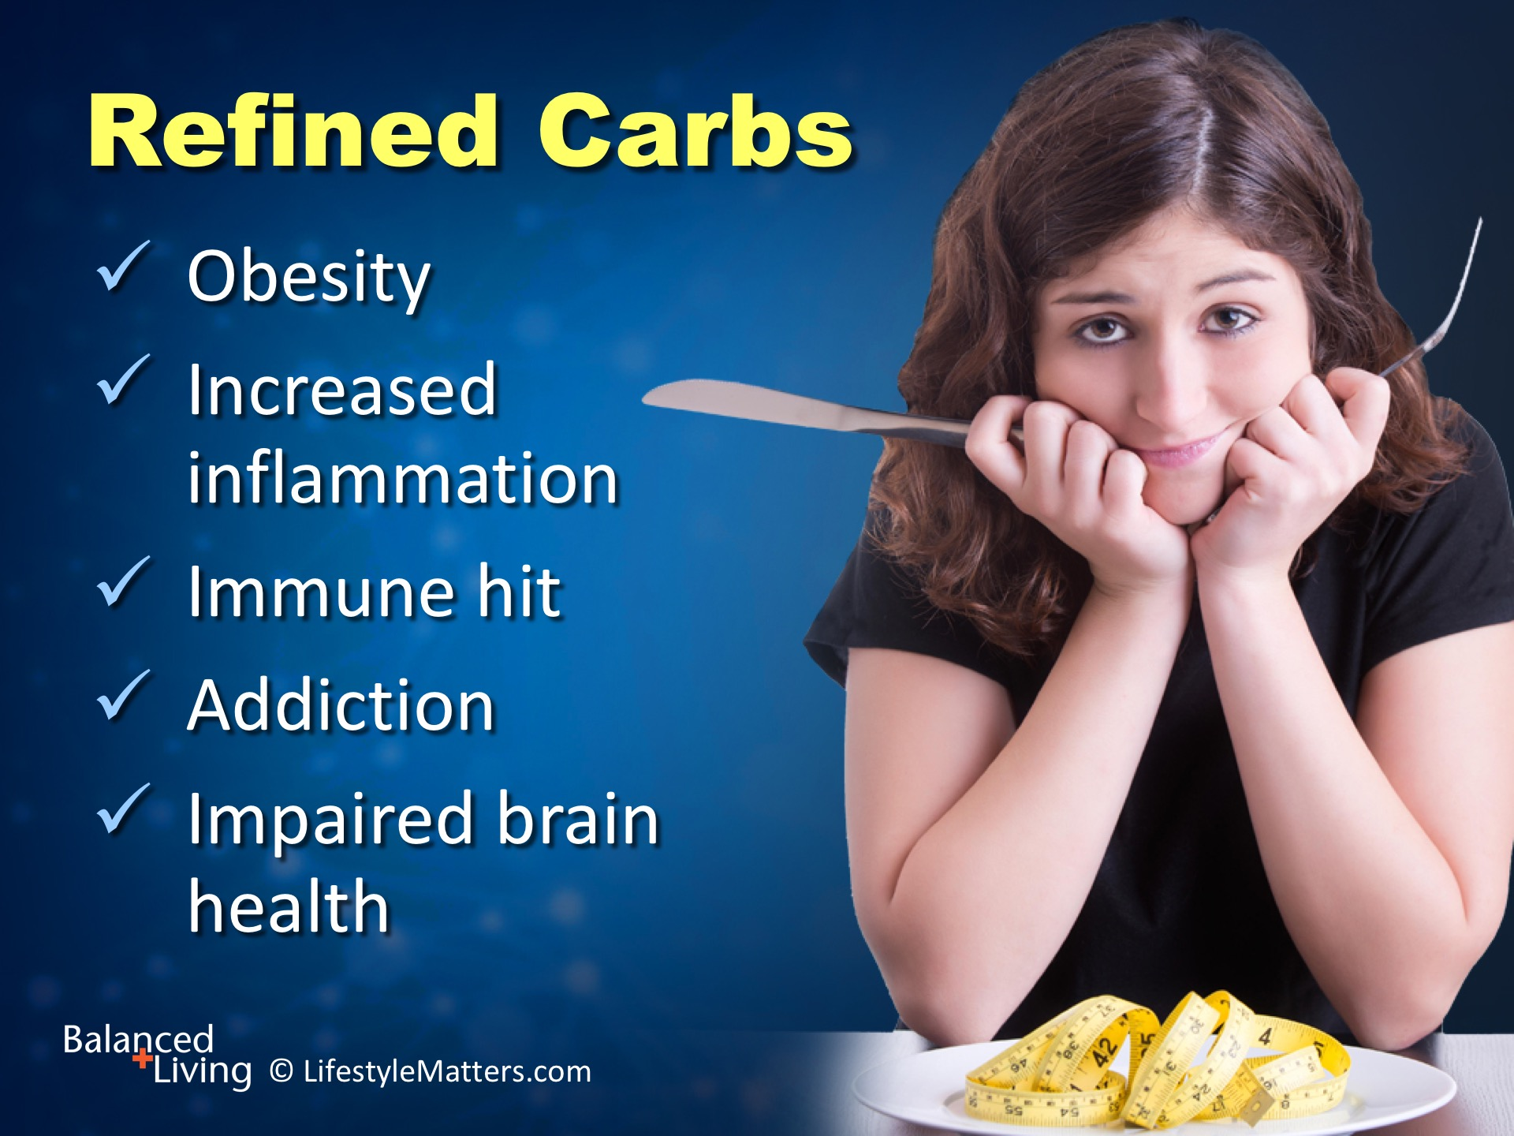
Notes:
Read slide.
This sugar load has serious health consequences over time.
This includes diabetes, heart disease, arthritis, autoimmune disease, high blood pressure, mood and learning problems, and increased risk for dementia.
As a nation we are addicted to refined, added sweets and caffeine with some pretty sour results!

Slide 21

Notes:
The real battleground is the brain: Read slide.

Slide 22
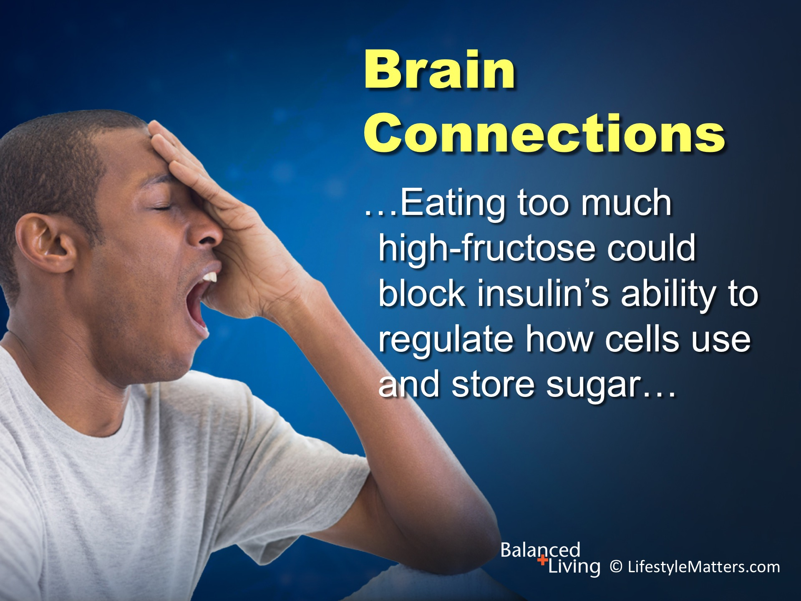
Notes:
Read slide.

Slide 23
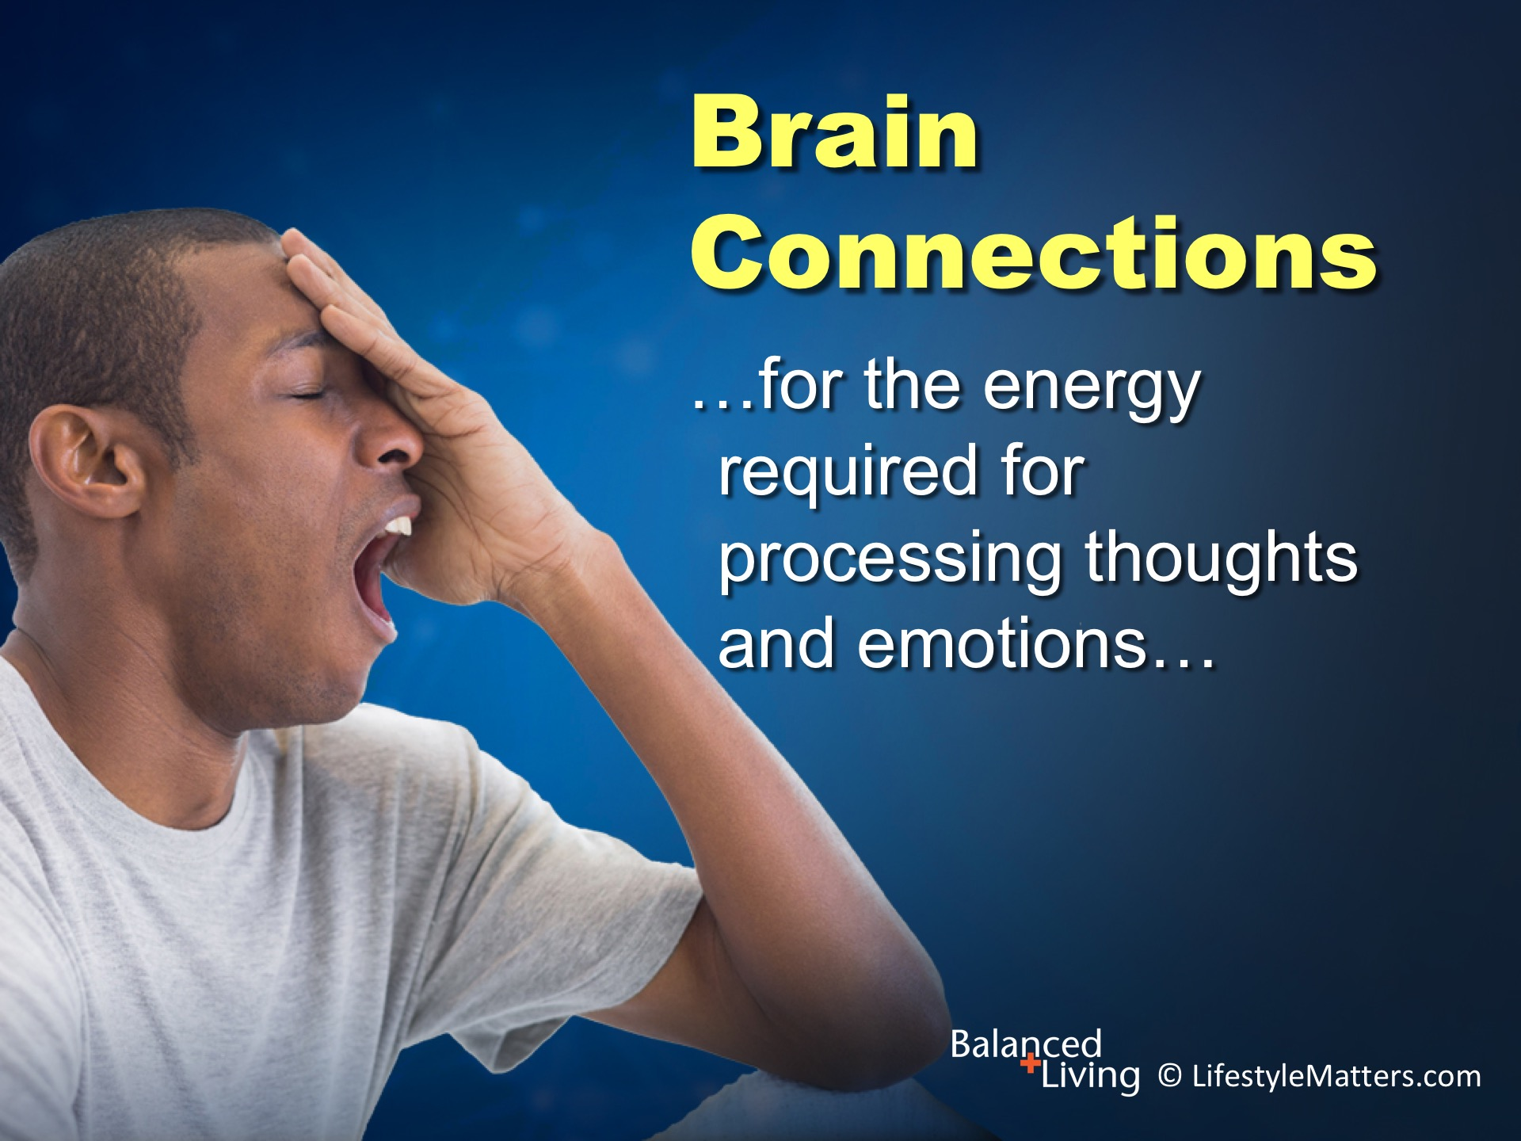
Notes:
Read slide.

Slide 24
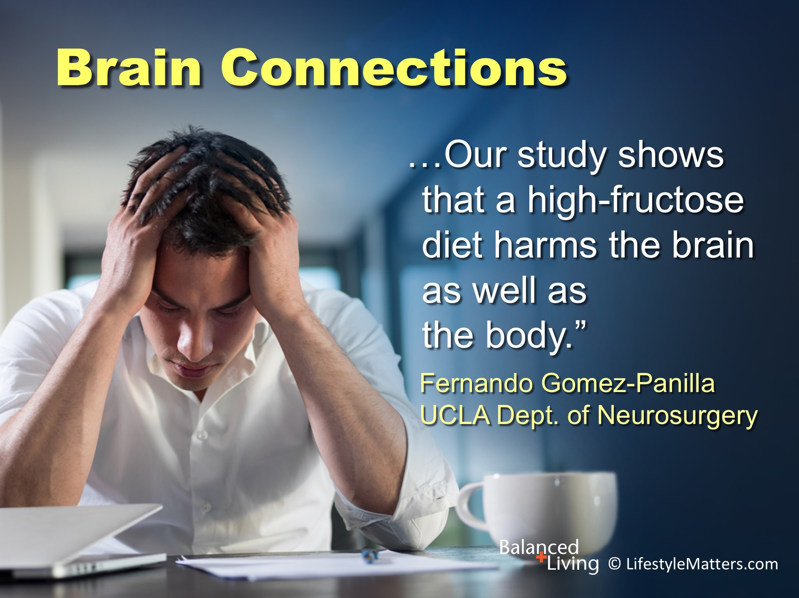
Notes:
Read slide.
Clearly, there is a battle being waged for the mental, physical, and spiritual health and energy of every man, woman and child.

Slide 25
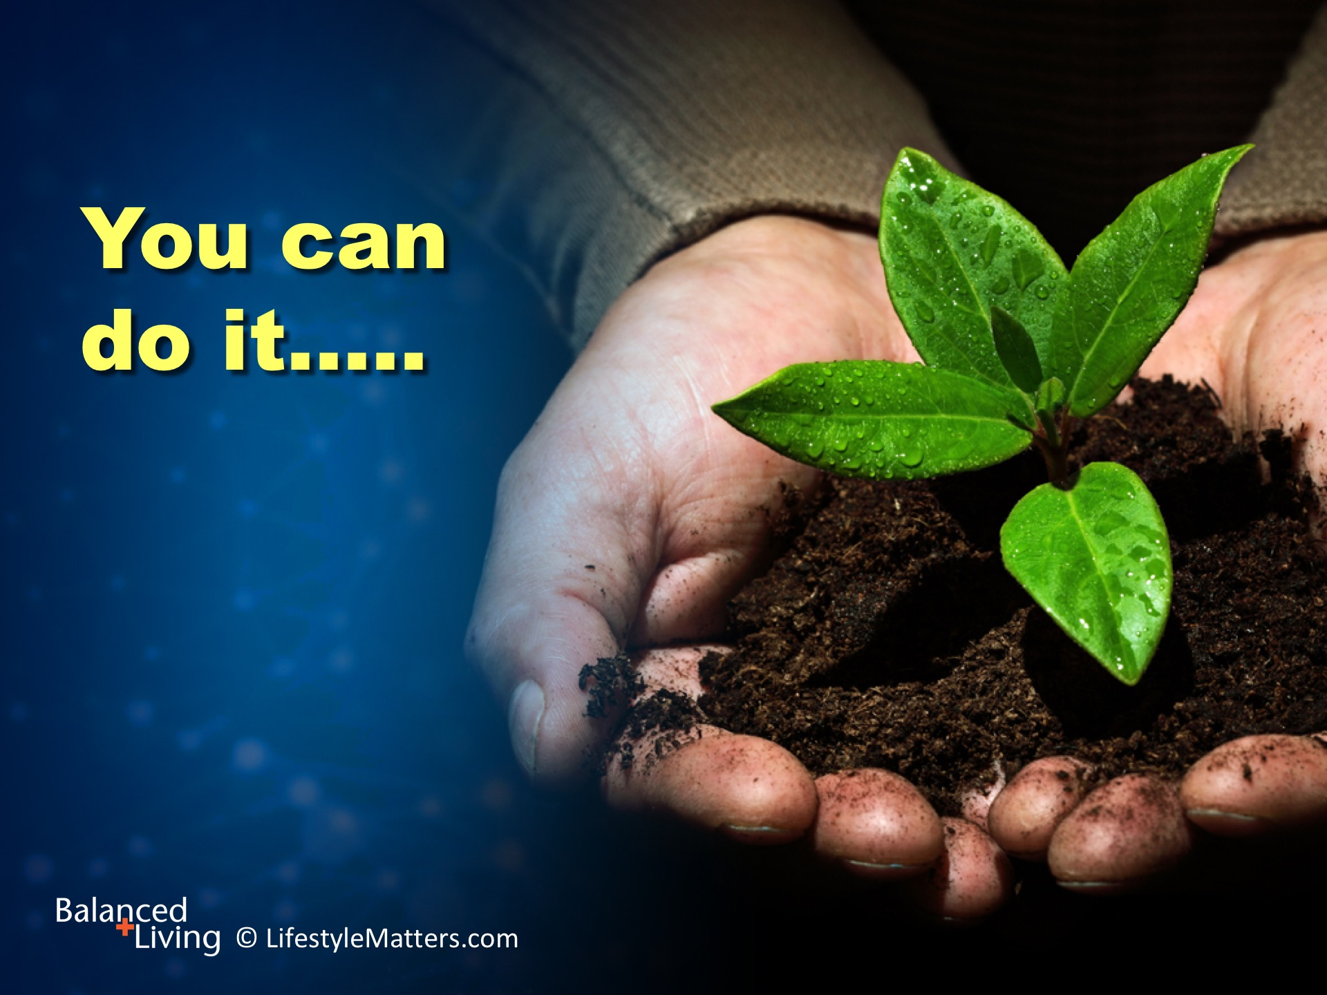
Notes:
Read slide.
Many people have overcome the caffeine habit and you can too.
Work with your healthcare provider if necessary.

Slide 26

Notes:
Read slide.
It will take time to recover lost energy reserves as you shift your lifestyle to more healthful choices, but each day you will gain strength, clarity, and real energy.

Slide 27

Notes:
Read slide.
As we take a look at the healing steps to overcome caffeine and sugar addiction, maybe this is a good time to ask yourself:
What would my life look like if I made the choice to move away from artificial stimulants and toward healthy choices?
What would my health look like? What would my sleep habits look like? What would this type of freedom feel like?
God can give you strength and power to overcome this habit.
“With God all things are possible.” Matthew 19:26.

Slide 28
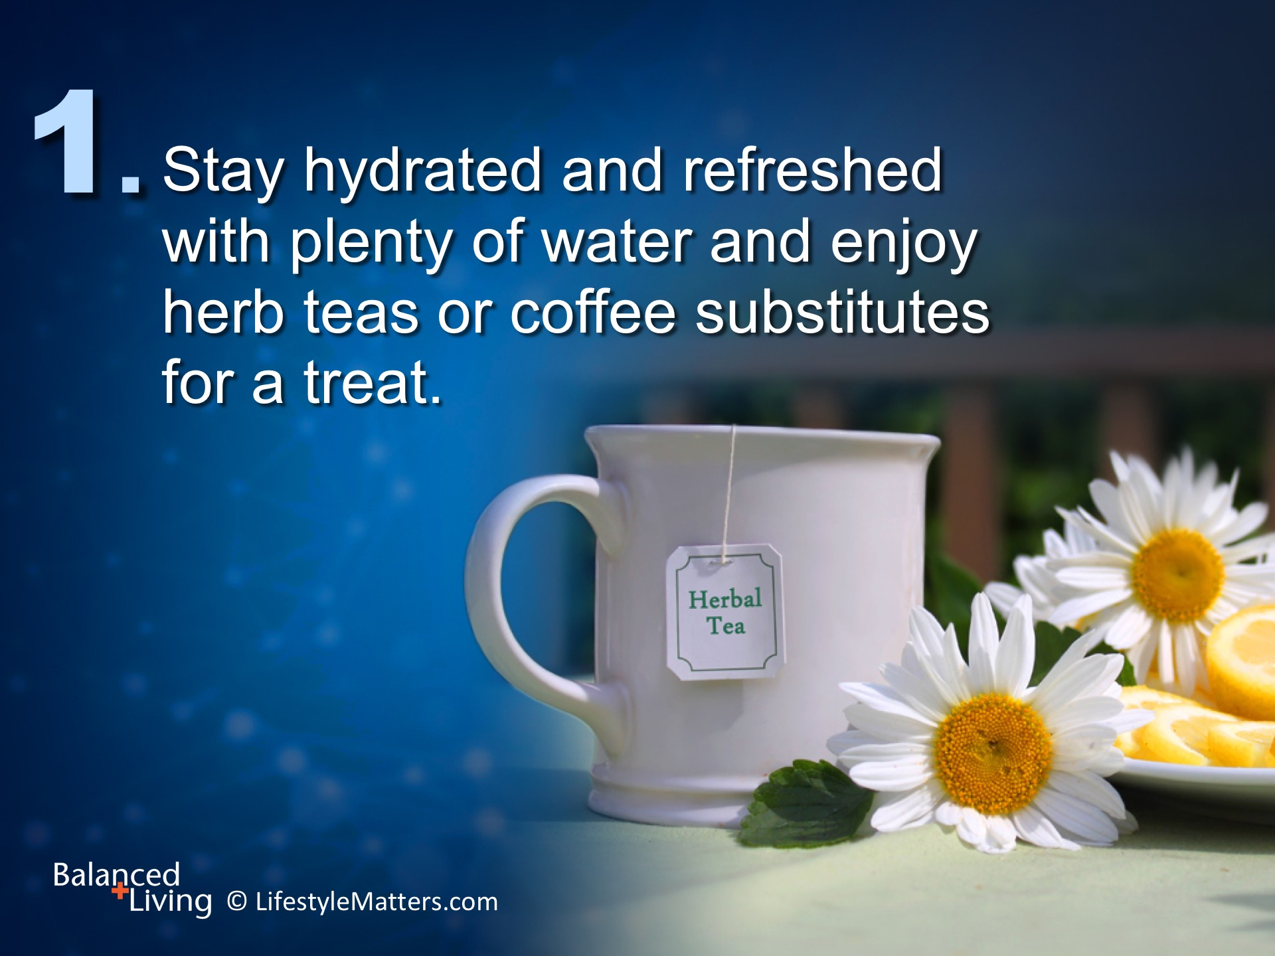
Notes:
The steps are easy, achievable, and powerful. First, Read slide.
Working on the plan of “addition” is the best way to squeeze out unhealthy habits.
For most coffee drinkers, the first act of the day is preparing their drink.
The best drink to prepare for the day is energizing, refreshing water.
Add a little fresh lemon if you like, or let it infuse overnight with a few blueberries, strawberries, or mint.
You may have it as a hot/warm drink or just drink the water at room temperature.
Start with 1-2 cups when you first get up in the morning.
Morning water flushes the system, energizes the appetite, stimulates circulation, and wakes up the sleepy brain.

Slide 29
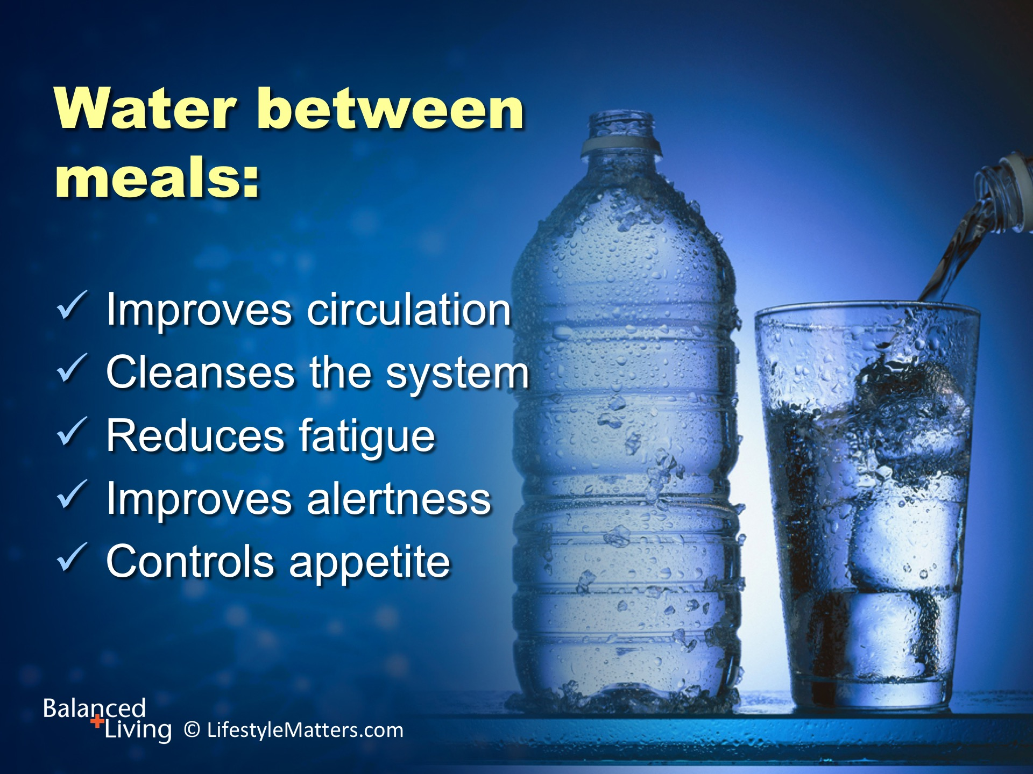
Notes:
Throughout the day, stay well hydrated with water instead of soft drinks, juice, or caffeine. Read slide.
Drinking between meals keeps the digestion strong during mealtime.
Drinking excess fluid at mealtime may interfere with optimal digestion and may even cause a mental fog from overloading the stomach.
Strive for 8-10 glasses a day.
Herb teas or coffee substitutes are also a nice alternative to soft drinks and coffee.

Slide 30

Notes:
Now this is a delicious step to add! Read slide.
Eating plenty of fresh fruits, vegetables, whole grains, and beans at regular meal times imparts real strength and vigor.
What garden foods do you already enjoy? (wait for response)

Slide 31
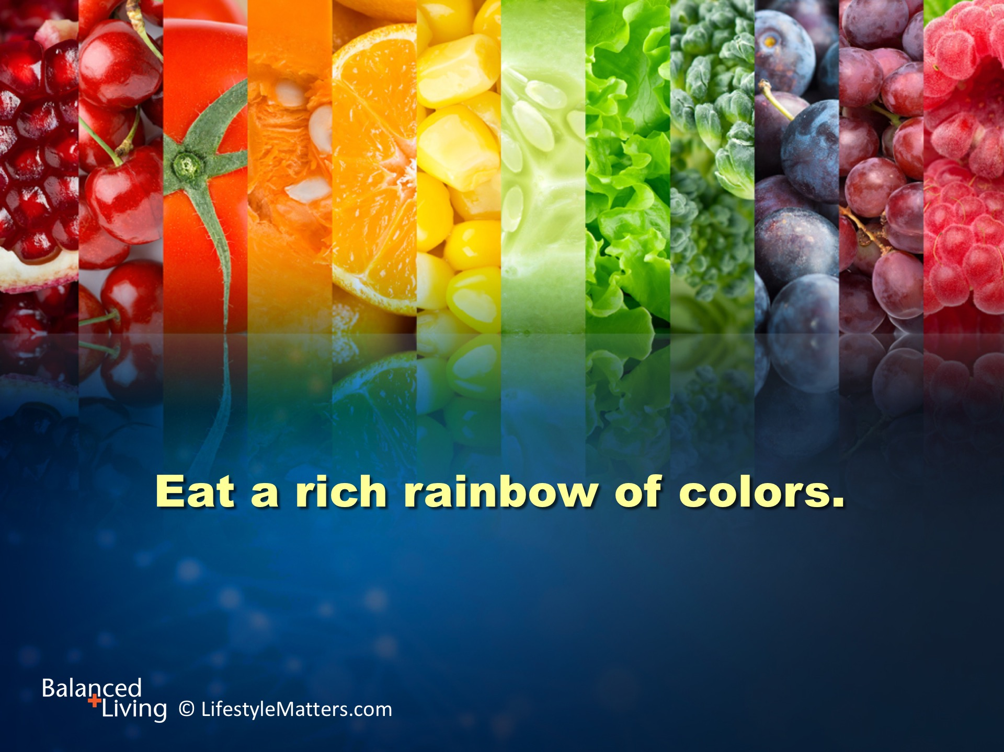
Notes:
Read slide.
Filling up on colorful fruits and vegetables provide stress-lowering compounds that sweep up dead cells and detoxify the system.
Which fresh fruits and vegetables do you already enjoy? (wait for response)
Leafy greens such as kale, and colorful fruits provide energy-producing nutrients such as magnesium, calcium, vitamin C, and B vitamins.
Try adding more “crunch factor” to your salads such as spinach, carrots, celery, red cabbage, walnuts, and chopped broccoli.

Slide 32
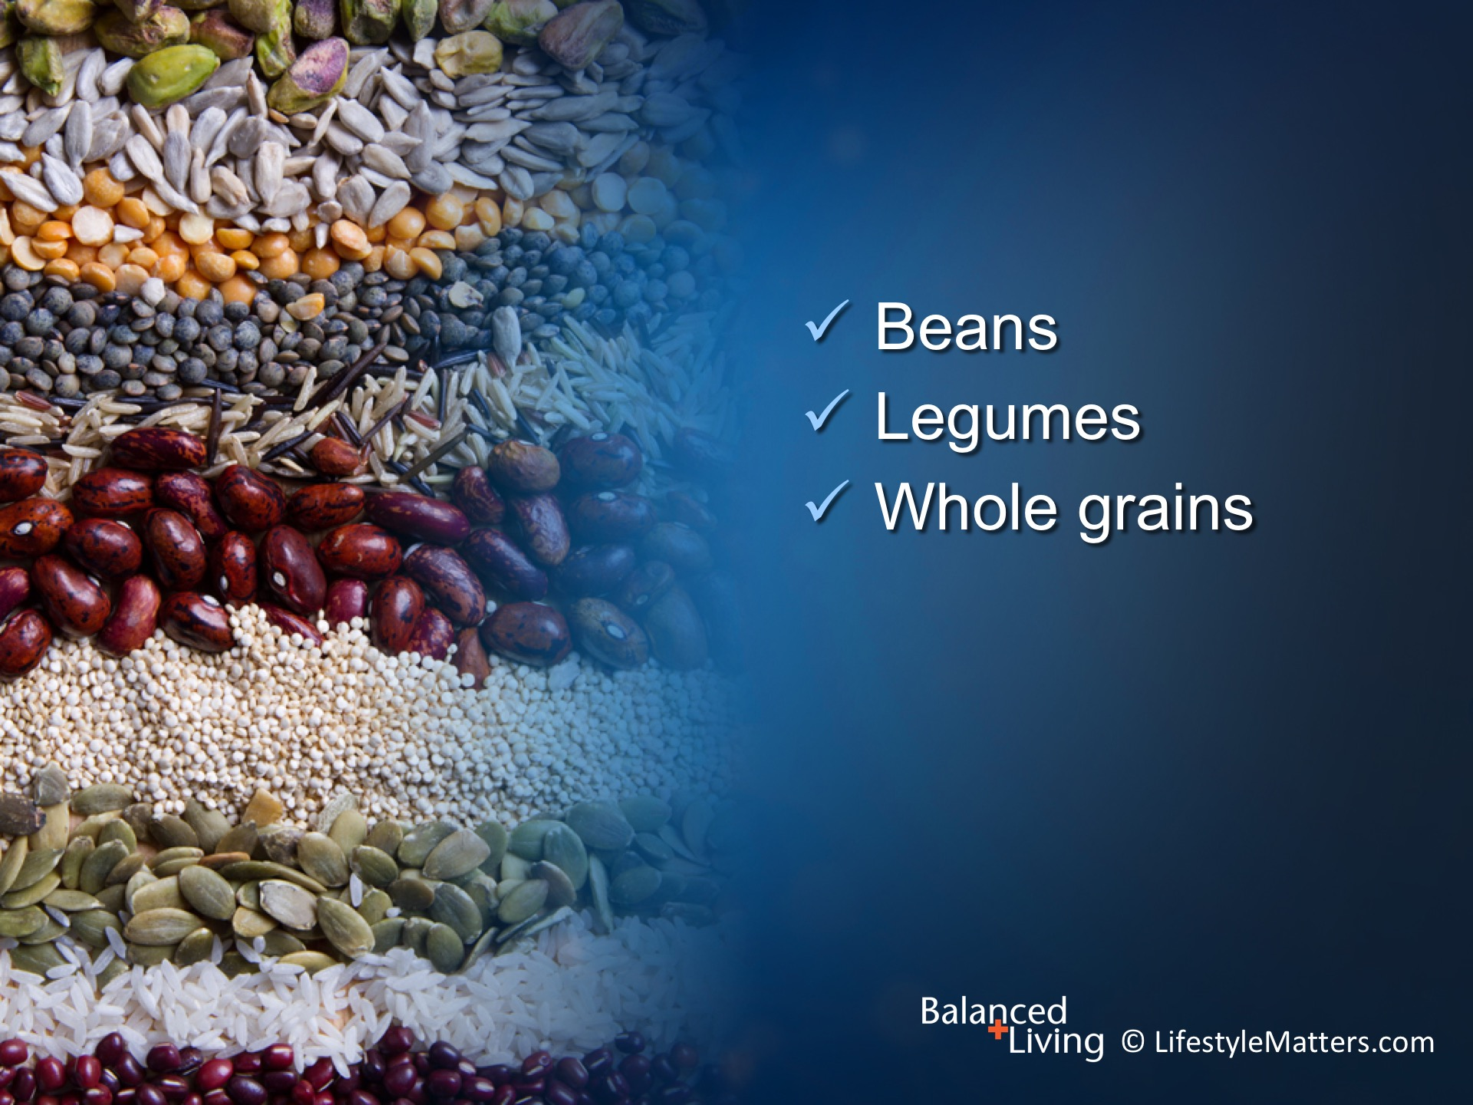
Notes:
Read slide.
Beans, legumes (peas, lentils, peanuts, soy beans), and whole grains such as whole wheat, brown rice, and oats, are the foundation of good nutrition all around the world—they are power-packed with nutrition, flavor, and fiber.
These foods provide strength. The people who live in countries where physical labor is strenuous get their energy and nutrition from these foods.
When it comes to gut health, brain health, reduced risk for chronic disease, and pure energy, beans and whole grains are major players.

Slide 33
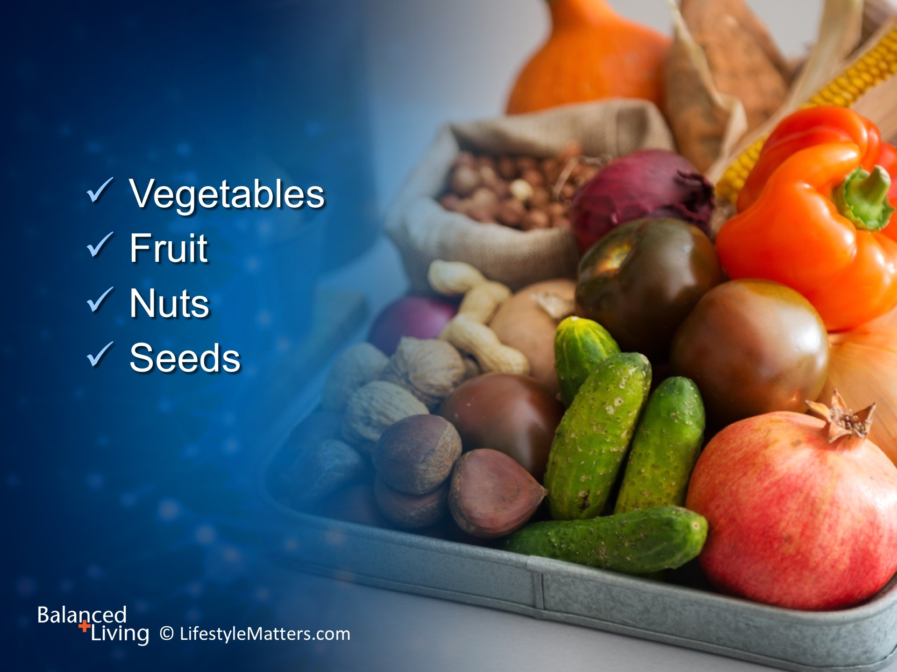
Notes:
Read slide.
Good nutrition—plant foods—are the foundation of our energy, strength, and vitality—not candy, soda, and caffeine.
Replacing candy and sweets with fresh and dried fruit; filling up on colorful fruits and vegetables; and eating healthy fats such as nuts, olives, avocados, and olive oil lower inflammation and reduce that foggy, “all gone” feeling that stimulants and junk foods create.
When it comes to plant foods, more is better!

Slide 34
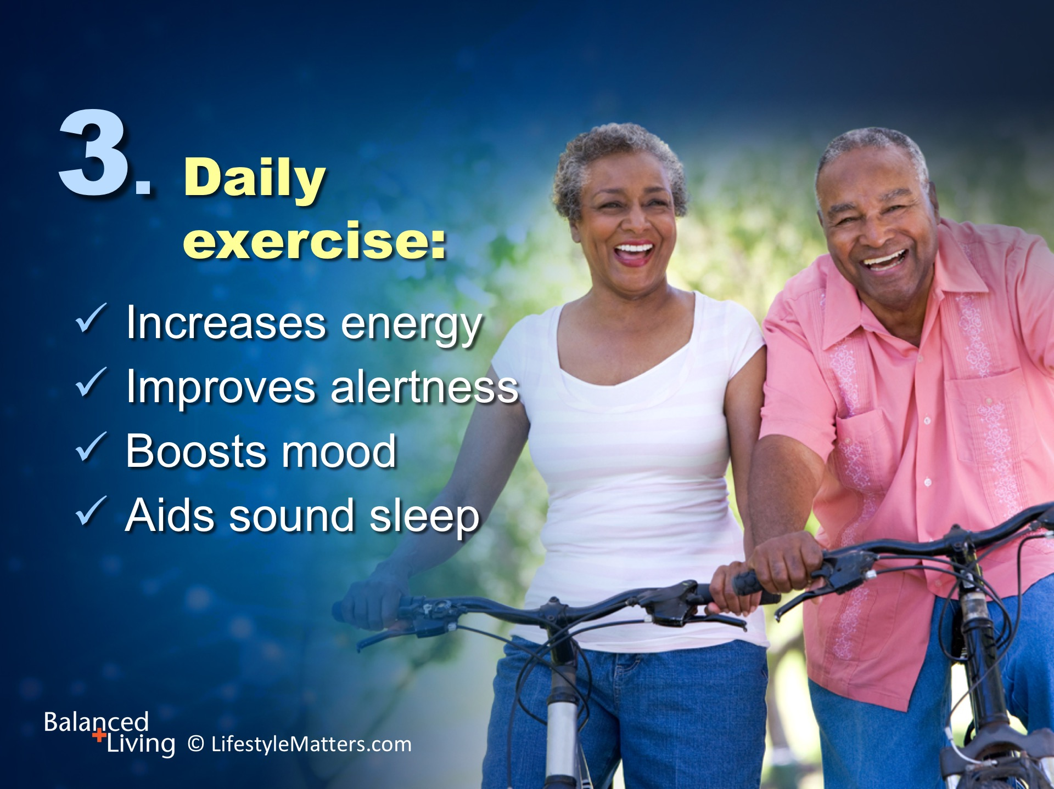
Notes:
It’s a paradox. Inactivity actually produces fatigue. Activity produces energy!
That’s because energy is produced from the good food we eat in muscle cells—and muscle cells produce energy when they are worked!
Read slide.
What is the best exercise? (wait for response)
Answer: It is the one you are willing to do!
Daily exercise is key to controlling stress, reducing pain and headache, and improving energy and alertness.

Slide 35
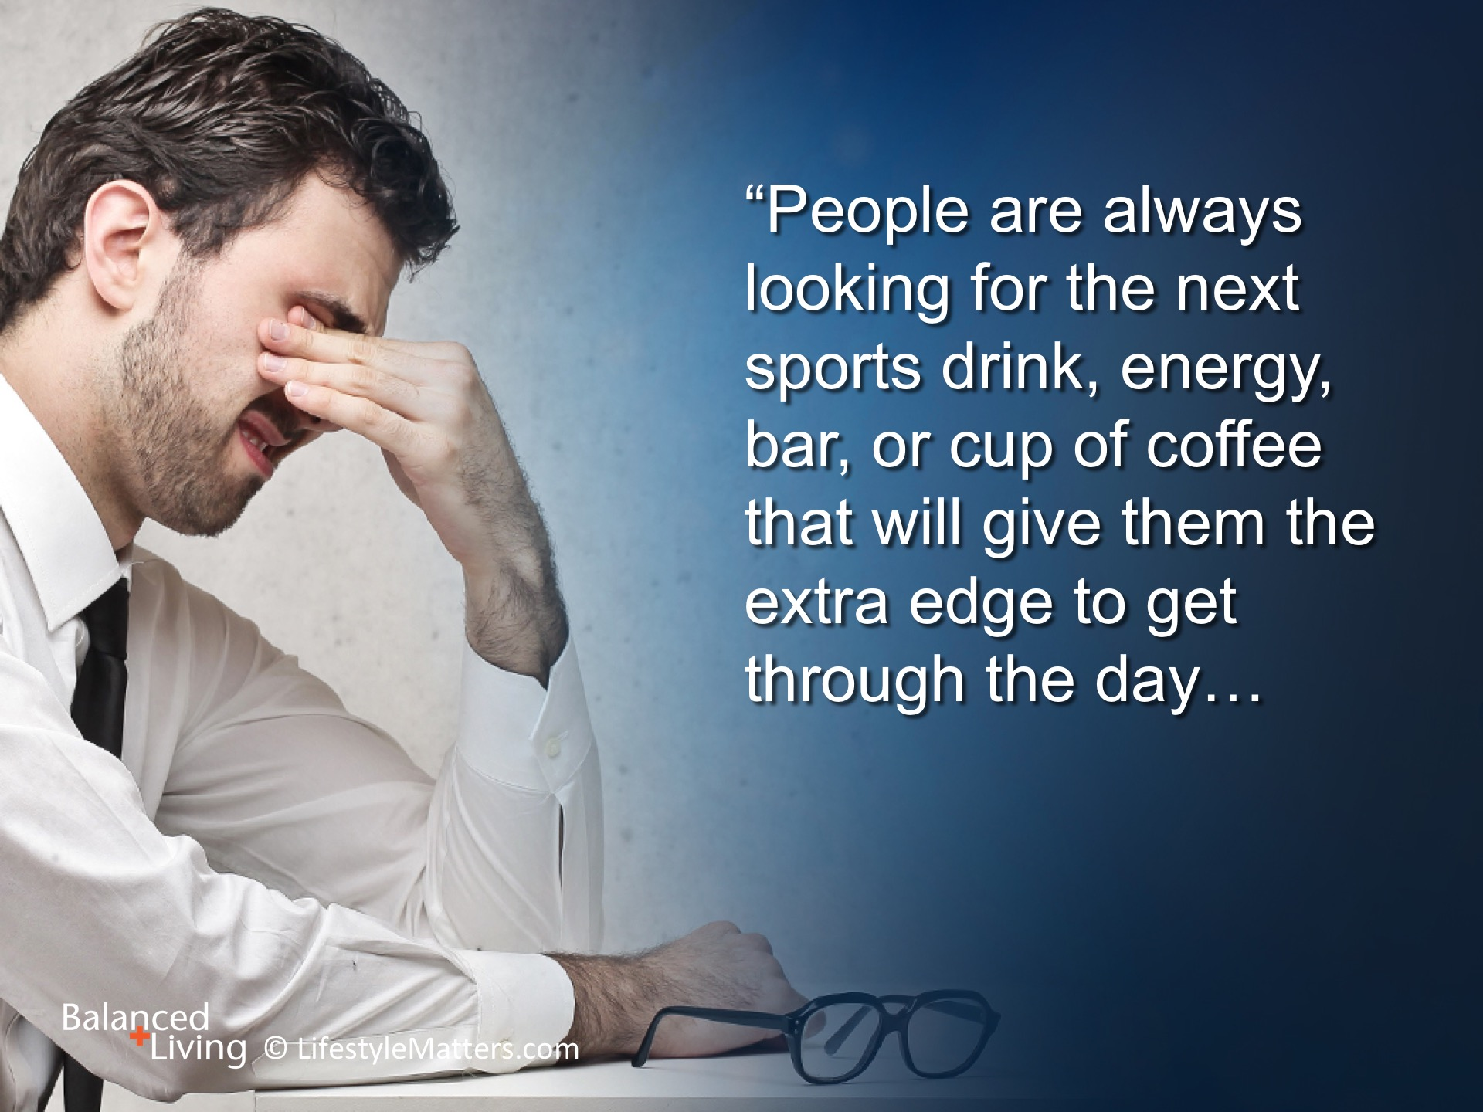
Notes:
Read slide.

Slide 36
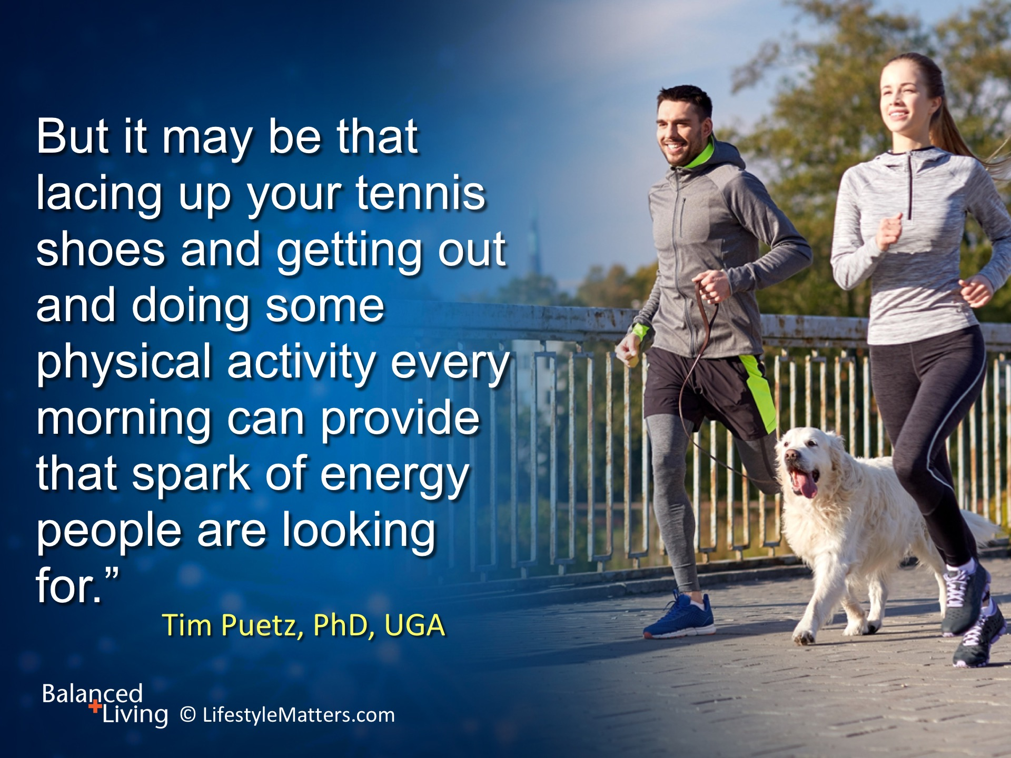
Notes:
Read slide.
(Note: Tim Puetz is a researcher from the University of Georgia exercise physiology lab.
Source: http://www.webmd.com/diet/20061103/exercise-fights-fatigue-boosts-energy)

Slide 37

Notes:
Read slide.
He has provided spiritual and lifestyle principles to give you real strength to face life’s challenges.

Slide 38
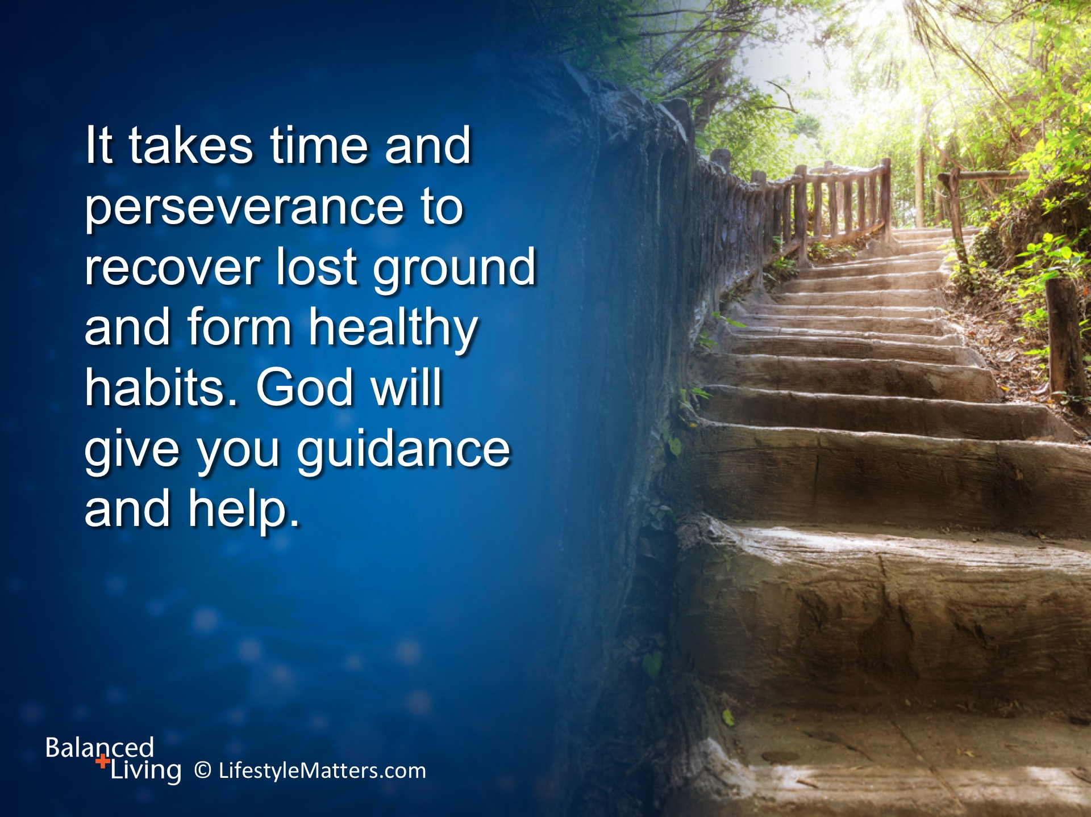
Notes:
Read slide.
Each good choice yields a gift for tomorrow, and the satisfaction of making the right choice today.

Slide 39

Notes:
Read slide.
When God promises you vigor, He means it!
The Bible teaches that you and I are His precious purchased possession—bought with a price.
He calls us to trust in His restoring power and plan—will you by faith accept His call to build your life around health enhancing principles instead of health-destroying habits? (call for raised hands)
You can trust the Man who died for you!

