Slide 1


Images © Alamy www.alamy.com
®
Images used in PowerPoint presentation are part of the presentation and not to be used out of context of the presentation, may not be used as stand-alone images unless to promote the presentation/event, and may not be resold in singular form or as part of an image library. Images are © Alamy and presentation templates and content therein are © MISDA, any other usage requires written permission from both parties.

Slide 2
®
Scripture quotations used in Balanced Living PowerPoints are taken from Bibles in the Public Domain which have no USA copyright restrictions. We have indicated which version each quotation is taken from as follows:
KJV - King James Version
BBE - Bible in Basic English
WEB - World English Bible
DBY - Darby's Translation
Any scriptures not otherwise noted are the author's paraphrase of one of these versions.

Slide 3
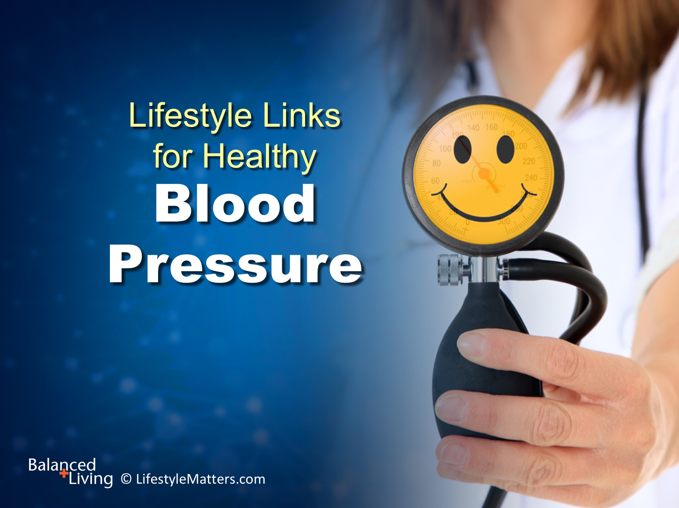
Notes:
Presenter: Please read and study the tract that accompanies this PowerPoint to prepare for this presentation.
High blood pressure, also called hypertension, is a serious, even deadly, global public health issue.
Blood pressure is the amount of force (or pressure) against the artery wall when the blood pumps through the arteries.
The higher the number, the more pressure against the artery wall.
The top number, the systolic, indicates the force against the artery wall when the heart beats.
The lower number, the diastolic, is the force on the artery wall between beats.
When the arteries are stiffer, the pressure of the blood against the arteries will be higher.
In this presentation we are looking at simple, practical, yet powerful: Read slide.
(Source: www.mayoclinic.org/.../high-blood-pressure/.../definition/con)

Slide 4
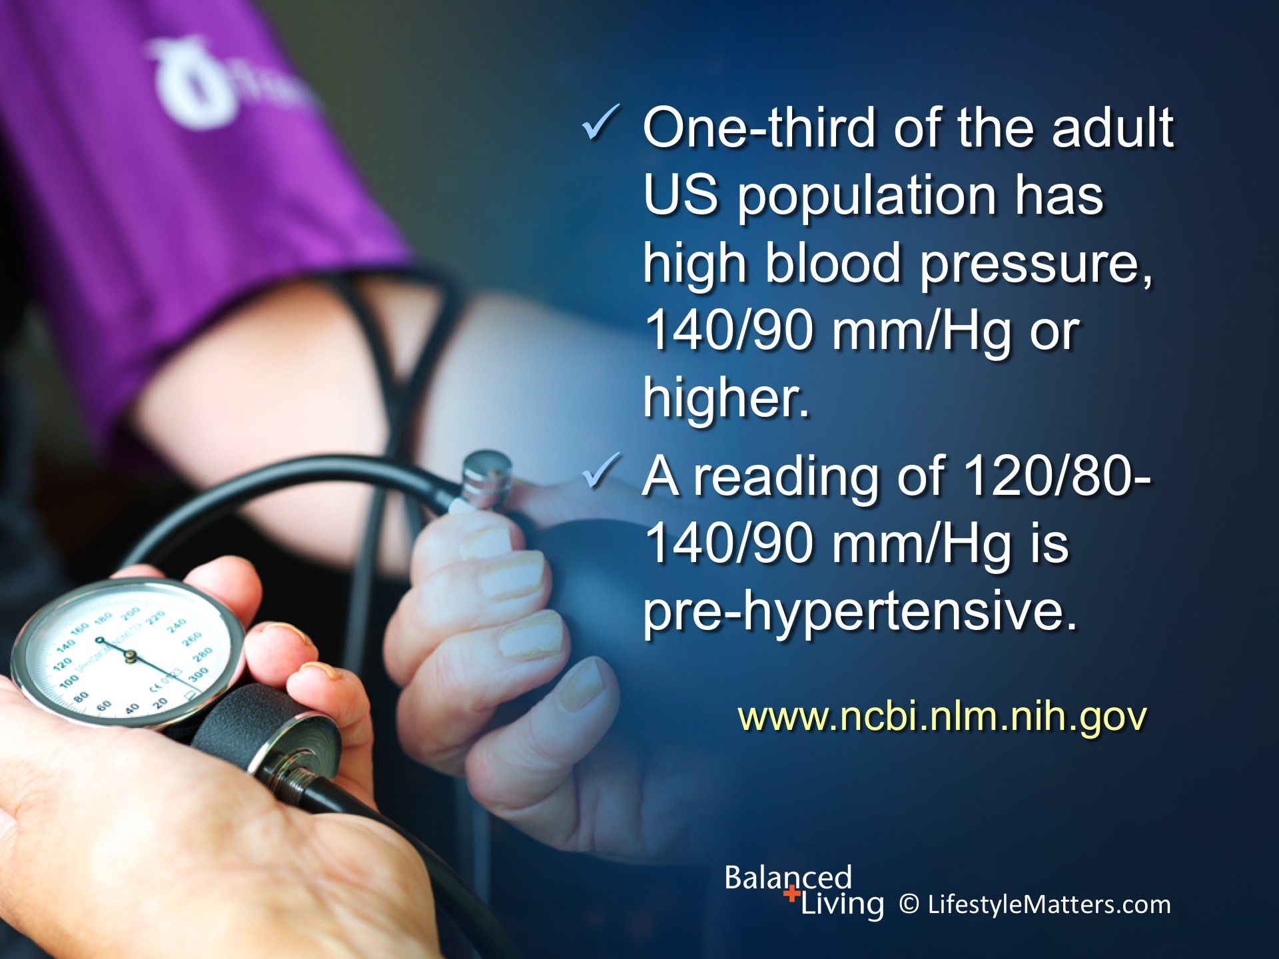
Notes:
Read slide.
According to the Centers for Disease Control, 1 in 3 adults have high blood pressure, that’s about 75 million American adults (32%).
(Source: www.cdc.gov/dhdsp/data_statistics/fact_sheets/fs_bloodpressure.htm)
Another 1/3 of Americans have pre-hypertension.
That makes 2/3rd of the adult population.

Slide 5
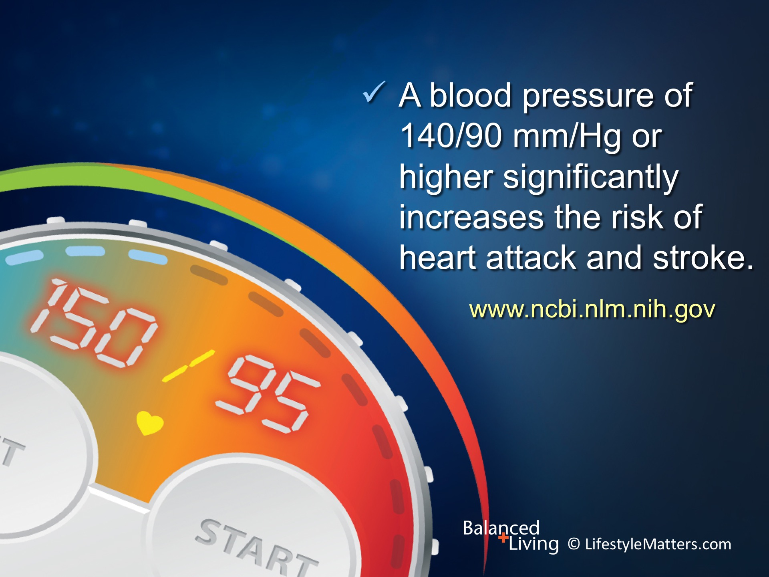
Notes:
Read slide.
Here are some points to note:
A normal or healthy blood pressure is less than 120/80 mm/Hg.
Research shows, however, that people whose blood pressure rises above 115/75 mmHg face a measurable increase in mortality.
For every 20 points of increase in the systolic blood pressure (the top number), the risk of cardiovascular disease doubles.
The same risk is true for every 10-point increase over 75 in the diastolic pressure (the bottom number).
(Source: Don Hall. The Vegetarian Advantage. Pacific Press, 2010.)

Slide 6
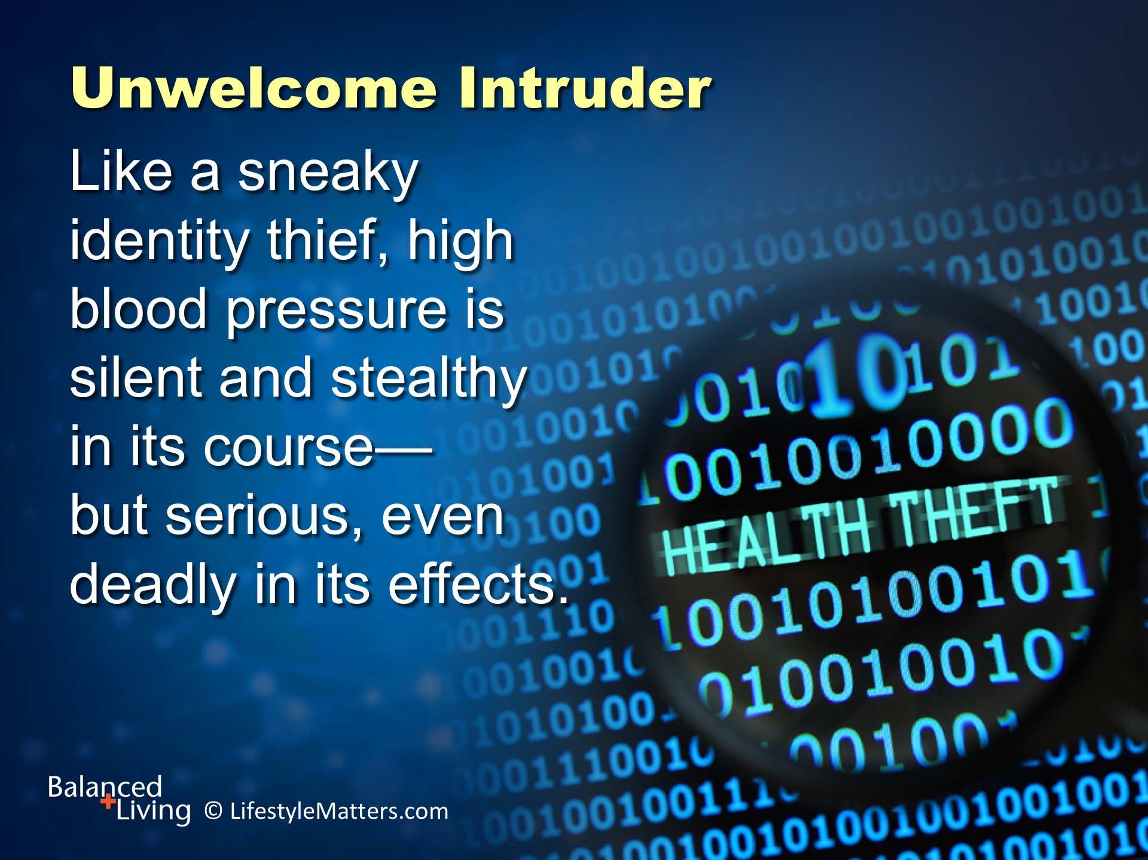
Notes:
Read slide.
One reason why high blood pressure is a thief is that you can have high blood pressure (hypertension) for years without any symptoms.
But high blood pressure works steadily and silently to increase your risk of serious health problems that impact mental as well as physical health.

Slide 7
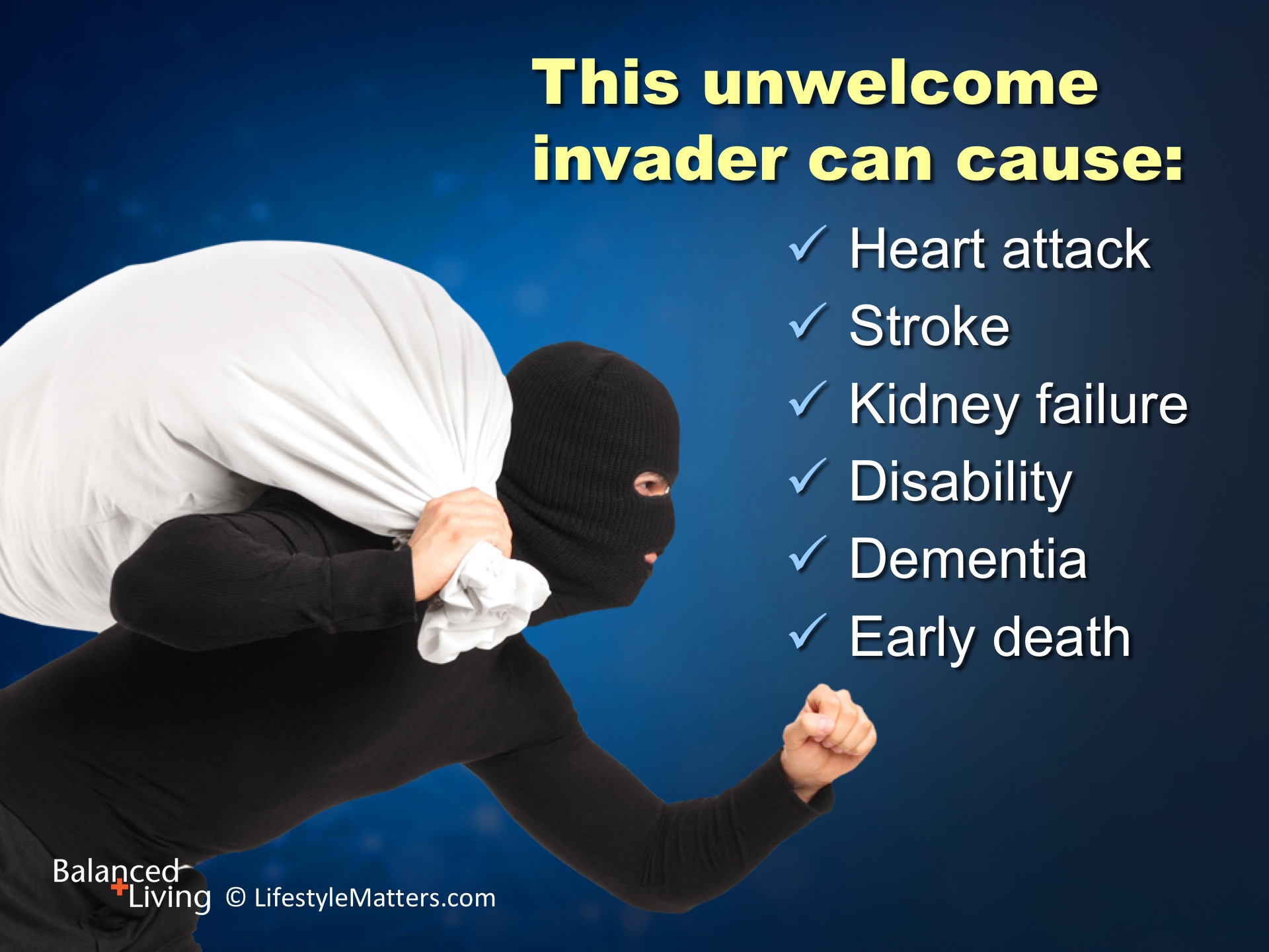
Notes:
Read slide.
In addition to coronary heart diseases and stroke, complications of raised blood pressure include chronic disability linked to heart failure, peripheral vascular disease, renal impairment, retinal hemorrhage and visual impairment.
(Source: http://www.who.int/gho/ncd/risk_factors/blood_pressure_prevalence_text/en/)

Slide 8
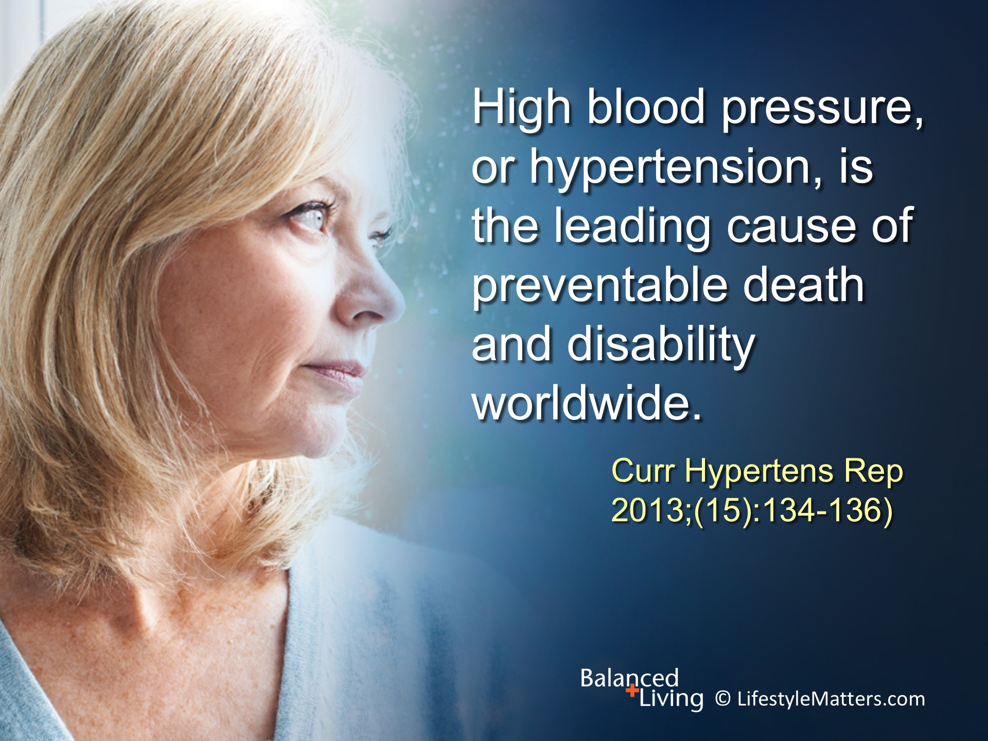
Notes:
Read slide.
Globally, hypertension affects nearly 1 billion (40%) of adults over the age of 25 worldwide.
Just cardiovascular complications related to hypertension cause 9.4 million deaths a year!
(Source: http://www.who.int/gho/ncd/risk_factors/blood_pressure_prevalence_text/en/; 2013 Geneva Switzerland report on Global Hypertension)

Slide 9
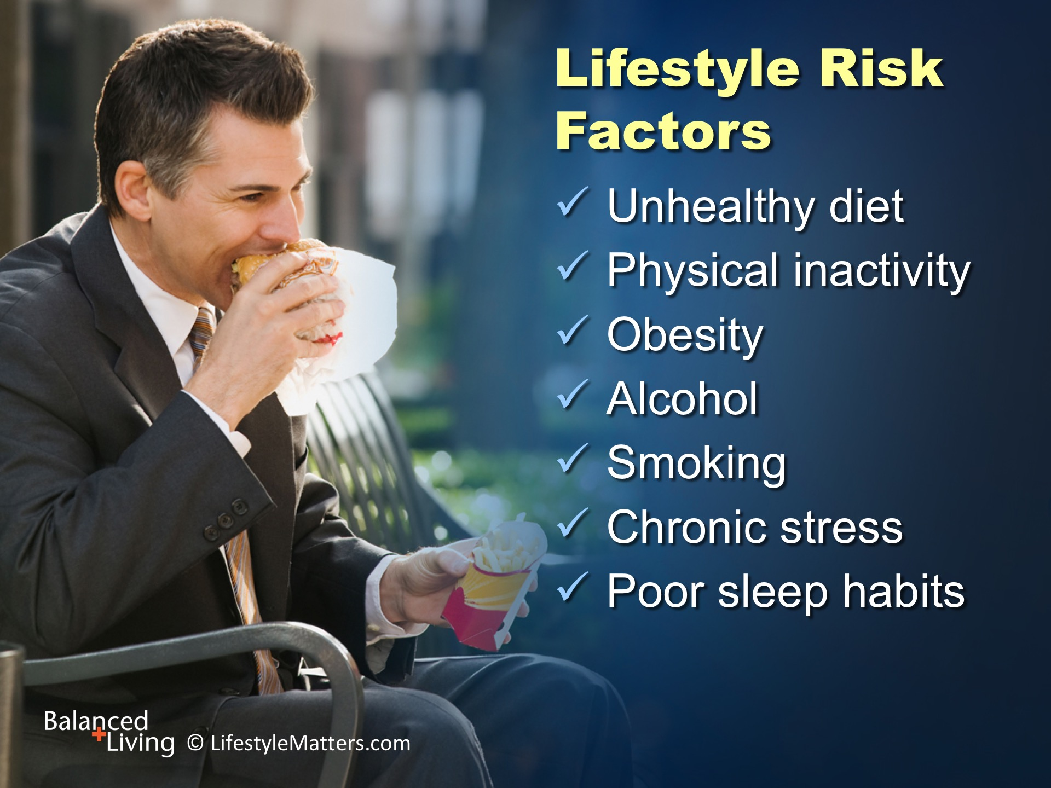
Notes:
Major lifestyle risk factors for high blood pressure include: Read slide.
We will examine some key lifestyle links in light of these risk factors in this presentation.
There are risk factors linked to high blood pressure other than lifestyle. They include:
Age, race, and gender
Family history and genetics
Certain medical conditions and medications
Kidney defects, injury, and chronic pain
Whatever the existing condition, healthy lifestyle choices add quality of life and can help you achieve your optimal blood pressure.

Slide 10
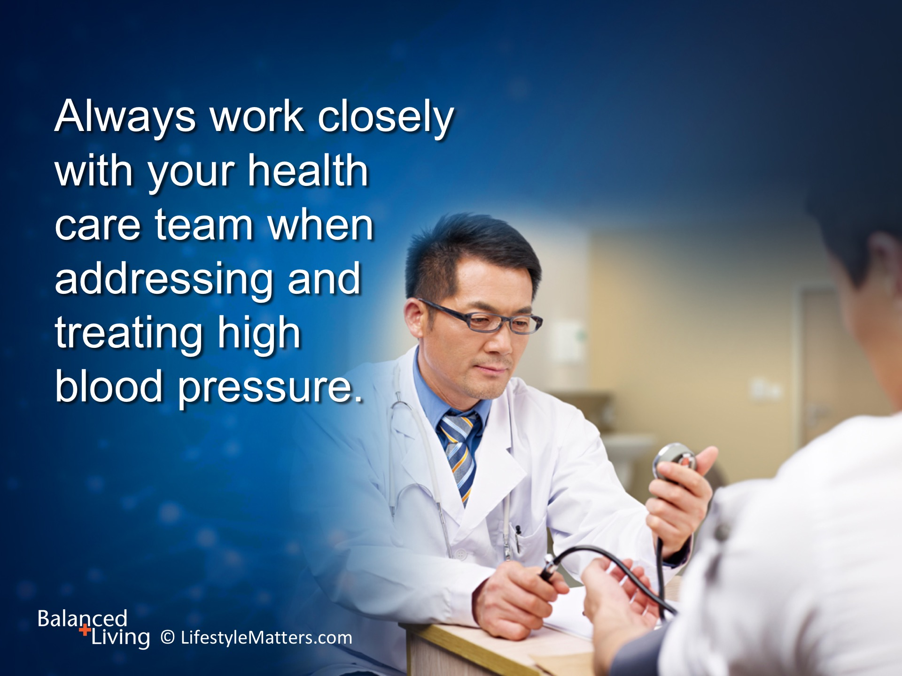
Notes:
Read slide.
Work with your doctor when making lifestyle and exercise changes, and get treatment for uncontrolled high blood pressure.

Slide 11
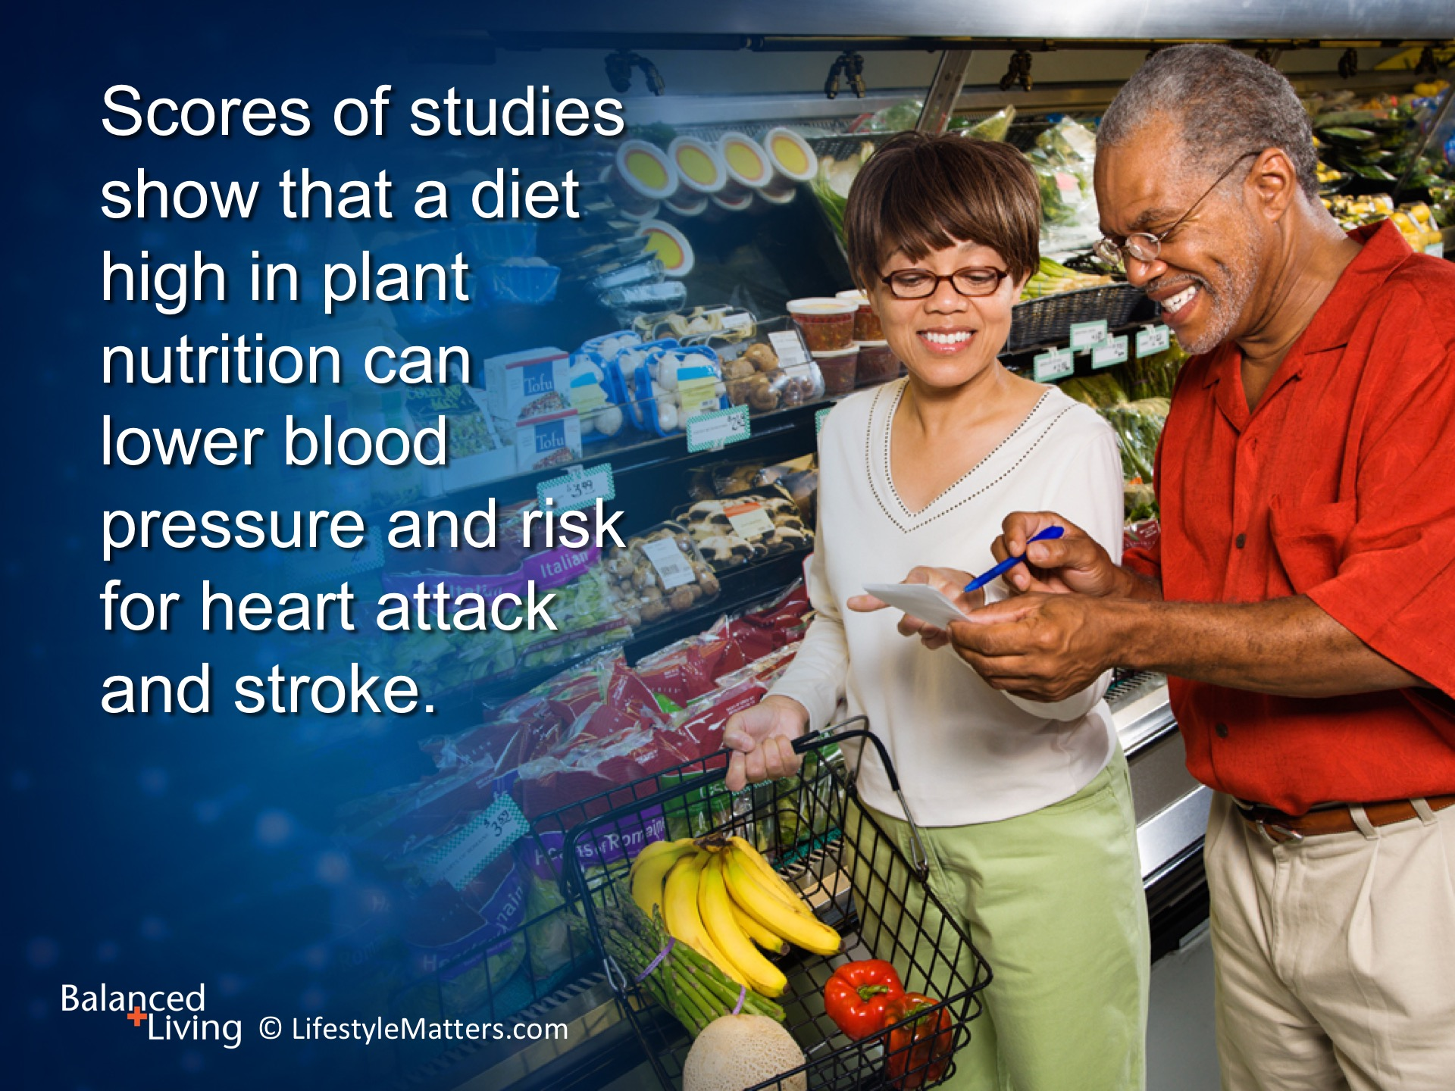
Notes:
Read slide.
A shift toward plant nutrition has many direct and indirect benefits.
A plant-based diet directly targets high blood pressure by lowering inflammation, elevating nutrient and antioxidant levels, and softening arterial walls.
It helps indirectly by helping you shed extra pounds and lower stress, two factors linked to unhealthy blood pressure.

Slide 12
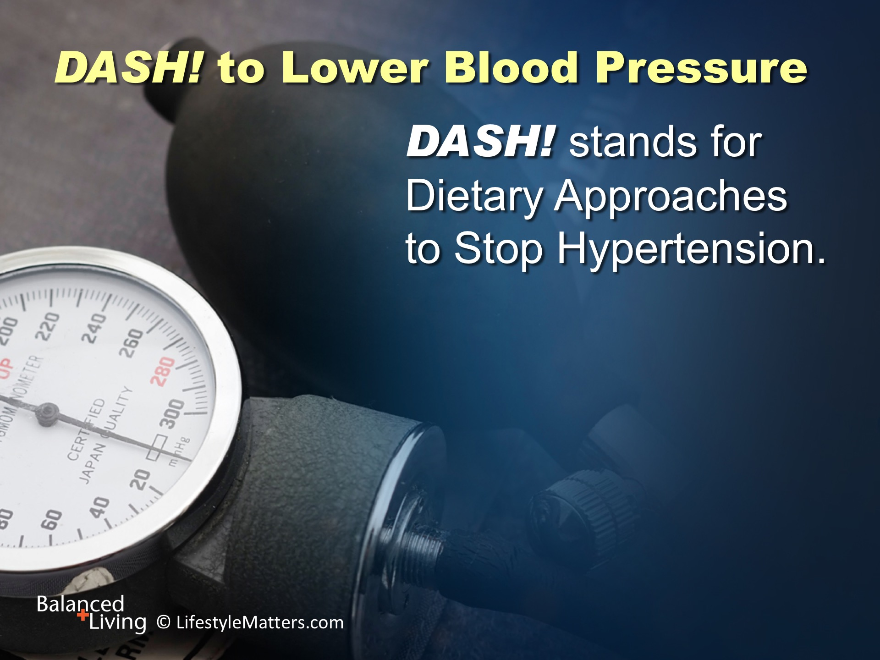
Notes:
Read slide.
DASH is a program initiated by the National Institute of Health and is based on research that is proven to lower blood pressure, reduce cholesterol, and reduce insulin sensitivity.
It emphasizes meal plans largely made up of fresh vegetables and fruits; beans, whole grains, nuts, and other nutrition-packed plant foods.
It is based on an eating plan that involves more than the traditional low salt or low sodium diet advice.

Slide 13
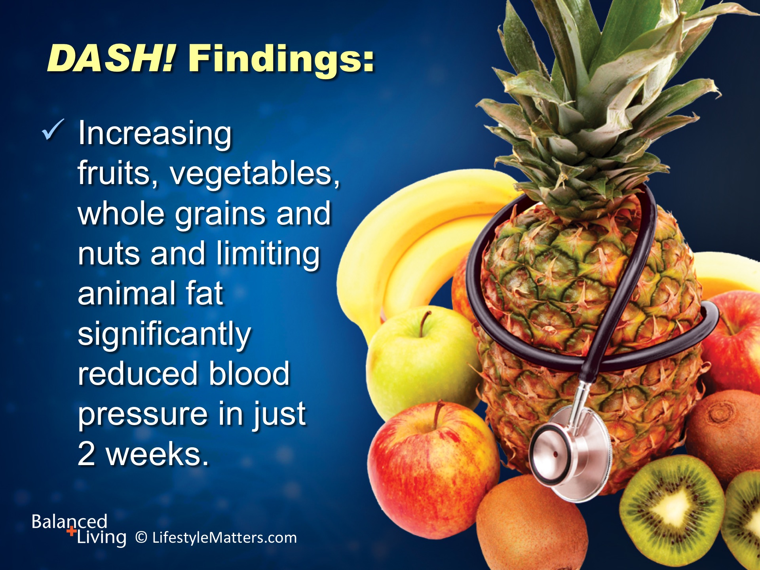
Notes:
The big-picture for a healthy blood pressure is just that—big!
It includes a big portion of healthy plant foods, a big mix of color, a big burst of flavor, and big meal satisfaction!
Read slide.
(Source: www.nhlbi.nih.gov/health/public/heart/hbp/dash/dash/_brief.htm; Don Hall. The Vegetarian Advantage. Pacific Press, 2010.)

Slide 14
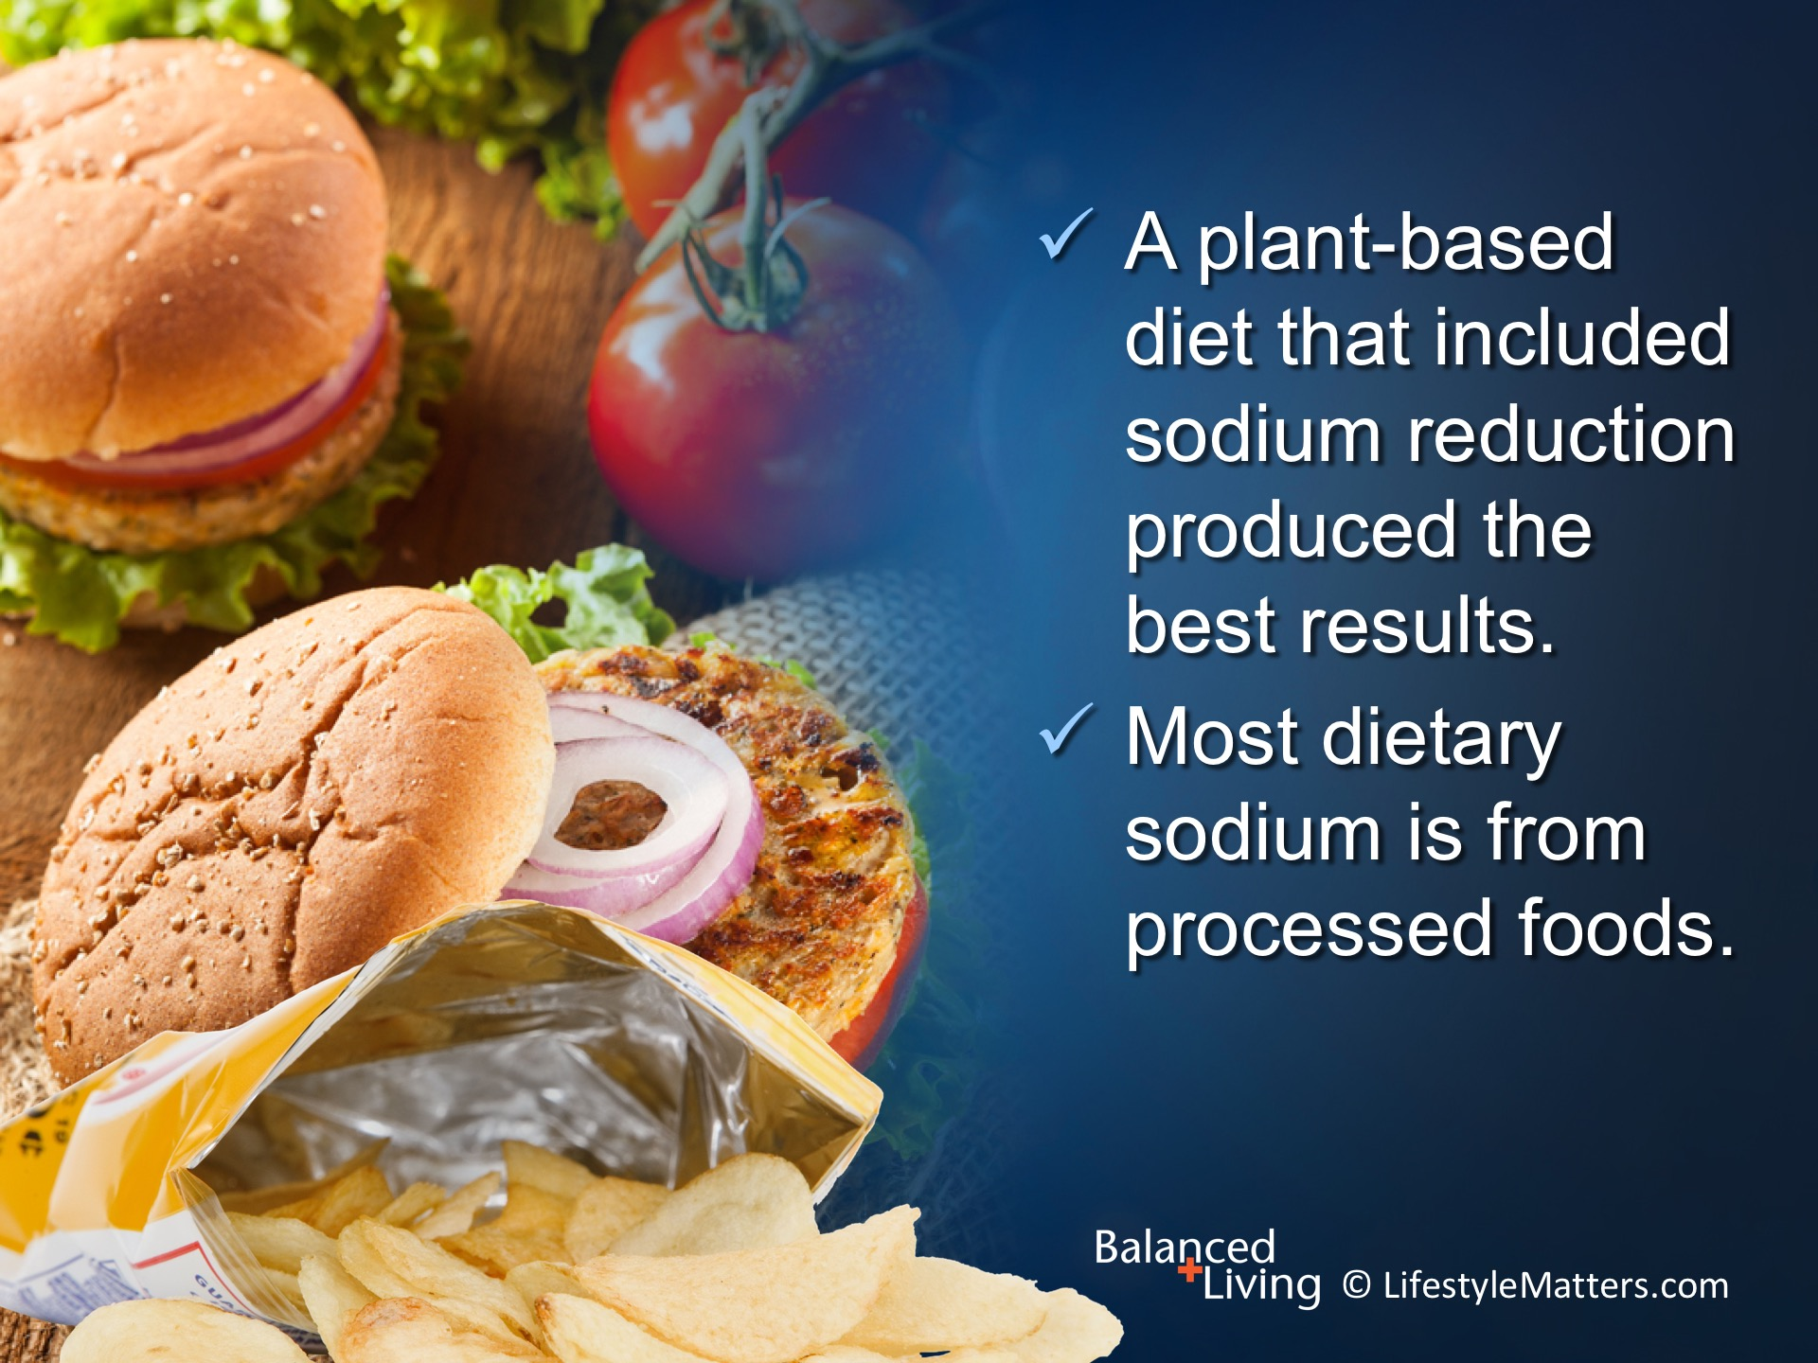
Notes:
Read slide.
The best results were diets rich in plant foods which are naturally low in sodium and curbing processed foods which are high in sodium.
One teaspoon of salt has about 2300 mg of sodium.
The recommendations vary, ranging from about 1500 to 2,300 mg of sodium a day
For better health, sodium should be limited to 1,500 mg or less each day. That would be 500 mg sodium per meal.
(Source: www.nhlbi.nih.gov/health/public/heart/hbp/dash/dash/_brief.htm; Don Hall. The Vegetarian Advantage. Pacific Press, 2010.)
(Note: Salt is made up of sodium chloride. 1 teaspoon of salt is 5 grams, which includes 2,300 mg of sodium)

Slide 15
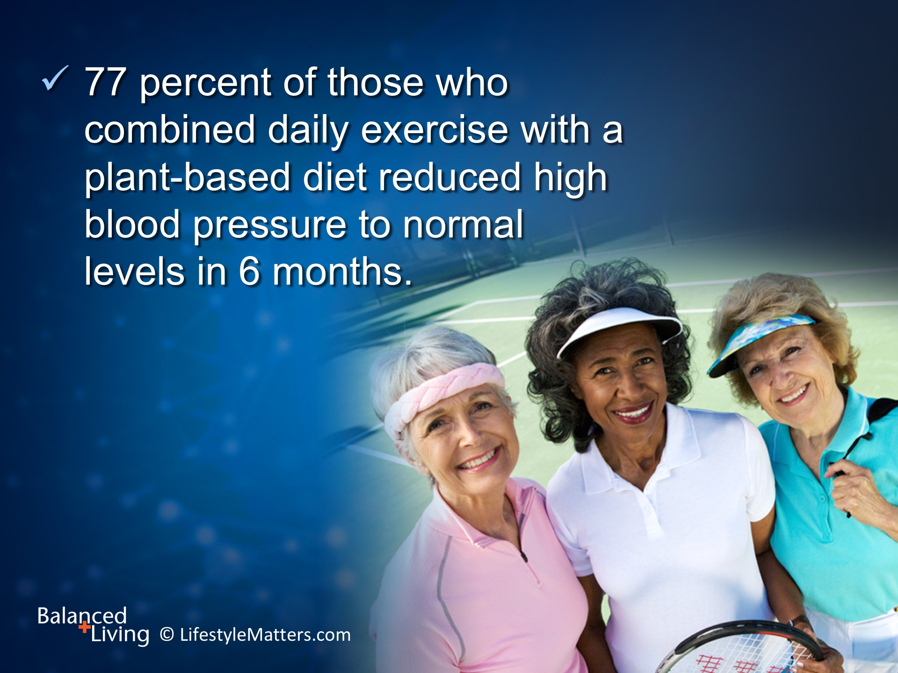
Notes:
Read slide.
Commenting on the NIH study, researcher Don Hall stated: “I consider this study to be remarkable. Think what an impact on health and the cost of health care that would result if all of the seventy-[five] million people who currently have high blood pressure would follow a vegetarian diet or even the DASH diet and would also walk thirty minutes a day!”
(Source: Don Hall. The Vegetarian Advantage, pp 43-44. Pacific Press, 2010.)

Slide 16
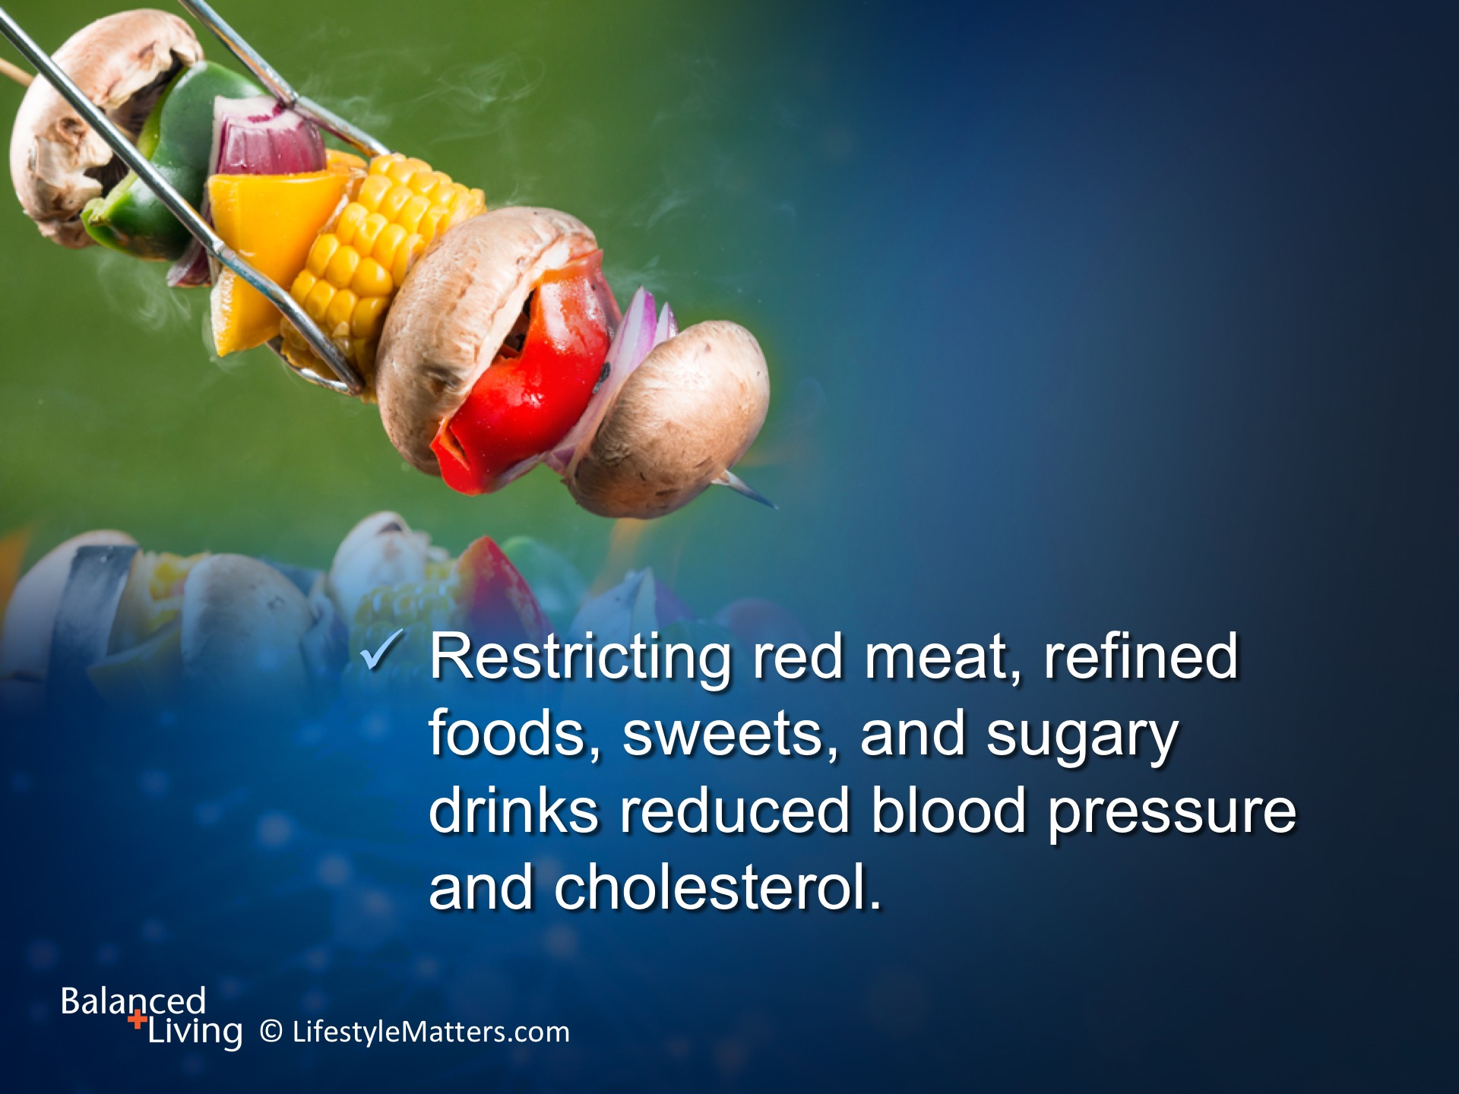
Notes:
Read slide.
A National Institute of Health (NIH) study of more than 800 people compared several dietary approaches to lower blood pressure.
The group who ate the least meat and added the most plant foods achieved the most significant drop in blood pressure. Here is a breakdown of the research:
1. Meat has a blood-pressure raising effect.
2. Eliminating meat from the diet lowers blood pressure.
3. A vegan or near vegan diet shifts blood pressure levels to the healthiest levels, and more...(see next slide)
(Source: Journal of the American Medical Association 2003;289(16):2083-93; Don Hall. The Vegetarian Advantage. Pacific Press, 2010.)

Slide 17
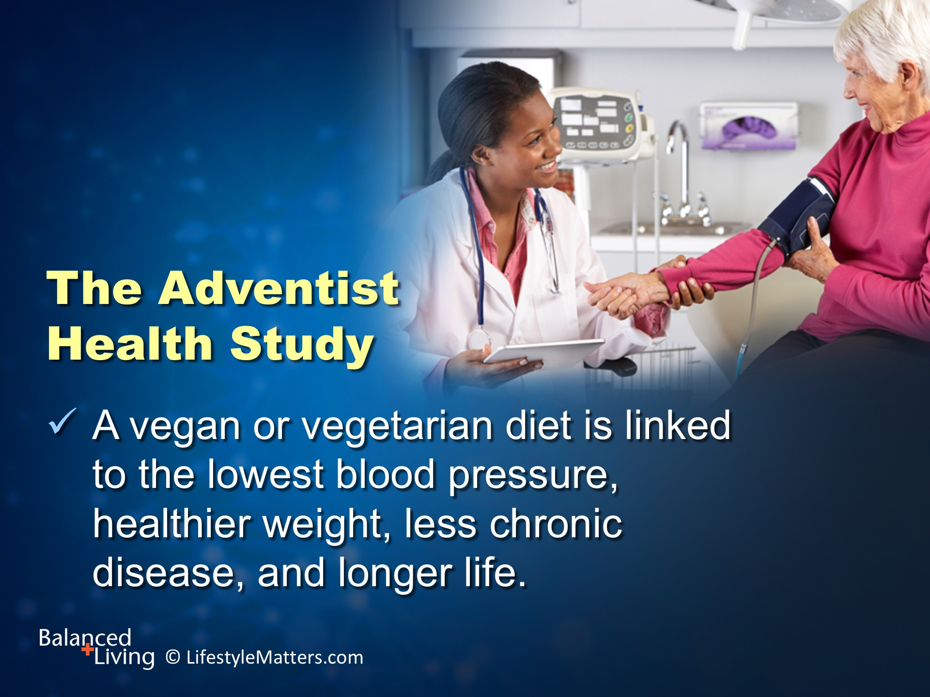
Notes:
Read slide.
Plant foods are rich in “blood pressure champions” such as magnesium, calcium, potassium, antioxidants, and fiber.
They are naturally low in sodium.
(Source: JAMA Intern Med 2014 April;174(4):577-87; David DeRose, MD. 30 Days to Natural Blood Pressure Control)

Slide 18
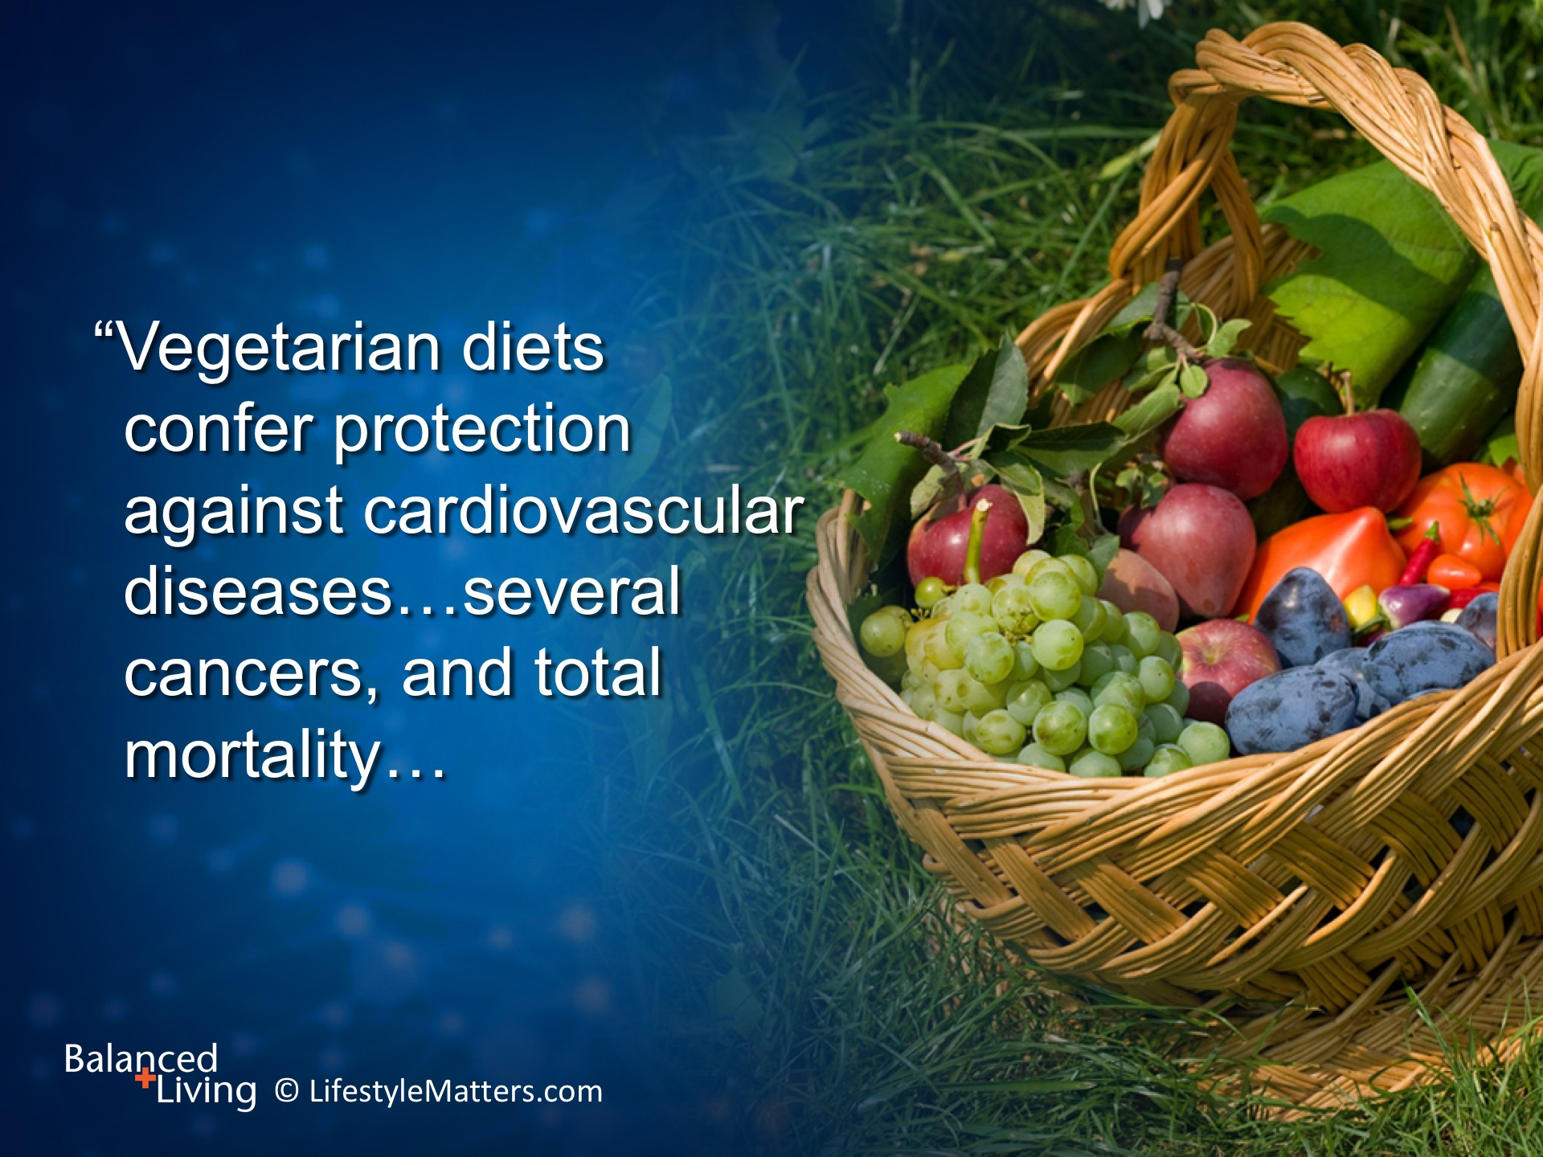
Notes:
Based on the Adventist Health Study of 89,000 people, meat-free diets cut high blood pressure risk by 55%.
Eliminating all animal products reduced the risk by a whopping 75%.
Notice this statement from the study report: Read slide.
(Source: Nutrients 2014 May;(6):2131-2147)

Slide 19
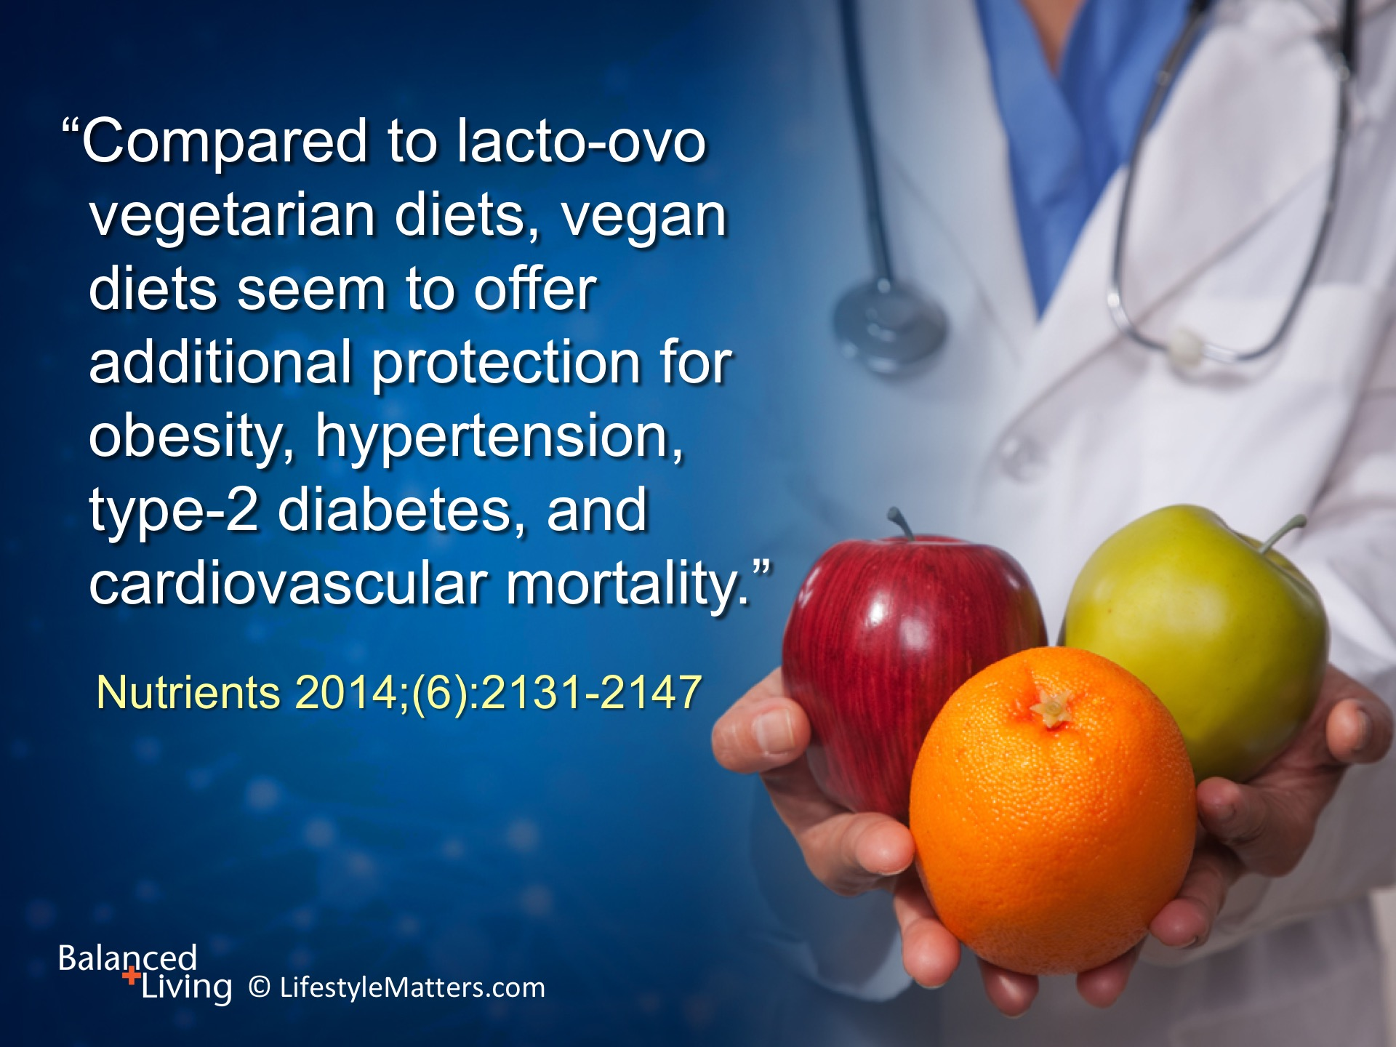
Notes:
Read slide.
Obesity, heart disease, and diabetes are major risk factors for hypertension—plant foods are a delicious and powerful way to tackle this trouble-making trio!
(Note: Lacto-ovo refers to a vegetarian eating plan that includes dairy and eggs)

Slide 20
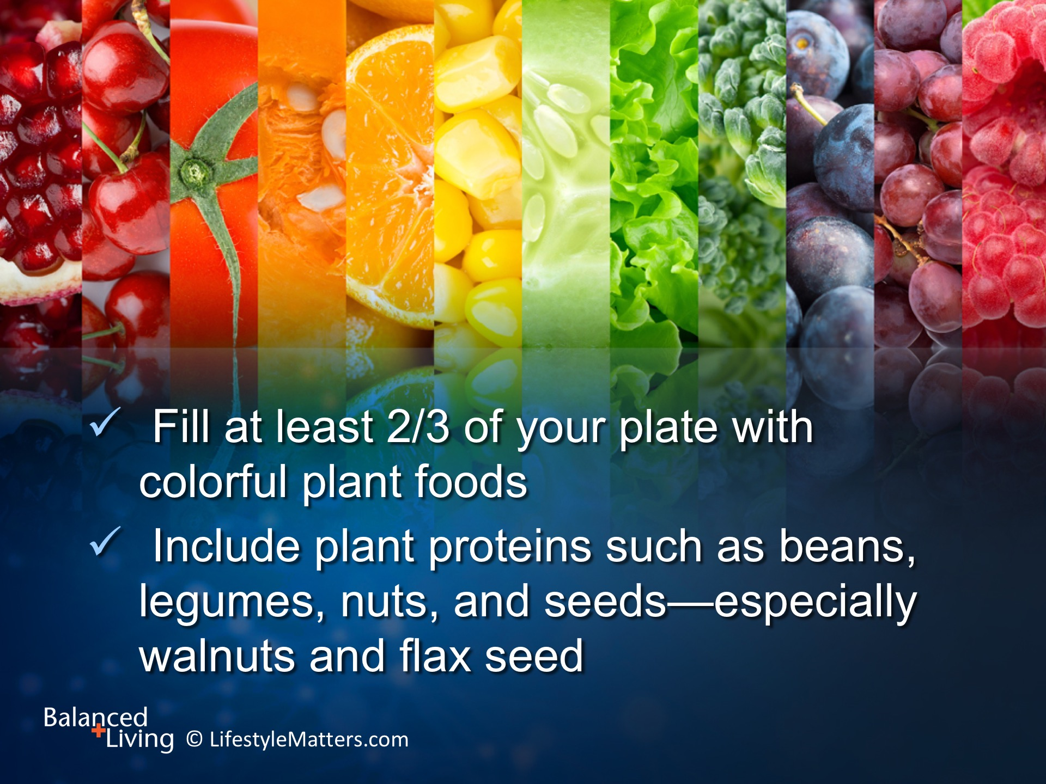
Notes:
Whichever meal plan you choose, aim to: Read slide.

Slide 21
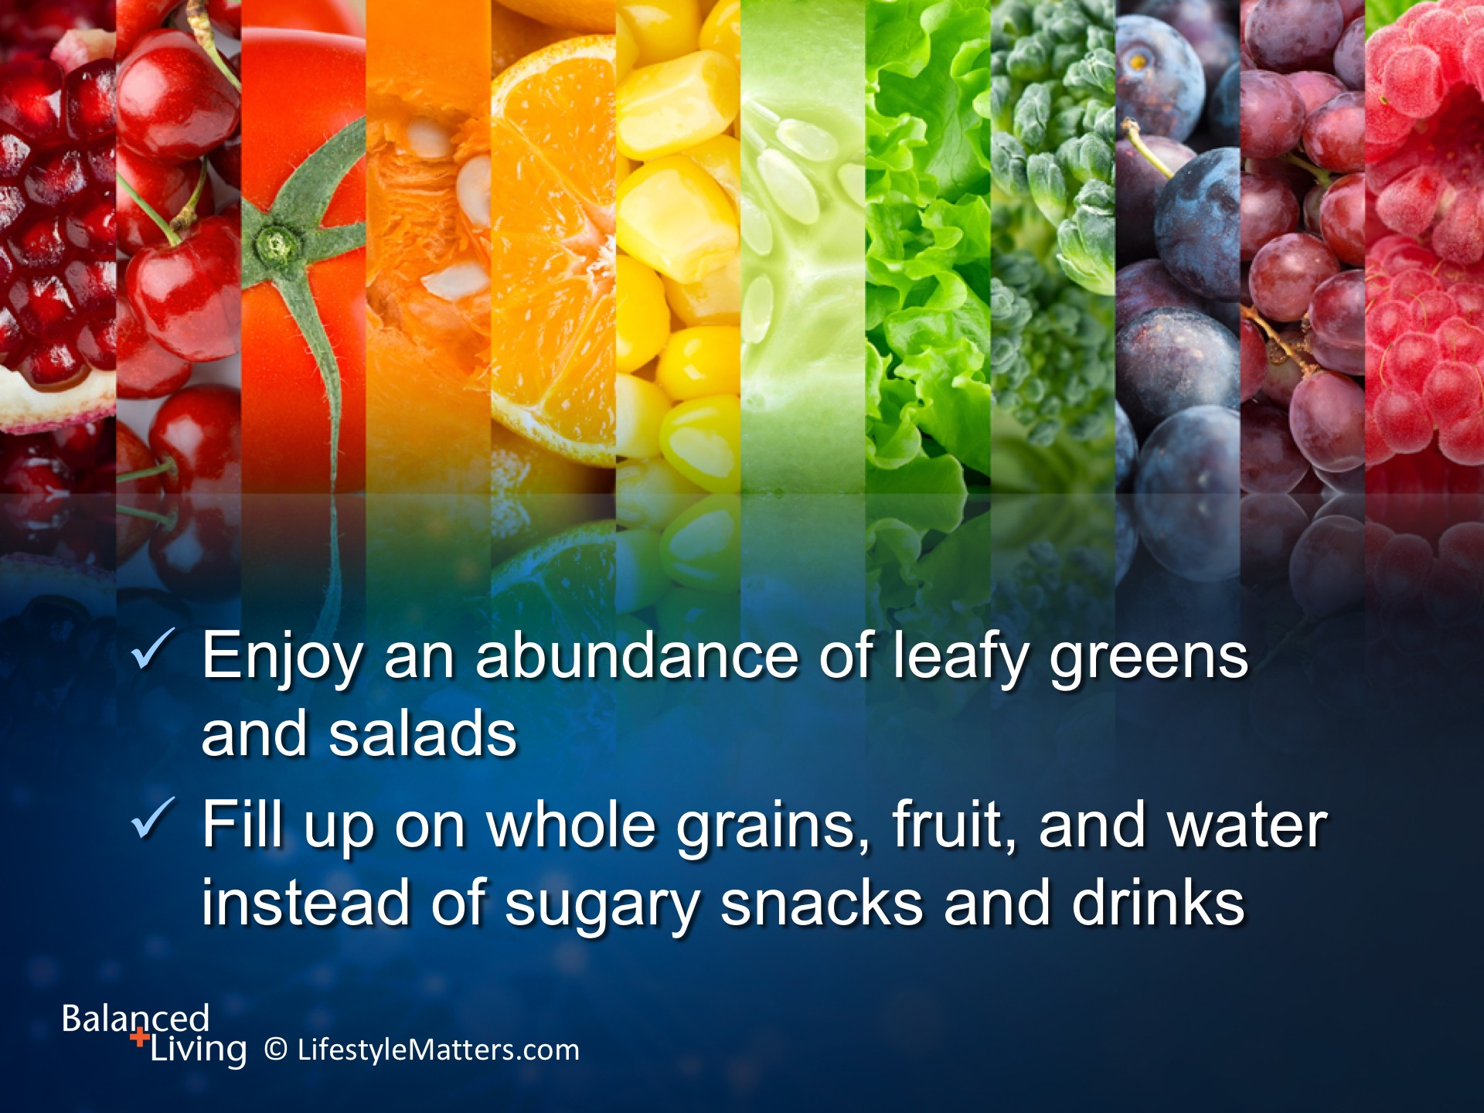
Notes:
Read slide.
It takes a lifestyle, not a label, to achieve your optimal health.
God will lead you step by step to make the choices that are best for you right now.
No single food is a magic bullet, but God’s family of colorful plant foods work together to provide the nutrition, variety, volume, and energy you need to pursue the other healthy habits so important to mental, physical, and spiritual health.

Slide 22
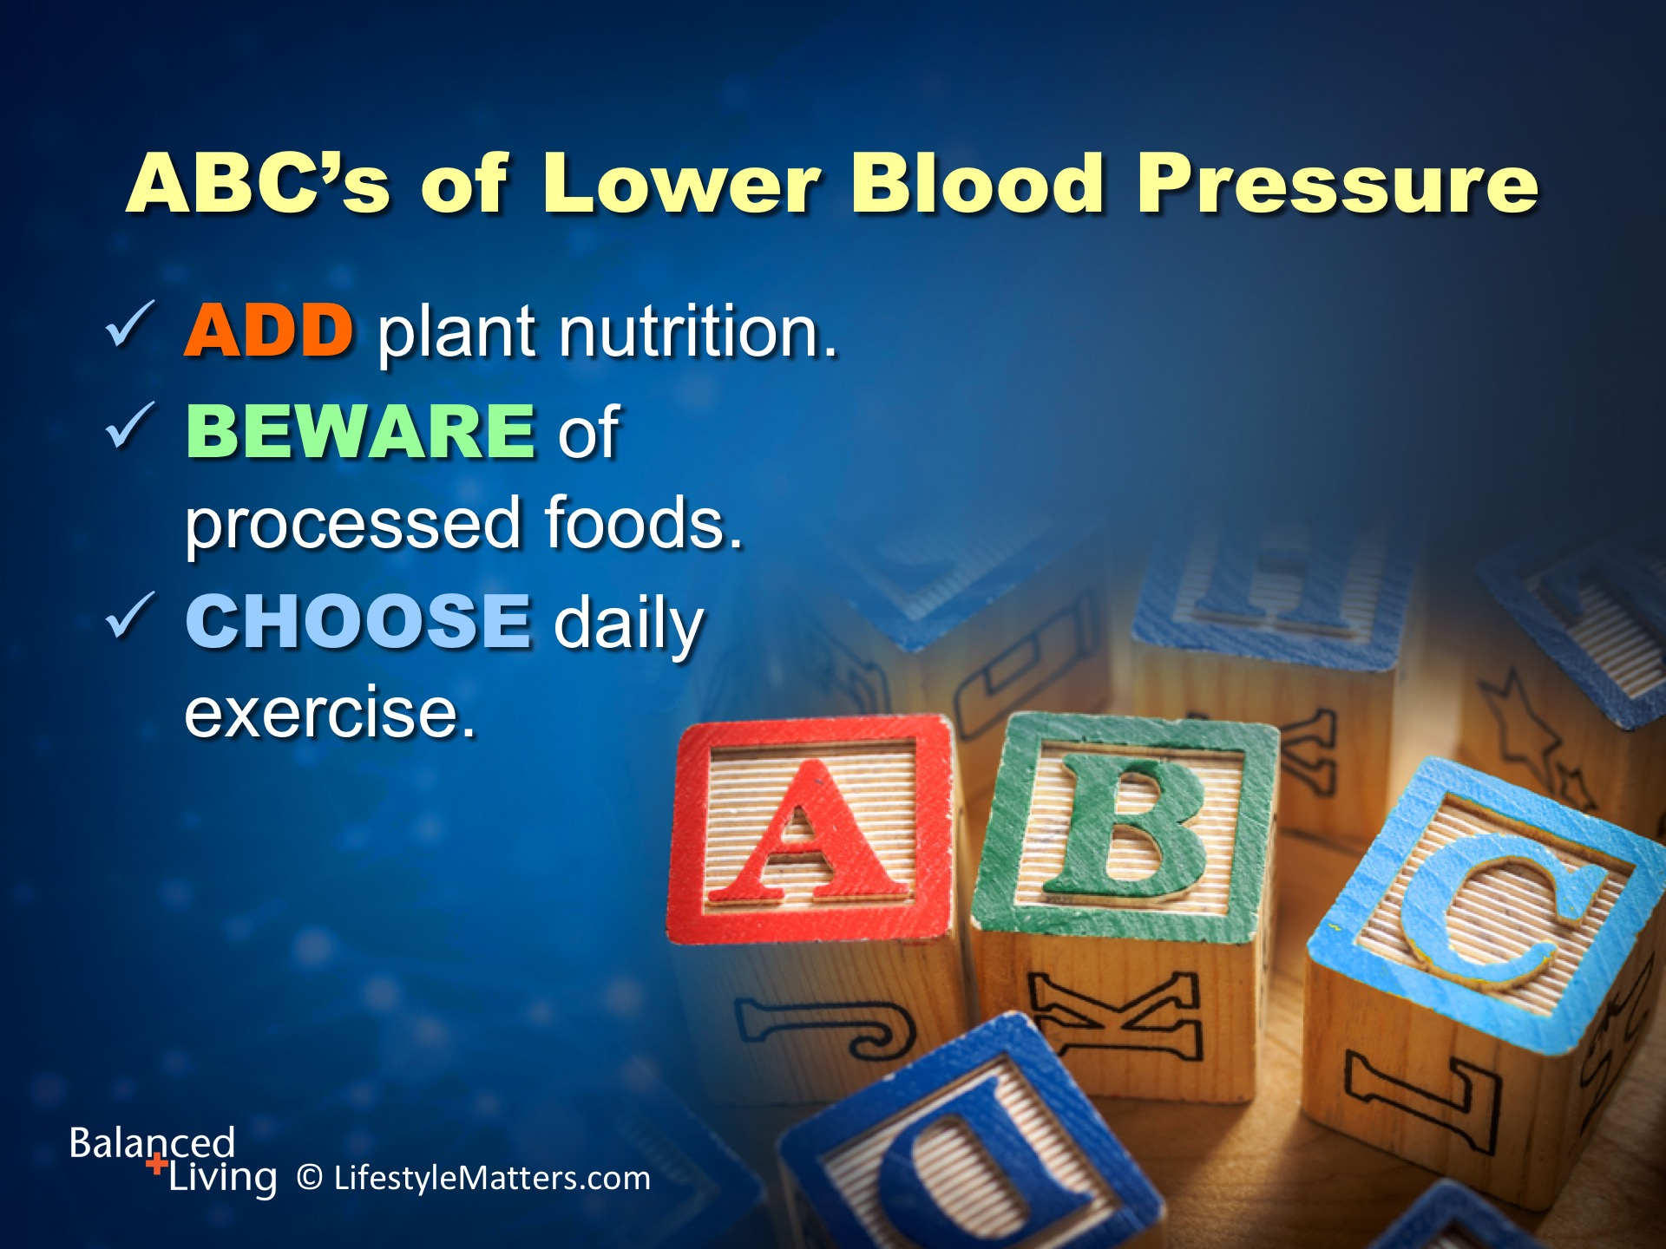
Notes:
The ABC’s of lowering blood pressure are basic and easy to remember: Read slide.
Let’s repeat our ABC’s together! (Repeat list with the group)

Slide 23
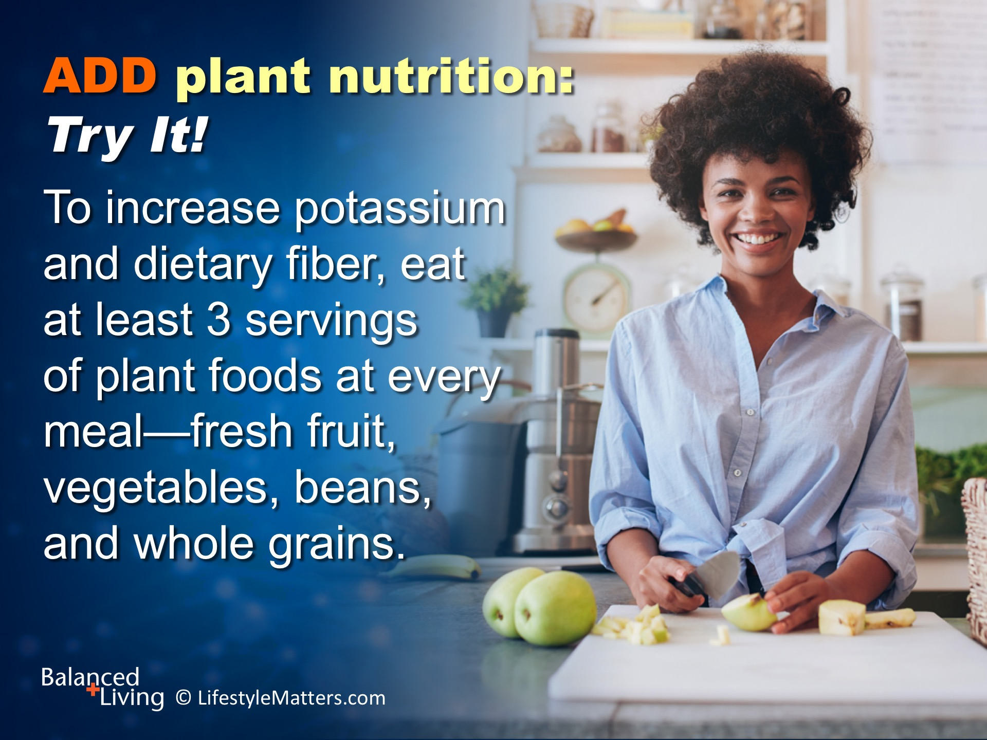
Notes:
Read slide.
A serving is 1 cup of raw fruit or vegetables or ½ cup of cooked beans, vegetables or grains.
Fruits and vegetables are high in potassium and fiber, both of which protect against high blood pressure.
A baked potato contains about 1,000 mg of potassium; beans, spinach, tomatoes, squash, green vegetables, and fresh fruits are also tasty sources of potassium.
Plant foods are rich in vitamins, minerals, trace minerals, and vessel-repairing antioxidants and low in sodium, saturated fat and calories.
What do you already love that you can enjoy more of? (Wait for response)
What are you willing to include that you have not made a part of your menu? (Wait for response)

Slide 24
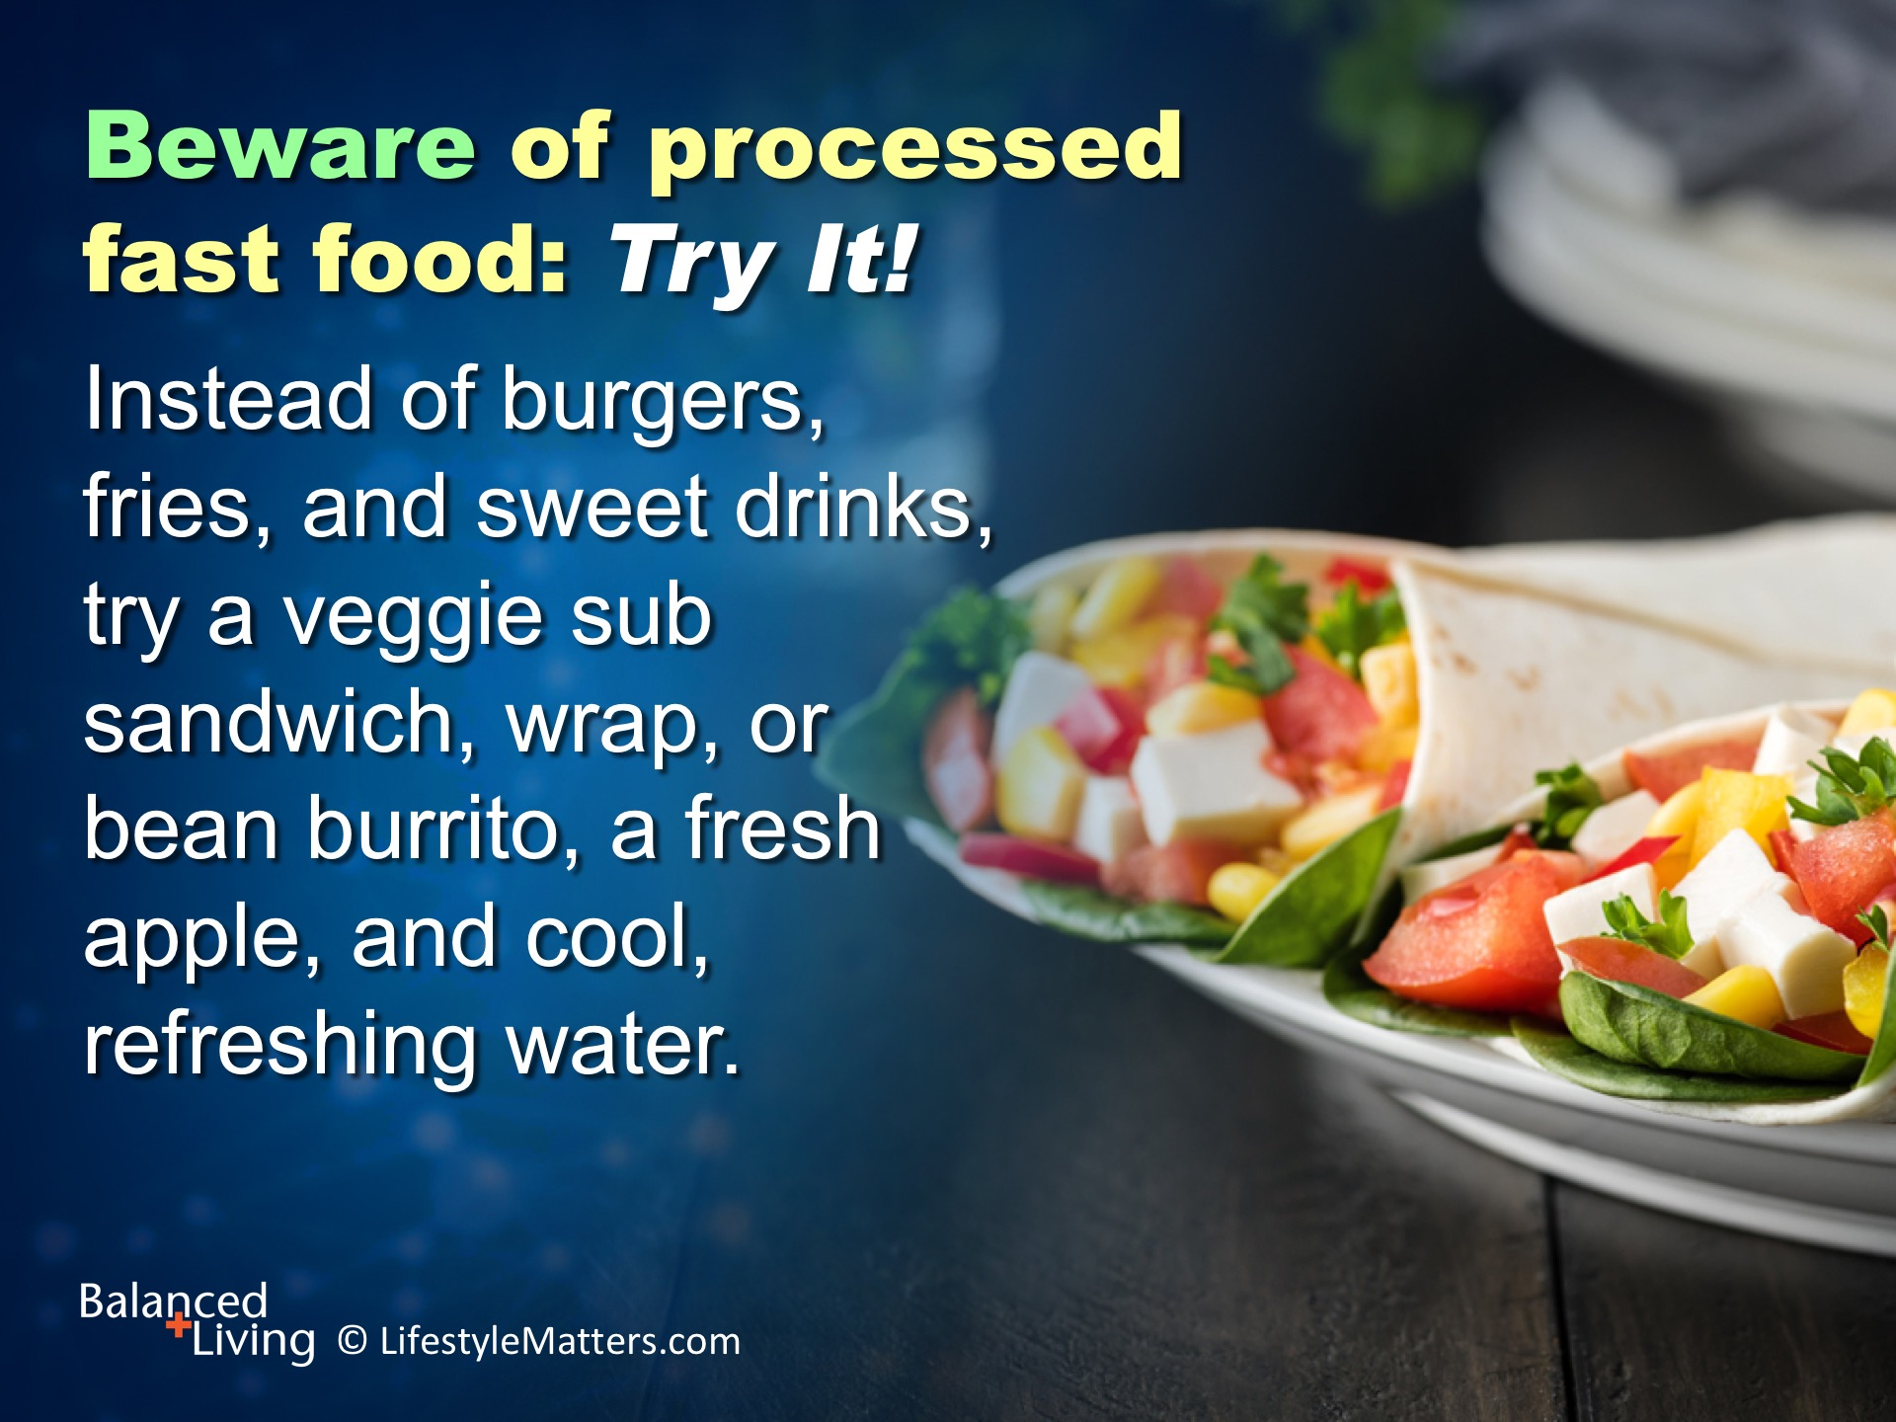
Notes:
Read slide.
Watch out for packaged bandits that tantalize your taste buds but target your good health.
A fast food meal of an 8 oz hamburger, small fries, and a 32 oz. soda is about 1600 calories and more than1400 mg of sodium.
Compare this to the daily recommendation of 1500 mg for the day, or about 500 mg per meal.
Most sodium comes from packaged foods - so check labels.

Slide 25
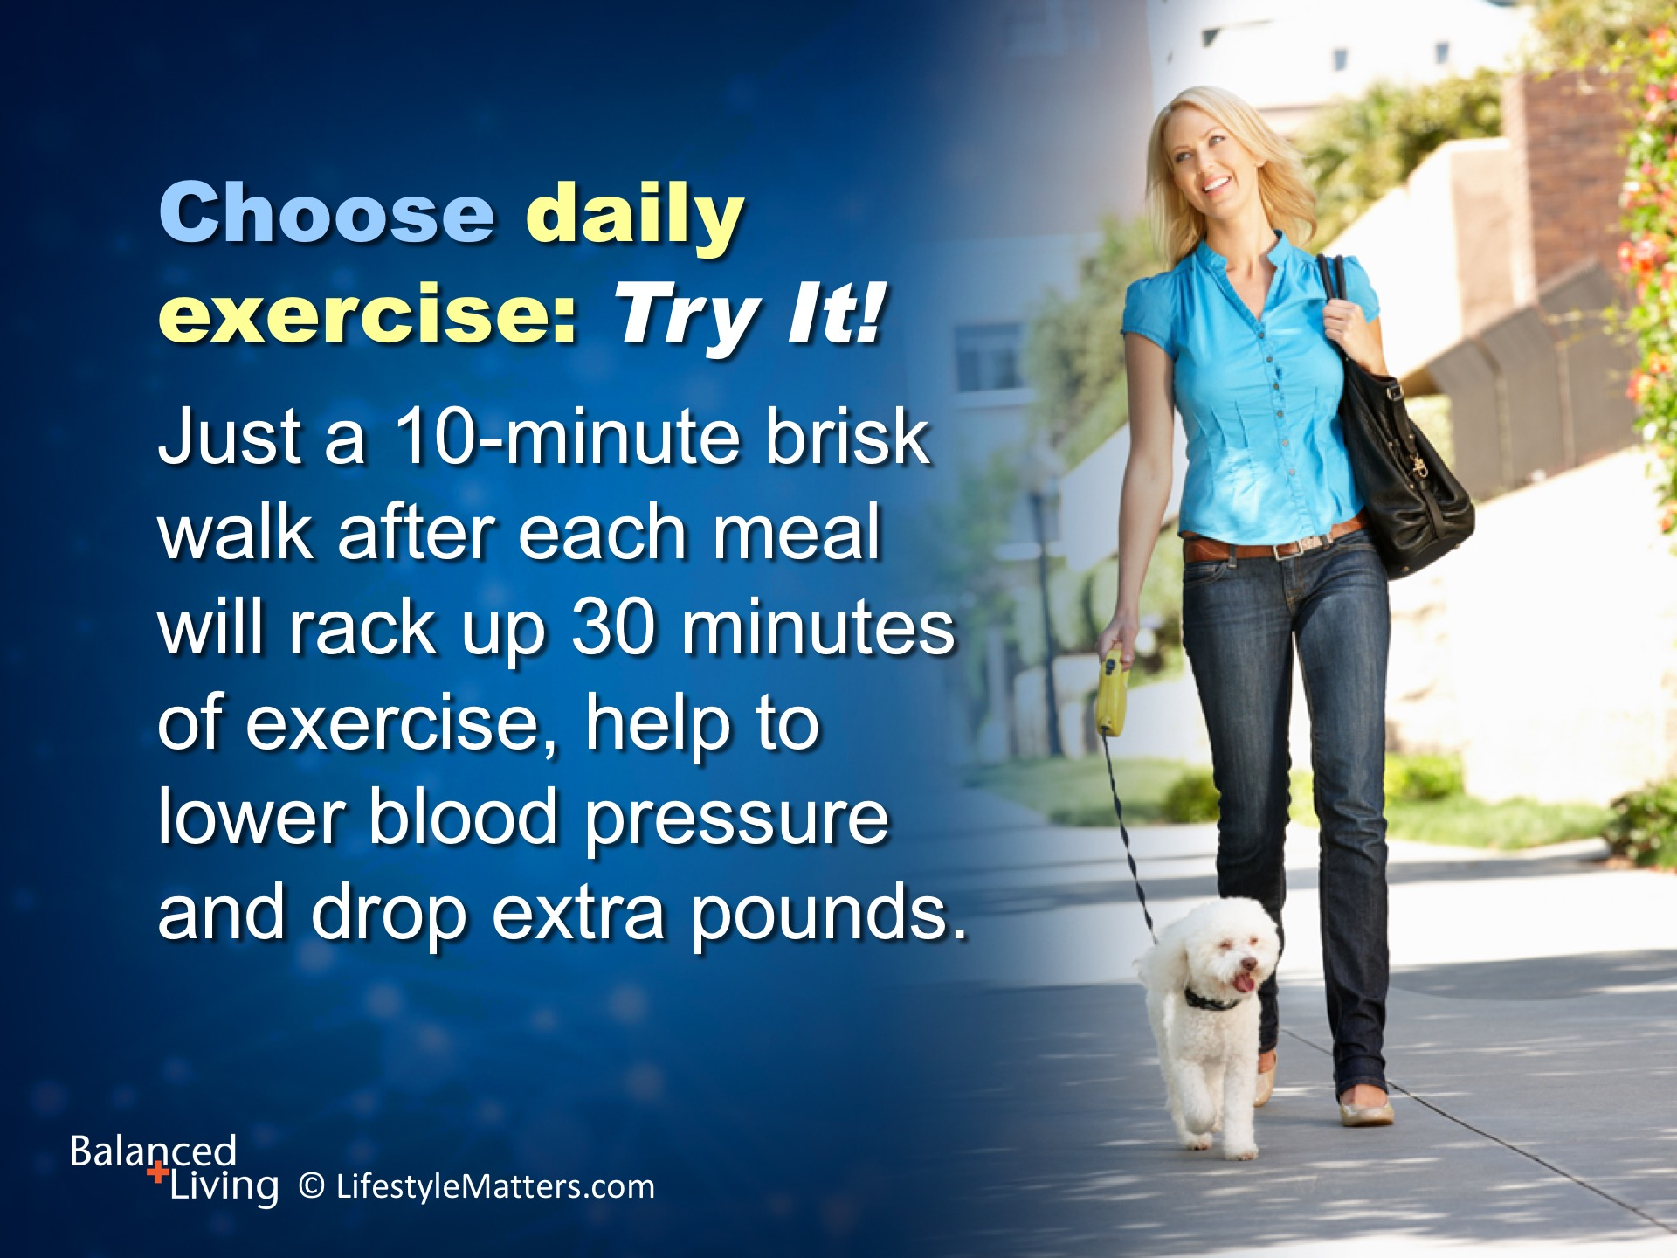
Notes:
Read slide.
People who are inactive tend to have higher heart rates.
The higher your heart rate, the harder your heart must work with each contraction and the stronger the force on your arteries.
Lack of physical activity also increases the risk of being overweight.
What are some ways you can increase your daily exercise to at least 30 minutes, preferably an hour? (Wait for response)
What is your plan for inclement weather? (Wait for response)
Don’t ask yourself: “Am I going to exercise today?” Ask yourself, “When and where am I going to exercise today?”

Slide 26
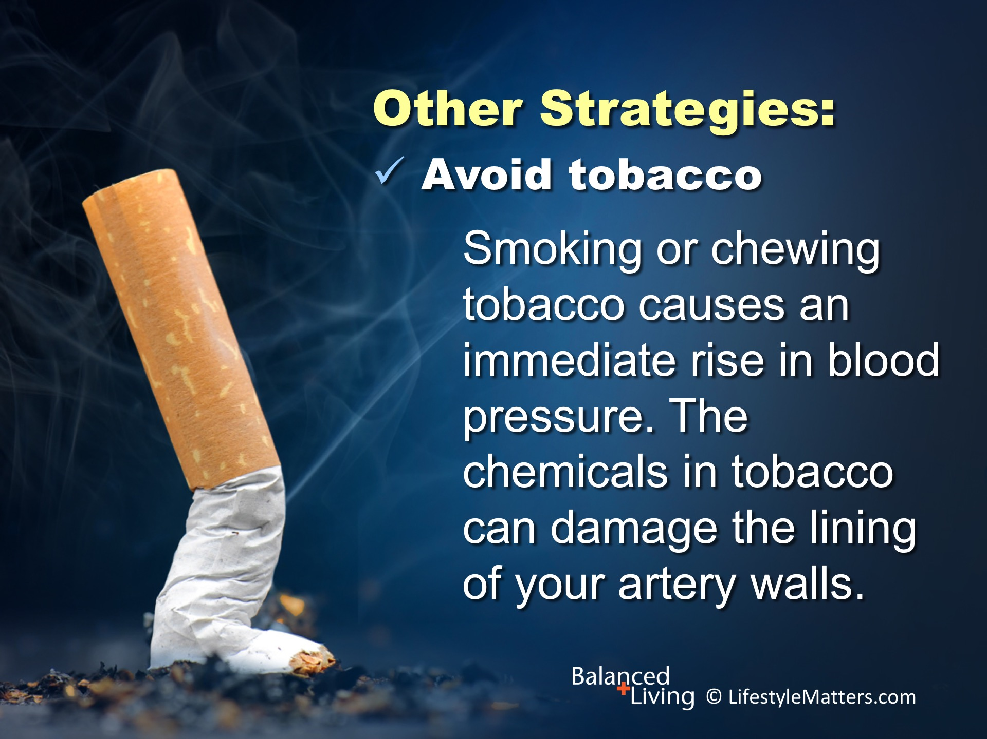
Notes:
Read slide.
This can cause your arteries to narrow, increasing your blood pressure.
Secondhand smoke also can increase your blood pressure.
You will need determination and prayer, but your body and brain will respond to healthful lifestyle changes.

Slide 27
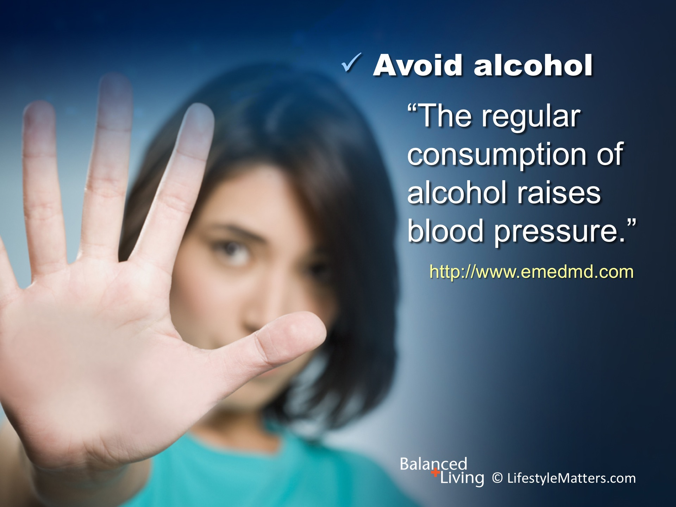
Notes:
Read slide.
According to a study published by the National Institute of Health, global alcohol consumption increases the risk of hypertension by 16%.
Instead, Grab those grapes! Grapes are just one of God’s family of flavorful foods that are high in fiber and plant compounds that improve blood vessel and heart health, and thus help lower blood pressure.
(Source: Clin Exp Parmacol Physiol 2006 Sept; 33(9):847-52; http://www.emedmd.com/content/avoiding-tobacco-alcohol-and-caffeine; www.mayoclinic.org/healthy-living/nutrition-and-healthy-eating/expert-answers/food-and-nutrition/faq)
NOTE: Work with your healthcare team to monitor changes related to alcohol withdrawal.

Slide 28

Notes:
Read slide.
High levels of stress can lead to a temporary increase in blood pressure by causing your heart to beat faster and your blood vessels to narrow—a bad combination.
If you find yourself getting tense, take a minute to slow down.
Take a walk; breathe deeply; drink adequate water; connect with a friend; talk to God who understands your situation.
Prayer, thanksgiving for what is working in your life, and focusing on solutions instead of problems can ease that sickening wave of stress hormones and dial down blood pressure!

Slide 29

Notes:
Read slide.
Building a network of social support, or “social capital,” whether in the context of parenting, workplace, church, or neighborhood, is a powerful buffer against stress.
The effect of social support on blood pressure and other indicators of heart health is strong and significant.
What are some ways to build “social capital?” (Wait for response)
(Source: Health Psychol 2014;33(11):1440-3.; BMJ Open 2013;3(2)pii.3002215)

Slide 30

Notes:
Read slide.
People who sleep five hours or less a night may be at higher risk of developing high blood pressure or worsening already high blood pressure.
It's thought that sleep helps your blood regulate stress hormones and helps your nervous system remain healthy.
Sleeping seven to eight hours a night may play a role in the treatment and prevention of high blood pressure.
What are some tips you know for establishing a good sleep routine? (Wait for response)
(Note: Daily exercise in the sun; adequate vitamin D levels; refrain from eating late; alcohol; caffeine; turn media off at night)
(Source: Sleep Med 2015;16(12):1411-5); http://www.mayoclinic.org/diseases-conditions/high-blood-pressure/expert-answers/sleep-deprivation/faq-20057959)

Slide 31

Notes:
Read slide.
Trust in God is good medicine—good for the heart and good for the soul.
Science reveals a consistent link between faith, trust in a loving God who cares for you, and many health variables, including blood pressure, immune function, and healing from trauma.
The Scriptures reveal a caring personal Savior who “has numbered the very hairs of your head” and will guide you through each busy day. Matthew 10:30.
He says, “Be anxious for nothing.” I will lead and guide you through every turn in life. Philippians 4:6.
(Source for health link to religiosity: Am Psychol 2003;58(1):24-35)

Slide 32
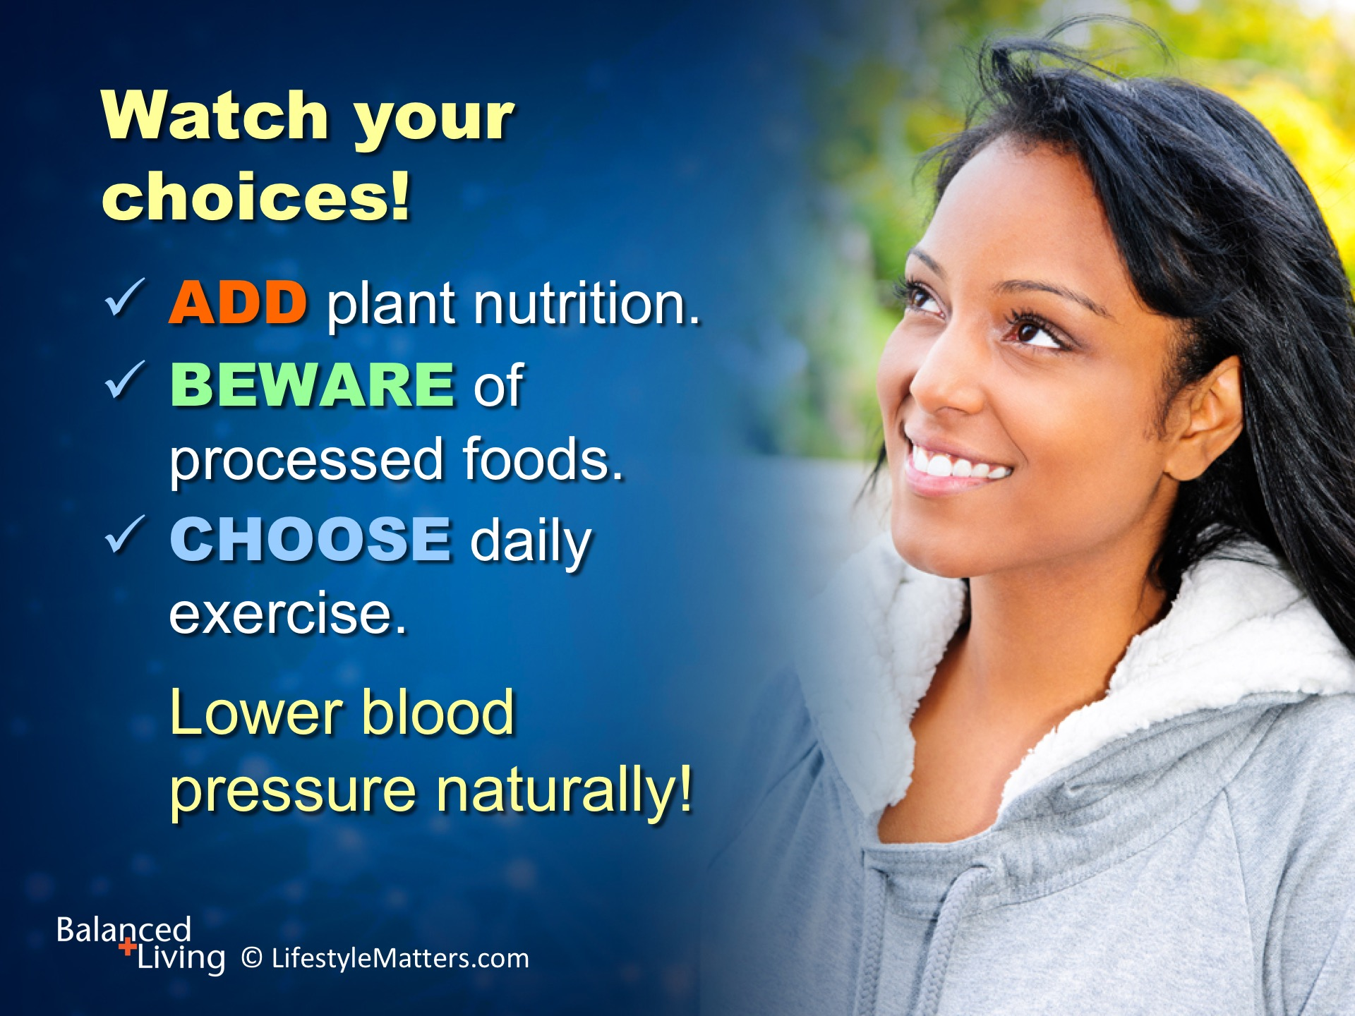
Notes:
Read slide.
Let’s repeat our ABC’s again! (Repeat list with the group)
Will you choose God’s ABC plan for blood pressure health?

Slide 33
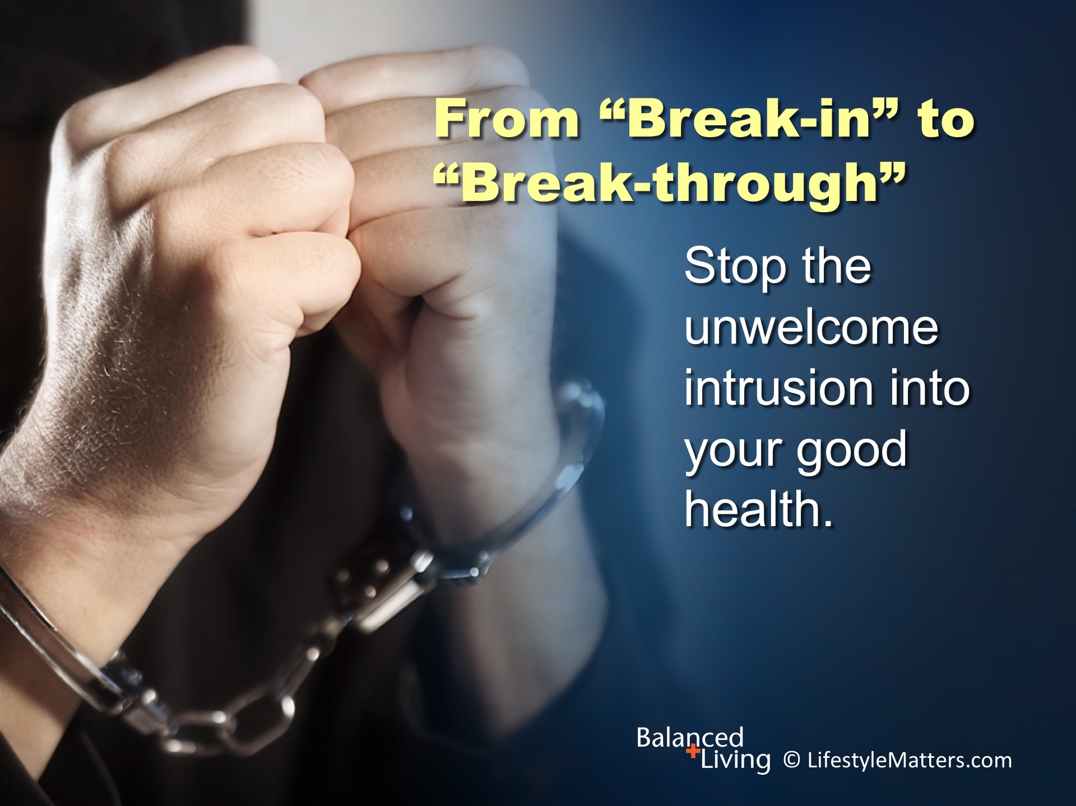
Notes:
Read slide.
It has been said that “there are no drive-thru break-throughs.”
It takes prayer, perseverance, and a plan to achieve and maintain physical, mental, and spiritual fitness.
Christ wants to give you more than raw essentials for survival in your quest for life and health.

Slide 34
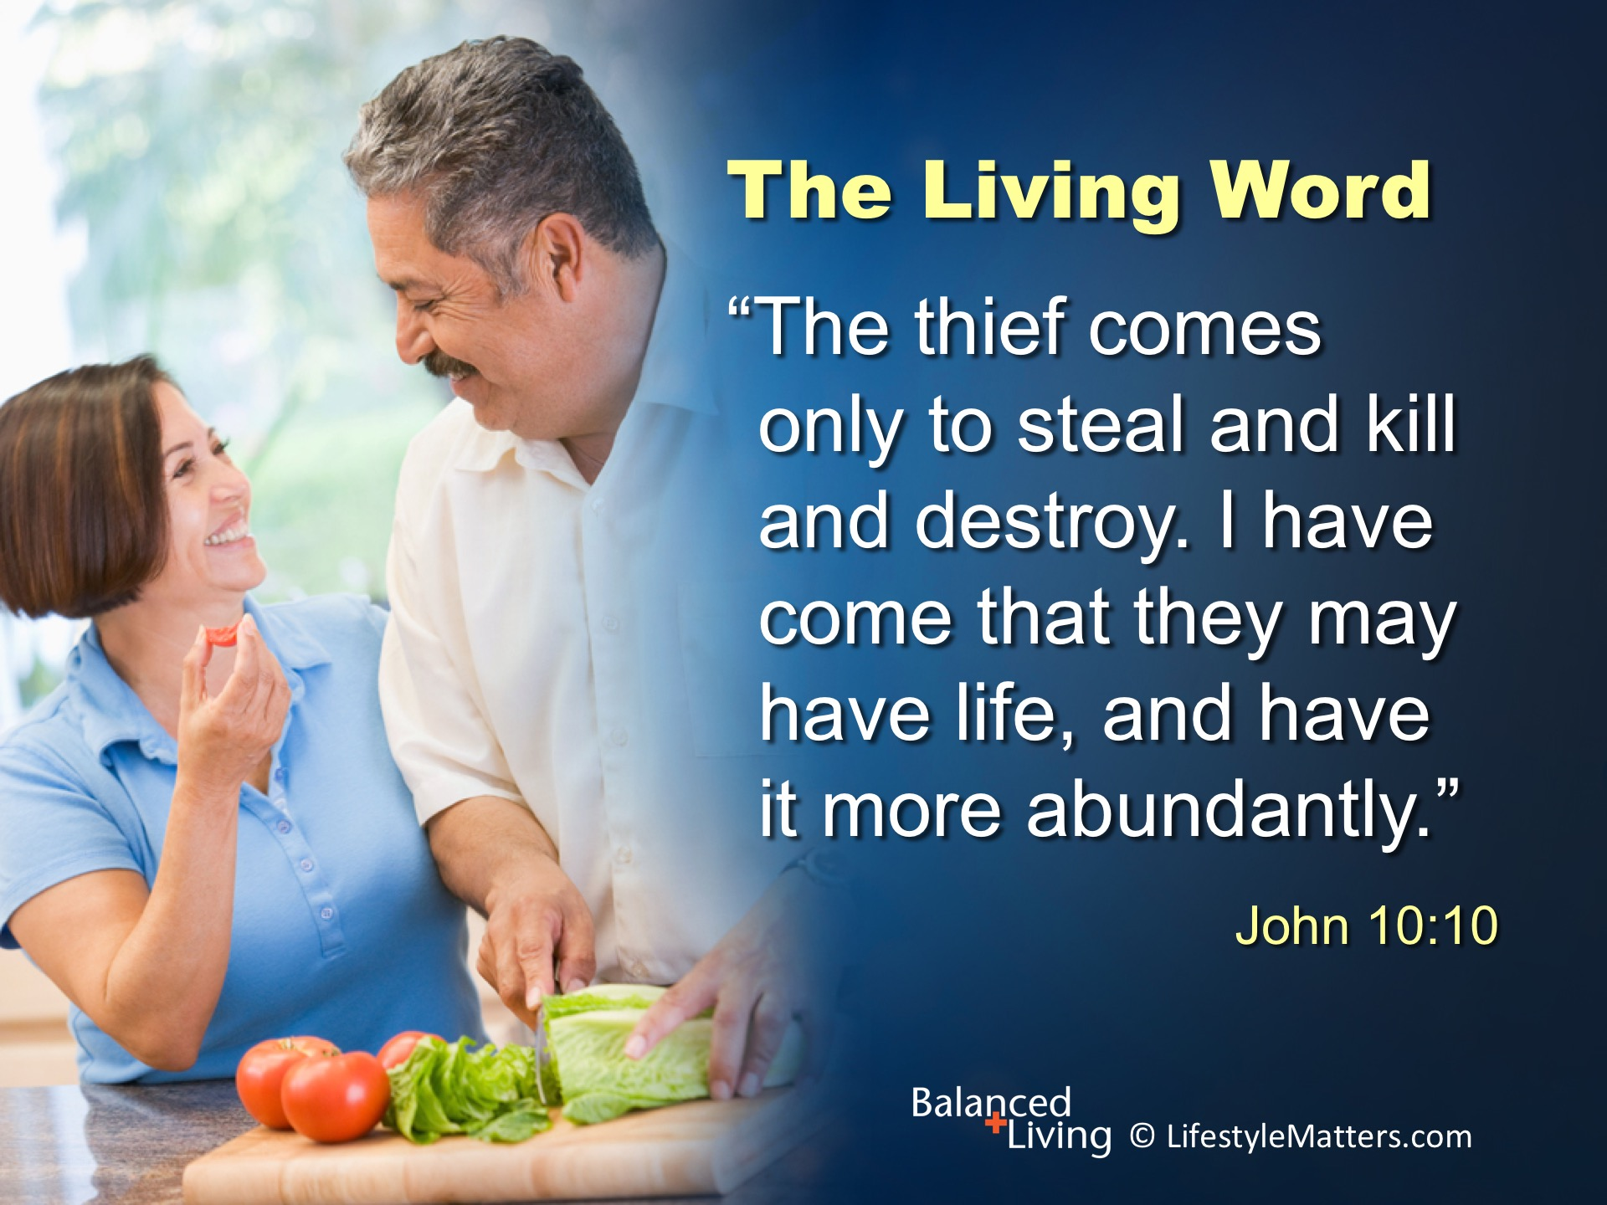
Notes:
Remember: Read slide.
Satan is a thief—he wants to steal your health, your joy, your life.
God wants to restore all that sin has broken and taken away.
There are only two choices. Will you choose God just now?
He wants you to have a “more abundant” life—a life filled with purpose, peace, power, and wisdom—a healthy lifestyle to preserve mind and body—and at last, eternal life where no thief can destroy!
Raise your hand with me to confirm your decision. (Raise your hand and wait for response)

